Slide 1
Trading Forum
Andy Rowsell – Data & Systems Assistant Head
Cat Rendell – Systems Officer
June 2023
Defence Commercial
1
OFFICIAL

Slide 2
Agenda
Data Centre Relocation (Crown Hosting) – System outage August 2023
CP&F Updates
DSP Updates
Procurement Reform readiness
Any Other Business / Questions?
Defence Commercial
OFFICIAL

Slide 3
Data Centre Relocation
The MOD is relocating its IT infrastructure for procurement systems to a crown-hosted site in Corsham, which will involve a physical move of the equipment taking place in August 2023.
In order to facilitate the move of infrastructure equipment, the MOD will be switching off its procurement systems at 17:00 on Friday 11th August 2023. Following the move, systems will be reinstated and switched on for use at 09:00 on Wednesday 23rd August 2023.
Impacts:
Delivery and Invoicing – Suppliers should still deliver in accordance with Contractual arrangements. Invoices can still be submitted through Exostar but will be held until systems are back up.
Orders – MOD cannot process any new orders during the outage. Teams are being encouraged to plan and either bring forward / push back new orders.
Unaffected:
Sourcing / Tendering Activities – The Defence Sourcing Portal is unaffected so Notices, PQQs and ITTs will continue to operate as normal.
Defence Commercial
OFFICIAL

Slide 4
CP&F Updates
Change updates – Recent changes to CP&F include:
Improvements to assist with generation and population of Acquisition Pipeline (https://www.gov.uk/government/publications/mod-acquisition-pipeline) – May 2023 & June 2023
Change to approvals workflow to improve time taken to implement Contract Amendments on CP&F – June 2023
Improvements to reporting prompts – June 2023
Data & Systems Event (internal) held May 2023, 1800+ attendees – CP&F refresher training topics:
Purchase Requisitions (including getting the Tax Treatment correct)
Acquisition Pipeline – populating Contract Requisitions to inform the pipeline
Framework Agreements
Drafting Contract Terms
Training and Guidance refresh
Defence Commercial
OFFICIAL

Slide 5
DSP Updates
Jaggaer Support Portal – We are maintaining oversight of calls logged by Suppliers through the Jaggaer support tool:
PCR PQQ Update – The PCR PQQ template has been updated in accordance with PPN 03/23 - PPN 03/23: Standard Selection Questionnaire (SQ) - GOV.UK (www.gov.uk)
Data & Systems Event (internal) held May 2023, 1800+ attendees – DSP refresher training topics:
Contract Award Notices
Procurement Notices
Defence Commercial
OFFICIAL

Slide 6
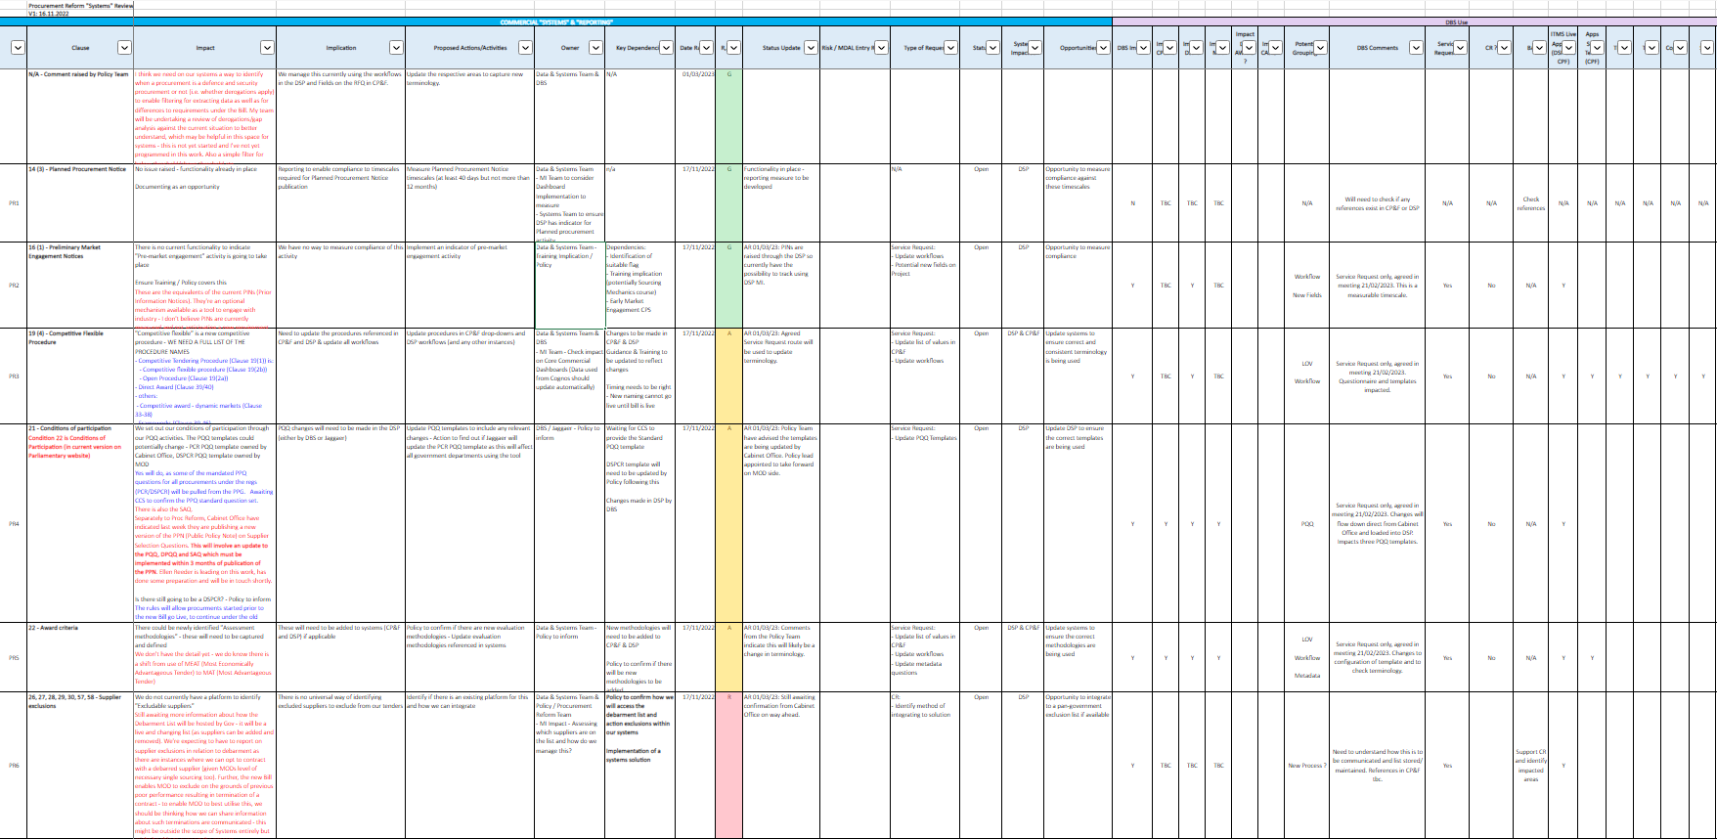
Procurement Reform Readiness
Current Bill go-live date anticipated to be October 2024
Defence Commercial Systems Team have reviewed the draft bill, documented impacts and raised the necessary Change Requests, using detailed project plan to track progress:
Overview of workstreams:
Changes Raised:
Identification of Frameworks within Systems
System-driven approach to KPI reporting
Access to Supplier Debarment List (Cabinet Office led)
Implementing the New Rule set for MOD
Policy / Guidance implementation
Review and Changes to current MOD guidance and detailed documentation of the policy
Commercial Process Definition
Process Mapping of the new Procurement Procedures and Commercial steps in the Acquisition Cycle
Systems Definition and Design
Reflecting the new processes into the P2P and linking up with common pan-gov transparency tool
Learning & Development – approach + delivery
Coordinating the cohorts of trainees; review content of CO generic training; generation of the MOD specific content for Defence Modules
Defence Commercial
OFFICIAL

Slide 7
Any AOB/Questions?
Question | Action
Defence Commercial
OFFICIAL

