Slide 1
Team Defence Executive Team – Townhall (September)
28th September 2022
10:45-14:45
Thornbury Leisure Centre

Slide 2
Agenda
Agenda Item | TDI Lead(s) | Lead |  | Duration
Meeting Opens |  | All | Standard | 1045-1100
Welcome and Introductions, Townhall background & purpose |  | Chairman: Steve Lammiman | Standard | 1100 – 1105
MoD Update ( inc DAIC, ) |  | Ed Cole/Dave Hawken | Standard | 1105 - 1120
TDI (Industry + DS F+ CIO’s Forum + DCE) Update |  | Phil Williams | Standard | 1120 - 1130
Outstanding Action update (overview only, discussed in pre-meet) |  | Philippa Arter | Standard | 1130 - 1140
Improving Defence Outputs |  | RAdm Andy Kyte | Townhall | 1140 – 1220
Support Advantage Charter Actions | Julian Dayment | Anne-Marie Evans | Townhall | 1220 -1235
Futures – Update (focus on Additive manufacturing, sustainability?) | Phil Williams |  | Townhall | 1235 -1305
Lunch/networking |  |  |  | 1305 – 1345
MDI - Update | Steve Worsnip | Graeme Ball/Chris Parker/Paul Eastman | Townhall | 1345 – 1355
JISCOT Update | Phil Williams | Phil Williams | Townhall | 1355 - 1405
People and Skills inc. Vanguard Update | Phil Williams |  | Townhall | 14.05 - 1415
ICEF | Tony Butler |  | Townhall | 14.15 - 1425
Conference 2023 Themes and update |  |  | Standard | 1425 - 1430
AoB | Chairmen |  | Standard | 1430 – 1440
Closing Comments, initial feedback on townhall and DoNM | Chairmen |  | Standard | 1440 - 1445

Slide 3
Team Defence Executive Team
Welcome and Introductions
Steve Lammiman

Slide 4
Team Defence Executive Team
MOD Update
Ed Cole/Dave Hawken

Slide 5
Team Defence Executive Team
TDI (Industry + DS F+ CIO’s Forum + DCE) Update
Phil Williams

Slide 6
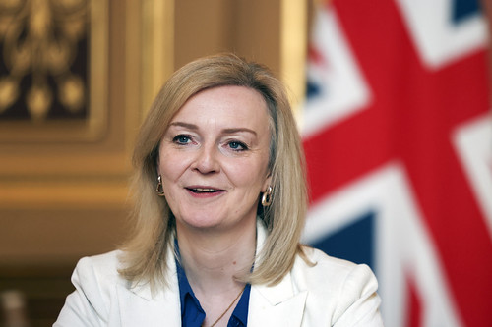
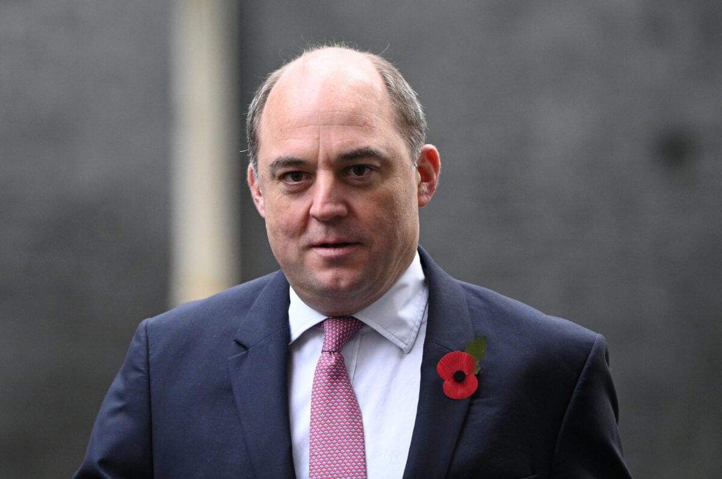
Integrated Review?
£100Bn
The Department has been so used to 30 or 40 years of defending cuts
or reconciling cuts with modern fighting;
we are going to have to get used to a completely different culture,
we are going to actually grow, we are going to actually change

Slide 7
Team Defence Governance
Defence Suppliers Forum
Team Defence Information Council (Quarterly)
3* Advisory Board (2x year)
Team Defence Strategy Group
(Quarterly)
Team Defence Executive Team
(Monthly)
Defence Support Force Development Board
Community of Practices
Working Groups
Delivery Continuity Executive
Workshops
Whitepapers
Projects
For reporting and calendar dates please see separate slide

Slide 8
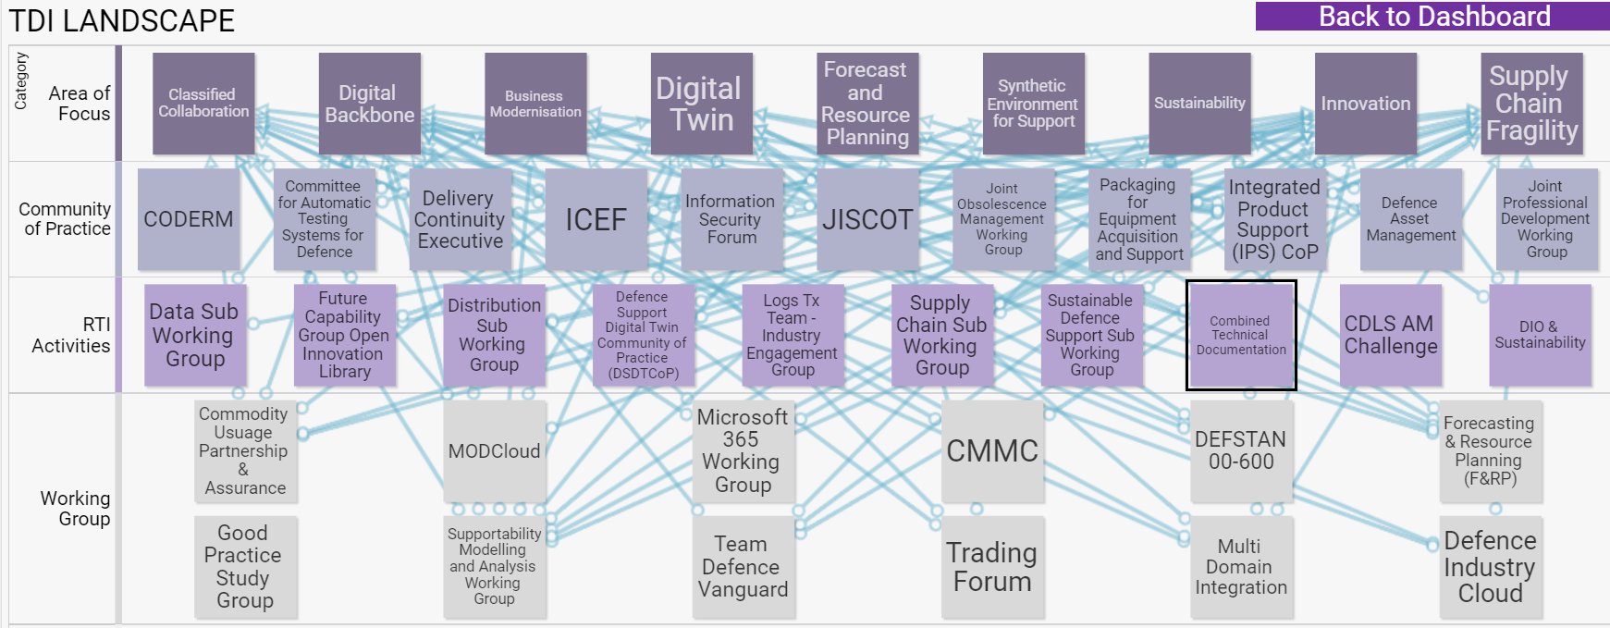
Activities Landscape – SharpCloud “as is”

Slide 9
TDI Activities

Slide 10
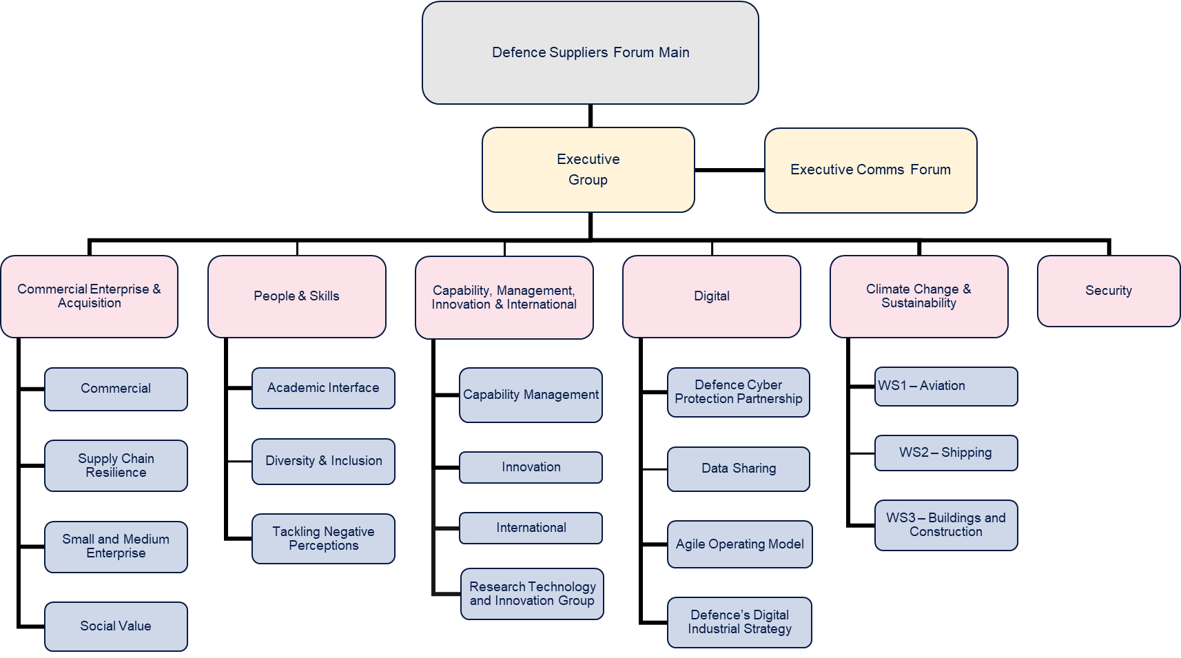
Defence Suppliers Forum

Slide 11
Defence Continuity Executive
Insurance Policy?

Slide 12









CIO’s Forum
Meeting with Charlie Forte, MOD CIO, and his team
Industry Primes – the consumers.

Slide 13
CIO’s Forum
The CIO’s challenge to us was to point to circumstances
(e.g. environments, architecture or practices)
that could be improved with appropriate intervention.

Slide 14
Team Defence Executive Team
Outstanding Actions
Philippa Arter

Slide 15
Outstanding Actions

Slide 16
Team Defence Executive Team
Improving Defence Outputs
RAdm Andy Kyte

Slide 17
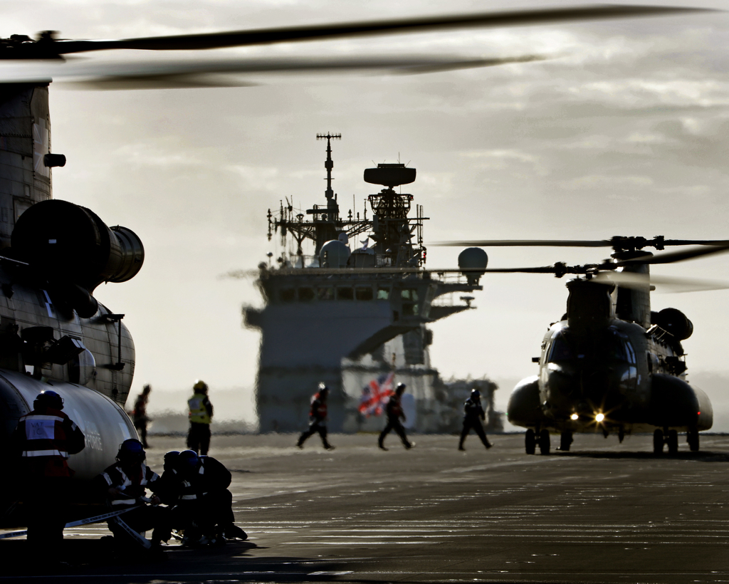
INCREASING DEFENCE OUTPUTS
STUDY
Brief to TDI Away Day
28 Sep 22
Context
Demand signal and Definition
Cost of Unavailability
Capability Deep-Dives

Slide 18
Increasing Defence Outputs
CDS challenge to increase outputs to reflect greater productivity and return on investment
  Part of strategic narrative in context of IR refresh, 3% GDP debate and credibility of Defence to be an efficient and streamlined org.
  FE@R taken as primary output of Defence.
  Operate and transition to Warfight – contingency in use.
  Greater availability / capability / sustainability within existing resource envelope; determine the blockers and impediments; then identify where further investment would deliver greatest effect.
    So very much in the Mobilise space, vice Modernise
  Co-sponsored by MilCap / CDLS / DCE DE&S; sits under a wider Head Office Capability Choices paper.

Slide 19
      Increasing Defence Outputs Study has 7 themes
1
Policy: Improving clarity on definitions, outputs, measuring readiness, force sensing & attribution
Increasing Defence Outputs:
Set the conditions for Defence to deliver increased levels of output
In-flight programmes: Mapping metrics/targets, capturing best practice, addressing coherence& impediments, data analytics
2
3
Cost of Unavailability: Exploratory work to understand value and applicability of a CoU model to Defence
Capability deep-dives: Focused analysis against specific capabilities to determine resources required to increase outputs
4
5
Performance Framework: Designing a cross-Defence Output Performance Framework
6
Benchmarks: Process and performance benchmarks to support broader work programme
7
Acquisition: Capturing key insights and findings from 1-6 and integrating into acquisition model

Slide 20
Improving clarity on definitions, outputs, measuring readiness, force sensing & attribution
  Ready for What; Ready for When; What Needs to be Ready?
  Refresh of Defence Planning Assumptions to reflect changes since the IR
  Defining Readiness and Availability
  How do we measure readiness and digitize the process
Policy

Slide 21
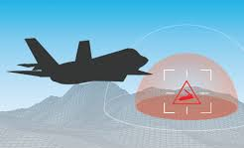
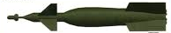

Readiness =
X X X
Availability
Assets Preparedness
Platform Numbers Workforce Reliability Repairability
+
Capability
Lethality Survivability
Deployability Weapon Systems Supply Chain C5I Force Protection Integration Training
+
Sustainability
Intensity Endurance
Workforce Enablement Munitions Eqpt Spt Inventory Strategic Base Defence Industry

Slide 22
Ready for What, Ready for When, What needs to be Ready?
Ready. Force Element or set of Force Elements is able to create a given effect, at a given time and location, for a given purpose, for a given duration and intensity.
(Proposed)
Readiness State
CAPABILITY. The ability to achieve a desired operational outcome or effect, and is relative to the threat, physical environment and the contributions of coalition partners. The combination of equipment, trained personnel, integrated networks and support.
(Defence Operating Model)
Capability:
Lethality
Survivability
R0
R1
R2
R3
R4
R5
R6
R7
R8
Availability:
Assets
Preparedness
WARFIGHT
CONSTRAIN
Availability. The assets, FEs, or sets of FEs ready at a given time, for a given purpose.
(Proposed)
ENGAGE
PROTECT
10
Sustainability:
Intensity
Endurance
30
SUSTAINABILITY. The ability of a force to maintain the necessary level of combat power for the duration required to achieve its objectives (NATO).
(JDP 0-01 – UK Defence Doctrine)
60
Readiness = Availability + Capability + Sustainability
90
V.5.2
180

Slide 23
Designing a cross-Defence Output Performance Framework which:
Aligns accountability and empowerment
Exploits as is process as far as possible
  Need to align this top down (ie the Head Office bit) and bottom up (ie the TLB/EO relationship) elements
Focuses on Readiness and its constituent parts (R=A+C+S)
Recognises domain-specific factors ie no pan-Defence availability metric
Articulates a year-on-year ambition of increasing outputs
Performance Framework:

Slide 24
Exploratory work to understand value and applicability of a CoU model to Defence
Cost of Unavailability

Slide 25
Performance issues are well recognized; an availability model could help to resolve them
57%
62%
25%
Statistics
Calculated
on different bases & methodologies
Surface Ships
Availability¹
Typhoon Availability²
SSN
Availability³
An availability model creates visibility over the trade-off between availability and cost – there are multiple ways to do this, but they all focus on driving better decision-making by surfacing hidden information
This visibility is necessary to improve performance, however it is not sufficient by itself. It must be a single component (albeit a central and important one) of a broader change program.
How do we change the behaviour of a system that meant a high value £115M intelligence asset is unavailable for the cost of a £5 set of imperial drills
A ship is alongside in Singapore when a steering gear motor fails. A £50k spare is shipped from the UK, taking 5 days, but doesn't work on arrival.
The suggested solution is to send another one from the UK (waiting another 5 days) rather than source the part locally at a cost of £250k.
This is despite the fact that the dockyard fees are £1m per day
Perception
A company is currently reporting as ready for operation, however if there are no transport aircraft available to move them then are they are not actually deployable
1. Based on Project RENOWN'S startup presentation 2. Based on Project RESOLUTION'S startup presentation
3. F&RP figures

Slide 26
During model design we are focusing on specific use cases in four case studies
  Each case study will seek to answer:
Case study
Initial use case
Astute
SDA
  What is the specific use case within which a model might support decisions making?
  For that use case, what specific model is most likely to drive value?
  Exactly how would it add value?
  Is the existing data good enough quality?
  What are the enablers required for that model to deliver? What are the gaps today?
  What are the implications for Defence as a whole? How can the centre support & enable this work?
Better understanding of the value trade-off between carrying out upgrade programmes during initial build versus during maintenance once asset is operational
Challenger 2
Army
  Estimating the trade-off value of ES Materiel across the CR2 fleet
Typhoon
RAF
  Assessment of whether the current level of DAS is optimal, given the implications for Typhoon unavailability and the cost of regularly switching systems between aircraft
SMC Marchwood
Strat Comm
  Evaluating the knock-on value impact of operational issues at Marchwood on the force elements depending on it as an infrastructure asset

Slide 27
We are testing how different models might provide value within UK Defence
1
We are looking at models & tools that can improve decision-making in order to drive up availability and associated metrics (e.g. readiness, sustainability).
While there are several potential models, each does something slightly different and has its own set of benefits and drawbacks.
There is no 'perfect' model as the context and requirements always inform design – any model needs to be grounded in the reality of actual decision-making.
Models need to be based in the actual needs of the Commands; IDO can enable and set conditions but ultimately this needs to be owned by the end users
Therefore, we will spend the next few weeks building a view of what potential models could work in UK Defence. The intention is to prove, or disprove, the value of such models.

Slide 28
There are different spaces where availability models may improve decisions
1
Example scenarios
Tactical
e.g. decisions on asset operation
TLB level strategic
e.g. TLB maintenance strategy
Cross-TLB strategic
e.g. BoI across Defence
A Typhoon is required for training exercises but currently has a faulty gearbox. There are no required parts in stock.
The responsible officer needs to decide:
(a) to wait 3 days for the replacement
(b) to pay for an expedited delivery that will arrive after a day
Astute fleet is currently at ~50% average availability (2/4 boats are available for tasking at any given time).
The Navy has a choice to:
(a) continue existing maintenance programme
(b) invest in a programme that increases availability by 20 ppt additional optimise the maintenance approach to reduce downtime
Ahead of the annual budget cycle, MOD is in discussion with HMT about how best to reinvest £1bn into existing capability.
Defence leadership has to decide where best to spend the funding.
While ambition to solve complex issues is important, we typically find the best way to get here is by starting with simpler use cases and building up

Slide 29
Models only add value when they are embedded in actual decision-making via a broad change effort
2
A clear vision that is understood by the organisation and is supported vocally from top of Head Office
A structured change programme focusing resources disproportionately on a limited set of priority areas
A data strategy that proactively improves quality of information but still? leverages heuristics as needed
A governance structure that empowers top-level leaders to make decisions & cascade down the org
A common lexicon and currency across the scope of the relevant decision space

Slide 30
Mapping metrics/targets, capturing best practice, addressing coherence across programmes, identifying impediments and understanding the data analytic/decision support tool requirement.
Identify and record the answer(s) to the ‘if only’ question
In-flight programmes

Slide 31
Focused analysis against specific capabilities to determine:
How much more can be delivered from within existing resource envelope
What further resources are required to increase outputs
Capability deep-dives

Slide 32
Capability Deep Dives - Purpose
To provide illustrative examples of actions to deliver the intent of IDO
  Each Deep Dive will:
    Quantify the demand and assess the achieved level of supply
    Quantify the demand – supply shortfall
    Codify the root-causes of the main losses of supply
    Propose actions to increase supply
  All Deep Dives will:
    Use a common approach
    Focus on the Eqpt, People and Logistic (and Infra where possible) DLODs
    Highlight relevant DLOD investments and adjustments
  Timeline
    Instructions issued 28 Sep, Deep Dives 10-21 Oct, Findings reported 1 Nov.

Slide 33
Capability Deep Dives
Maritime
Type 45
Astute SSN
Merlin Mk 2
Merlin Mk 4
Enabling the Integrated Force
Global Command and Control
Deployed Medical Support
Strategic Lift
Strategic Base
Air
Typhoon
F35B
A400M
Land
Armd Brigade Combat Team: Challenger 2/3, Warrior/Ajax

Slide 34
Summary
Require greater clarity in the output demand signal via refresh of Defence Planning Assumptions.
Readiness definition endorsed by COS provides conceptual baseline.
Need to understand interdependencies between TLBs needed to deliver Force Elements @ Readiness and an integrated, resilient and enabled force.
Data-driven decision making underpins delivery of increased outputs which will change the requirement for data quality, curation and analytics (link to DX4D).
Adopting Cost of Unavailability model(s) has potential to provide evidence to support BoI decision making at all levels and would change the way Defence makes corporate level decisions, enabled by strong root cause analysis and senior, empowered governance.
Capability Deep Dives provide an opportunity to identify the steps needed to drive up outputs for key capabilities and generate evidence to inform wider Dept planning; but ambition will need tempering and expectations managed; focus on what really matters and tailor the approach. View as a first step in an iterative process.

Slide 35
INCREASING DEFENCE OUTPUTS
STUDY
Brief to TDI Away Day
28 Sep 22
Context
Demand signal and Definition
Cost of Unavailability
Capability Deep-Dives

Slide 36
Increasing Defence Outputs
CDS challenge to increase outputs to reflect greater productivity and return on investment
  Part of strategic narrative in context of IR refresh, 3% GDP debate and credibility of Defence to be an efficient and streamlined org.
  FE@R taken as primary output of Defence.
  Operate and transition to Warfight – contingency in use.
  Greater availability / capability / sustainability within existing resource envelope; determine the blockers and impediments; then identify where further investment would deliver greatest effect.
    So very much in the Mobilise space, vice Modernise
  Co-sponsored by MilCap / CDLS / DCE DE&S; sits under a wider Head Office Capability Choices paper.

Slide 37
      Increasing Defence Outputs Study has 7 themes
1
Policy: Improving clarity on definitions, outputs, measuring readiness, force sensing & attribution
Increasing Defence Outputs:
Set the conditions for Defence to deliver increased levels of output
In-flight programmes: Mapping metrics/targets, capturing best practice, addressing coherence& impediments, data analytics
2
3
Cost of Unavailability: Exploratory work to understand value and applicability of a CoU model to Defence
Capability deep-dives: Focused analysis against specific capabilities to determine resources required to increase outputs
4
5
Performance Framework: Designing a cross-Defence Output Performance Framework
6
Benchmarks: Process and performance benchmarks to support broader work programme
7
Acquisition: Capturing key insights and findings from 1-6 and integrating into acquisition model

Slide 38
Improving clarity on definitions, outputs, measuring readiness, force sensing & attribution
  Ready for What; Ready for When; What Needs to be Ready?
  Refresh of Defence Planning Assumptions to reflect changes since the IR
  Defining Readiness and Availability
  How do we measure readiness and digitize the process
Policy

Slide 39
Readiness =
X X X
Availability
Assets Preparedness
Platform Numbers Workforce Reliability Repairability
+
Capability
Lethality Survivability
Deployability Weapon Systems Supply Chain C5I Force Protection Integration Training
+
Sustainability
Intensity Endurance
Workforce Enablement Munitions Eqpt Spt Inventory Strategic Base Defence Industry

Slide 40
Ready for What, Ready for When, What needs to be Ready?
Ready. Force Element or set of Force Elements is able to create a given effect, at a given time and location, for a given purpose, for a given duration and intensity.
(Proposed)
Readiness State
CAPABILITY. The ability to achieve a desired operational outcome or effect, and is relative to the threat, physical environment and the contributions of coalition partners. The combination of equipment, trained personnel, integrated networks and support.
(Defence Operating Model)
Capability:
Lethality
Survivability
R0
R1
R2
R3
R4
R5
R6
R7
R8
Availability:
Assets
Preparedness
WARFIGHT
CONSTRAIN
Availability. The assets, FEs, or sets of FEs ready at a given time, for a given purpose.
(Proposed)
ENGAGE
PROTECT
10
Sustainability:
Intensity
Endurance
30
SUSTAINABILITY. The ability of a force to maintain the necessary level of combat power for the duration required to achieve its objectives (NATO).
(JDP 0-01 – UK Defence Doctrine)
60
Readiness = Availability + Capability + Sustainability
90
V.5.2
180

Slide 41
Designing a cross-Defence Output Performance Framework which:
Aligns accountability and empowerment
Exploits as is process as far as possible
  Need to align this top down (ie the Head Office bit) and bottom up (ie the TLB/EO relationship) elements
Focuses on Readiness and its constituent parts (R=A+C+S)
Recognises domain-specific factors ie no pan-Defence availability metric
Articulates a year-on-year ambition of increasing outputs
Performance Framework:

Slide 42
Exploratory work to understand value and applicability of a CoU model to Defence
Cost of Unavailability

Slide 43
Performance issues are well recognized; an availability model could help to resolve them
57%
62%
25%
Statistics
Calculated
on different bases & methodologies
Surface Ships
Availability¹
Typhoon Availability²
SSN
Availability³
An availability model creates visibility over the trade-off between availability and cost – there are multiple ways to do this, but they all focus on driving better decision-making by surfacing hidden information
This visibility is necessary to improve performance, however it is not sufficient by itself. It must be a single component (albeit a central and important one) of a broader change program.
How do we change the behaviour of a system that meant a high value £115M intelligence asset is unavailable for the cost of a £5 set of imperial drills
A ship is alongside in Singapore when a steering gear motor fails. A £50k spare is shipped from the UK, taking 5 days, but doesn't work on arrival.
The suggested solution is to send another one from the UK (waiting another 5 days) rather than source the part locally at a cost of £250k.
This is despite the fact that the dockyard fees are £1m per day
Perception
A company is currently reporting as ready for operation, however if there are no transport aircraft available to move them then are they are not actually deployable
1. Based on Project RENOWN'S startup presentation 2. Based on Project RESOLUTION'S startup presentation
3. F&RP figures

Slide 44
During model design we are focusing on specific use cases in four case studies
  Each case study will seek to answer:
Case study
Initial use case
Astute
SDA
  What is the specific use case within which a model might support decisions making?
  For that use case, what specific model is most likely to drive value?
  Exactly how would it add value?
  Is the existing data good enough quality?
  What are the enablers required for that model to deliver? What are the gaps today?
  What are the implications for Defence as a whole? How can the centre support & enable this work?
Better understanding of the value trade-off between carrying out upgrade programmes during initial build versus during maintenance once asset is operational
Challenger 2
Army
  Estimating the trade-off value of ES Materiel across the CR2 fleet
Typhoon
RAF
  Assessment of whether the current level of DAS is optimal, given the implications for Typhoon unavailability and the cost of regularly switching systems between aircraft
SMC Marchwood
Strat Comm
  Evaluating the knock-on value impact of operational issues at Marchwood on the force elements depending on it as an infrastructure asset

Slide 45
We are testing how different models might provide value within UK Defence
1
We are looking at models & tools that can improve decision-making in order to drive up availability and associated metrics (e.g. readiness, sustainability).
While there are several potential models, each does something slightly different and has its own set of benefits and drawbacks.
There is no 'perfect' model as the context and requirements always inform design – any model needs to be grounded in the reality of actual decision-making.
Models need to be based in the actual needs of the Commands; IDO can enable and set conditions but ultimately this needs to be owned by the end users
Therefore, we will spend the next few weeks building a view of what potential models could work in UK Defence. The intention is to prove, or disprove, the value of such models.

Slide 46
There are different spaces where availability models may improve decisions
1
Example scenarios
Tactical
e.g. decisions on asset operation
TLB level strategic
e.g. TLB maintenance strategy
Cross-TLB strategic
e.g. BoI across Defence
A Typhoon is required for training exercises but currently has a faulty gearbox. There are no required parts in stock.
The responsible officer needs to decide:
(a) to wait 3 days for the replacement
(b) to pay for an expedited delivery that will arrive after a day
Astute fleet is currently at ~50% average availability (2/4 boats are available for tasking at any given time).
The Navy has a choice to:
(a) continue existing maintenance programme
(b) invest in a programme that increases availability by 20 ppt additional optimise the maintenance approach to reduce downtime
Ahead of the annual budget cycle, MOD is in discussion with HMT about how best to reinvest £1bn into existing capability.
Defence leadership has to decide where best to spend the funding.
While ambition to solve complex issues is important, we typically find the best way to get here is by starting with simpler use cases and building up

Slide 47
Models only add value when they are embedded in actual decision-making via a broad change effort
2
A clear vision that is understood by the organisation and is supported vocally from top of Head Office
A structured change programme focusing resources disproportionately on a limited set of priority areas
A data strategy that proactively improves quality of information but still? leverages heuristics as needed
A governance structure that empowers top-level leaders to make decisions & cascade down the org
A common lexicon and currency across the scope of the relevant decision space

Slide 48
Mapping metrics/targets, capturing best practice, addressing coherence across programmes, identifying impediments and understanding the data analytic/decision support tool requirement.
Identify and record the answer(s) to the ‘if only’ question
In-flight programmes

Slide 49
Focused analysis against specific capabilities to determine:
How much more can be delivered from within existing resource envelope
What further resources are required to increase outputs
Capability deep-dives

Slide 50
Capability Deep Dives - Purpose
To provide illustrative examples of actions to deliver the intent of IDO
  Each Deep Dive will:
    Quantify the demand and assess the achieved level of supply
    Quantify the demand – supply shortfall
    Codify the root-causes of the main losses of supply
    Propose actions to increase supply
  All Deep Dives will:
    Use a common approach
    Focus on the Eqpt, People and Logistic (and Infra where possible) DLODs
    Highlight relevant DLOD investments and adjustments
  Timeline
    Instructions issued 28 Sep, Deep Dives 10-21 Oct, Findings reported 1 Nov.

Slide 51
Capability Deep Dives
Maritime
Type 45
Astute SSN
Merlin Mk 2
Merlin Mk 4
Enabling the Integrated Force
Global Command and Control
Deployed Medical Support
Strategic Lift
Strategic Base
Air
Typhoon
F35B
A400M
Land
Armd Brigade Combat Team: Challenger 2/3, Warrior/Ajax

Slide 52
Summary
Require greater clarity in the output demand signal via refresh of Defence Planning Assumptions.
Readiness definition endorsed by COS provides conceptual baseline.
Need to understand interdependencies between TLBs needed to deliver Force Elements @ Readiness and an integrated, resilient and enabled force.
Data-driven decision making underpins delivery of increased outputs which will change the requirement for data quality, curation and analytics (link to DX4D).
Adopting Cost of Unavailability model(s) has potential to provide evidence to support BoI decision making at all levels and would change the way Defence makes corporate level decisions, enabled by strong root cause analysis and senior, empowered governance.
Capability Deep Dives provide an opportunity to identify the steps needed to drive up outputs for key capabilities and generate evidence to inform wider Dept planning; but ambition will need tempering and expectations managed; focus on what really matters and tailor the approach. View as a first step in an iterative process.

Slide 53
Team Defence Executive Team
Defence Support Advantage Charter Activity​
Julian Dayment

Slide 54


Support Advantage Charter
TD-Info Update -28 Sep 22
Support Advantage Charter - GOV.UK (www.gov.uk)

Slide 55
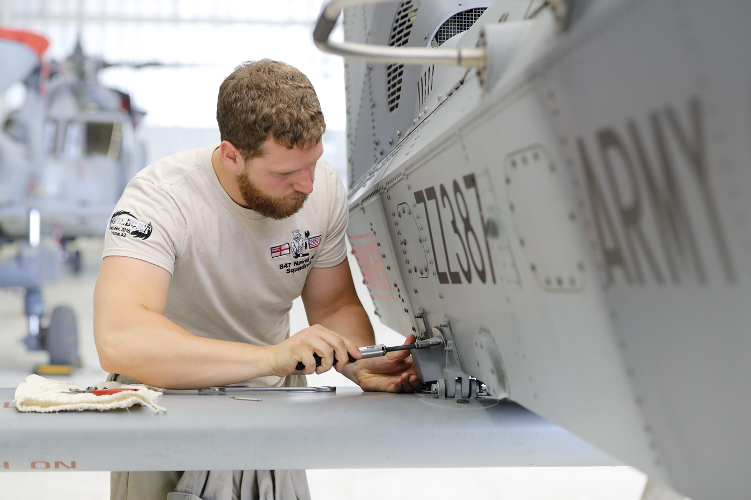
Priority Actions
Hosted on SharpCloud
Exploitation of Support Data and Technology |  |  |  |  |  | Establish a joint strategic workforce plan. DefSp Lead – AVM Rich Pratley. FP WS 5.3
Environmental Sustainability |  |  |  |  | Drive the change agenda for CC&S for Support. DefSp Lead – AVM Rich Pratley. FP WS 4.4
Availability and Readiness | Develop a commercial mechanism to demonstrate pragmatism across the Defence Support Enterprise. DefSp Lead – Maj Gen Simon Hutchings. FP WS 3.1 |  | Determine and implement an Analysis and Modelling Strategy. DefSp Lead – AVM Richard Hill. FP WS 3.3 | Ensure the SSE appropriately supports Strategic Asset Management DefSp Lead – Maj Gen Simon Hutchings. FP WS 1.1
Support Capability and Resilience |  | Provide support to the Agile Stance Campaign Plan. DefSp Lead – AVM Rich Pratley. FP WS 4.3
 | Priority 1 | Priority 2 | Priority 3 | Priority 4 | Priority 5 | Priority 6
DSF Climate Change & Sustainability SG: Stephen Wilcock & Steve Wadey (QinetiQ)
TD-Info Modelling & Analysis Community of Practice
DSF Commercial Enterprise and Acquisition SG:
Andrew Forzani & John Howie (Babcock )
DSF People and Skills SG: R Adm Paul Marshall & Anna Keeling (BDUK)
TD-Info IPS Community of Practice
Support Advantage Charter Principles
DSF Capability Management International & Innovation SG:
Lt Gen Rob Magowan & Alex Cresswell (Thales)
(Progress will be monitored/reported at the DSF EG, TDi Strategy Group and MOD’s Support Plan Progress Group)

Slide 56

Proposed
Commercial Mechanism
Support to ASCP
Action progress
Principle
Priority Action
Status
Update
Approved
Eqpt Supt Modelling & Analysis Strategy
Improved availability & Readiness
1 – New commercial mechanism(s) to support globally deployed assets
Proposed
DJS meeting DG Comrcl and John Howie (Babcock) 31 Aug 22
D SpTx drafting BC to bring in EA to drive strategy development.
3 – Analysis and Modelling Strategy
Approved
4 – Ensure the SSE appropriately supports Strategic Asset Management
Develop
Introduction of improved SSE
Joint Strategic Workforce Plan
Develop
Eng Spt COE producing paper to scope introduction of IPS.
Improved capability & resilience
2 – Support to the Agile Stance Campaign Plan
Proposed
ACDS SpOps meeting DCDS MilCap and Alex Cresswell (Thales) 6 Sep 22.
Implement
Sustainable Support Strategy
Sustainable Support
5 – Drive the change agenda for CC&S for Support
Implement
DSF CCS SG held 11 Aug 22 - Dir CC&S to define the CC&S MOD/Industry Engagement Model to inc SSS implementation actions within the broader sectoral approach
Exploitation of Support data & technology
6 – Establish a joint strategic workforce plan
ACDS SpOps drafting PID with DSF People & Skills SG.
Completed
Develop
SSE Support Solutions Envelop

Slide 57
Analysis and Modelling Strategy
MOD Lead assigned (Darron Jackson)
Introduced yesterday via e-mail to TD-Info Modelling and Analysis Community of Practice co chairpersons (Frank Murphy & Jon-Craig Stuckey)
Plan for work start in October

Slide 58
SSE appropriately supports Strategic Asset Management
Gary Cox update 23 Sep.
  Engineering Support Centre of Expertise (part of the Engineering Support Transformation Team) currently drafting paper to explain the impact of the recommended adoption of IPS and the recommended approach that should be taken
  Time has been taken for industry discussion to ensure learning of best practice in managing such a transition and how best to approach this challenge
  The paper will soon be with 2* Sp Tx Director after which it will receive a broader circulation in Def Spt ahead of CDLS for endorsement
  If the paper is endorsed, work is planned to commence in the New Year although Eng Spt CoE is already starting to develop some of the artefacts and thinking to prepare for this activity
  Ryan Griffin is the technical lead on this work

Slide 59
Team Defence Executive Team
Futures​
Steve Green

Slide 60
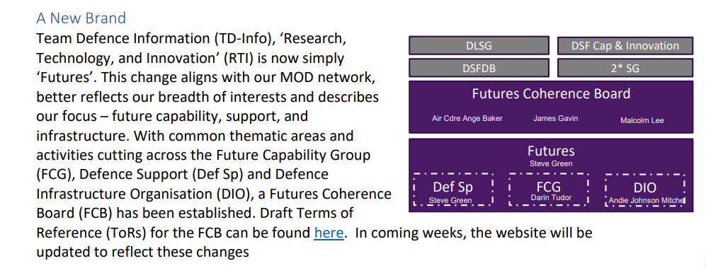

Futures

Slide 61
Futures
Futures Coherence Board ToRs
Purpose
The Futures Coherence Board is a standing, joint MOD and Industry body reporting to the Team Defence Information 2* Steering Group and the Defence Support Force Development Board (DSFDB). It’s purpose is to direct, cohere, exploit, and where appropriate sponsor TD-Info Future activity.
Outcomes
Futures activity outputs will provide insight to inform, guide and enable accelerated development of Defence Capability.
Scope
Futures activity has three core focus areas: DE&S Future Capability Group, Defence Support[1] and Defence Infrastructure. The Board will consider business model innovation and advances in technology and digital assessing the potential to transform Defence acquisition, capability development and support.
[1] Defence Support encompasses Logistics, Engineering and Equipment Support activities.

Slide 62
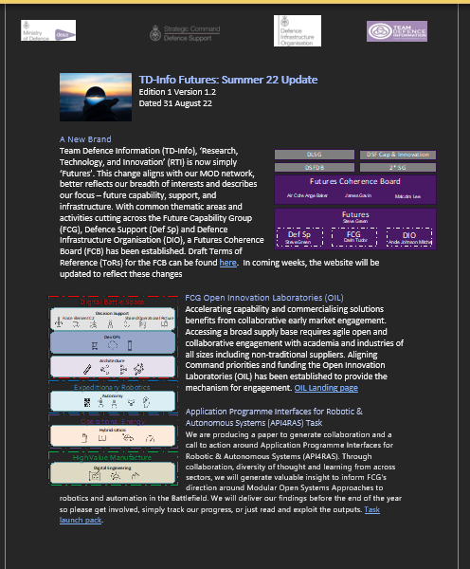

Futures - Newsletter
For more information please find the latest newsletter on the website

Slide 63

API4RAS
Application Programme Interfaces for Robotic & Autonomous Systems
(API4RAS)

Slide 64
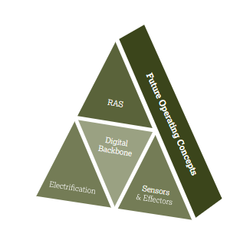
High Level Context
NATO Domains
Lethality
Mobility
Survivability
C4i
Sustainability
Integration: How can the future uncrewed capabilities be integrated and networked to enable scalable, modular, ubiquitous and secure digital eco-system and capabilities to achieve Defence outcomes and deliver military effect
Master Question List
What are the network and data requirements (data flows, processing power, bandwidth requirements, security policies and latency) ?
How can next generation off boarded sensors support route reconnaissance, route proving and clearance?
How can next generation off boarded effectors detect and neutralise threats?
How can electrification and future energy vector technology and architectures power these sub-systems?
How can how can advanced analytics, data science and AI/ML architectures enhance the operational output?
How can platform RAS architectures enable to create stand-off capability?
C2 (AI&ML)
Effectors
API enabled Integration
Energy
Uncrewed platform
Sensors

Slide 65
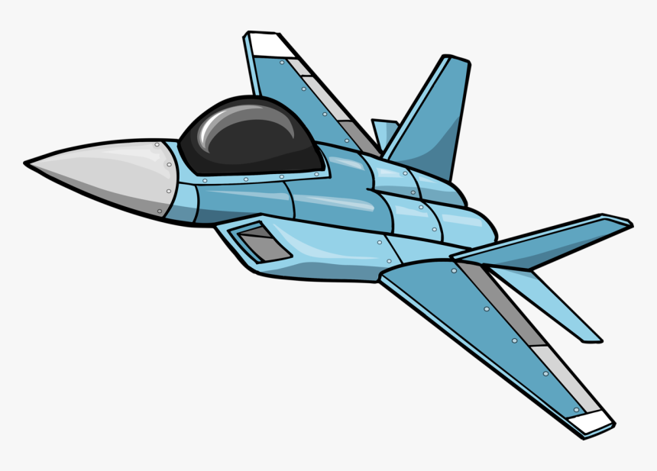
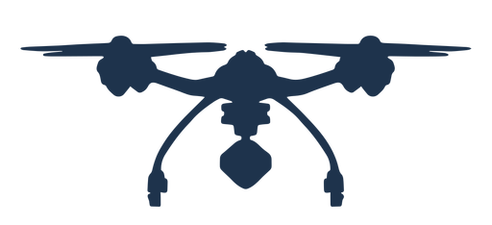



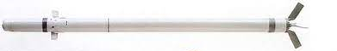







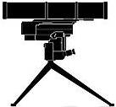


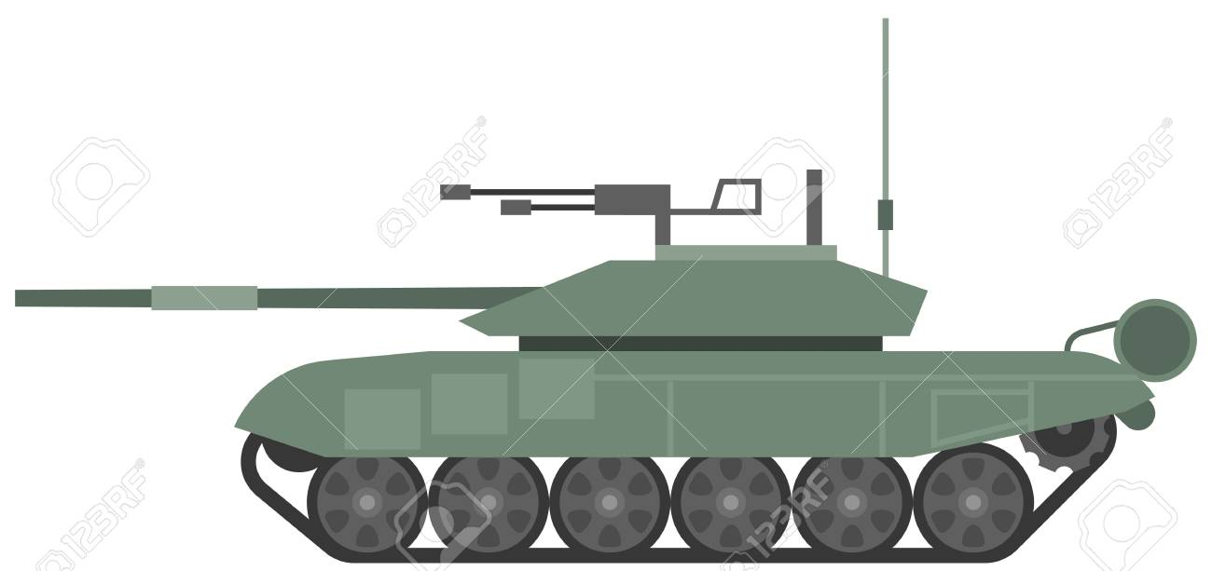
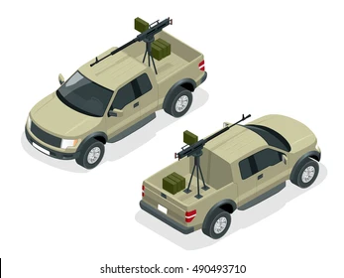
Strategic View 1/2
1
Integration
2
C-ISTAR
1
3
C-EMS
AI/ML
2
4
4
C-Air VSRAD
UAS
5
C Air Defence
Network
5
12
6
6
C-RAM
Novel Weapons
15
5
7
C-AT
3
Sensors
Effectors
8
C-SAF
14
9
Electrical Power
9
C-CBRN
10
10
15
15
7
C-EO
RAS
11
Mob Sp
8
12
11
12
C-Mob
13
Non-lethal sys
14
Multi spectral camouflage
15
Deception and stealth

Slide 66
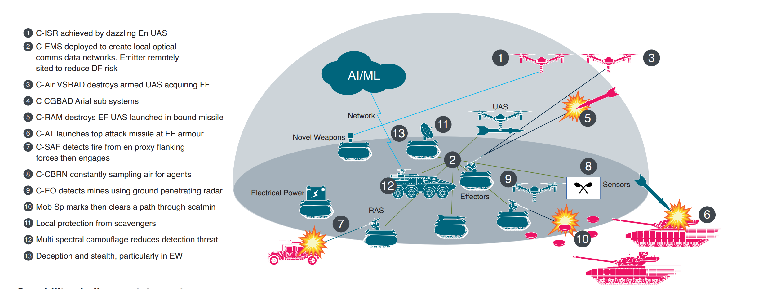
Strategic View 2/2
a
4
b
14
f
d
6
e
c
i
h

Slide 67
Introductions
Col Dan Anders-Brown (FCG Sponsor)
Iain McDowell (MOD Task Lead)
Mark Cornforth (Industry Task Lead)
Steve Green (TD-Info facilitator)

Slide 68
Application Programme Interfaces for Robotic & Autonomous Systems (API4RAS)
Aim
Agree approach to delivery of API4RAS task and allocation of troops to task
Objective
Agree ToRs
Outline task approach and timelines
Develop strawman structure
Allocate authors and contributors to sections
Call for case studies, practices and best practice

Slide 69
AdM Update
Initiated in January of this year, TDI-Info is providing secretarial support to the Def Sp Transformation team in the delivery of Certification and Inventory Management Working Groups as part of CDLS’ Additive Manufacturing (AdM) as a Service Challenge (See 1st graphic below)
Through these WGs, a stakeholder community has been developed, formed from across Industry and MoD, identifying key challenges and opportunities with the MoD vision of wider use of AdM across the Defence Supply Chain
Networking between SMEs and OEMs is targeted to enable the identification and introduction of relevant and value add AdM technologies, processes, and manufacturing capabilities
TD-Info has been central to the development of guiding Vignettes for the Challenge, as well as supporting the development of individual WG plans and the key assumptions that are assisting the delivery of the incremental Spirals (see 2nd graphic below)
  To date TD-Info has arranged and supported 4 sets of Working Groups (virtual & in person) across the Certification and Inventory Management areas
  The next in-person Working Group, including all Working Groups and the Exec Group cabals, will take place at the Defence Academy in Shrivenham on the 17th November
An end of year report is scheduled from each Working Group, with Spiral 1 of the AdM as a Service Challenge due to be on contract by January 2023 (under the Future Capabilities Group, DE&S)
TDI-Info is hosting a shared working site on Kahootz for all WGs, and has a page on its website outlining the aim of the Challenge, together with key documentation and links.

Slide 70
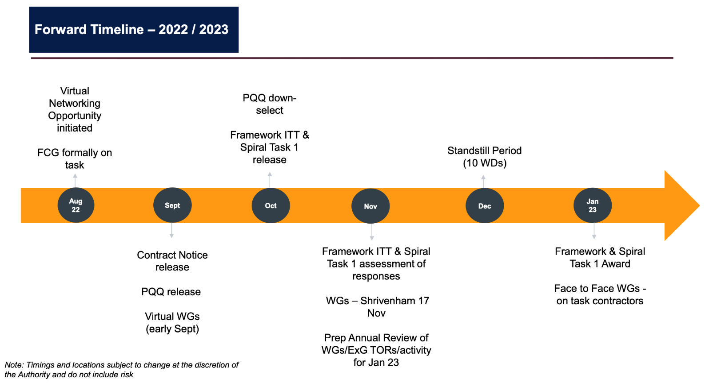
Reference - Graphic 1

Slide 71
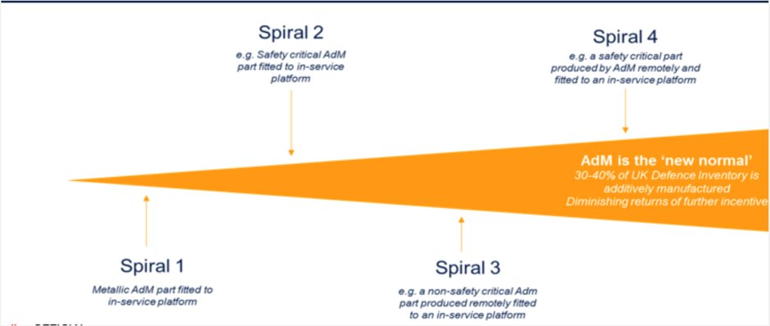
Reference – Graphic 2

Slide 72
DIO - Sustainability
Current Situation
It is approaching 12 months since the last DIO Sustainability Conference (DISIC)
Six Joint MOD & Industry workshops have taken place and the summaries collated:
  WORKSHOP 1- RETRO FITTING EXISTING ASSETS TO ACHIEVE NET ZERO
  WORKSHOP 2 – NET ZERO NEW BUILD AND MAJOR REFURBISHMENT
  WORKSHOP 3 – SUSTAINABILITY WITHIN FOOD AND WATER
  WORKSHOP 4 – MAKING THE ESTATE CLIMATE RESILIENT
  WORKSHOP 5 - EMBEDDING SUSTAINABILITY INTO OUR CULTURE
  WORKSHOP 6 – DRIVING CARBON EMISSIONS OUT OF THE SUPPLY CHAIN
The intention was to have a follow up conference this autumn. Conference Options have been provided by TDInfo to DIO, covering possible locations, costs and agenda, however, DIO are currently having internal discussions to determine governance and scope of the sustainability agenda. As such, they have called a hiatus on further work on DISIC until this is resolved.

Slide 73
Team Defence Executive Team
Lunch 1305 – 1345

Slide 74
Agenda
Agenda Item | TDI Lead(s) | Lead |  | Duration
Meeting Opens |  | All | Standard | 1045-1100
Welcome and Introductions, Townhall background & purpose |  | Chairman: Steve Lammiman | Standard | 1100 – 1105
MoD Update ( inc DAIC, ) |  | Ed Cole/Dave Hawken | Standard | 1105 - 1120
TDI (Industry + DS F+ CIO’s Forum + DCE) Update |  | Phil Williams | Standard | 1120 - 1130
Outstanding Action update (overview only, discussed in pre-meet) |  | Philippa Arter | Standard | 1130 - 1140
Improving Defence Outputs |  | RAdm Andy Kyte | Townhall | 1140 – 1220
Support Advantage Charter Actions | Julian Dayment | Anne-Marie Evans | Townhall | 1220 -1235
Futures – Update (focus on Additive manufacturing, sustainability?) | Steve Green | James Gavin (?) | Townhall | 1235 -1305
Lunch/networking |  |  |  | 1305 – 1345
MDI - Update | Steve Worsnip | Graeme Ball/Chris Parker/Paul Eastman | Townhall | 1345 – 1355
JISCOT Update | Phil Williams | Phil Williams | Townhall | 1355 - 1405
People and Skills inc. Vanguard Update | Phil Williams |  | Townhall | 14.05 - 1415
ICEF | Tony Butler |  | Townhall | 14.15 - 1425
Conference 2023 Themes and update |  |  | Standard | 1425 - 1430
AoB | Chairmen |  | Standard | 1430 – 1440
Closing Comments, initial feedback on townhall and DoNM | Chairmen |  | Standard | 1440 - 1445

Slide 75
Team Defence Executive Team
MDI​
Steve Worsnip

Slide 76
MDI WG input
The Team Defence Information (TDI) Multi Domain Integration (MDI) Working Group, Currently comprising three phases of the MDI Embedding Integration & Design Authority (EI&DA), as follows:
Phase 1 as a MOD Embedding Integration (EI) Study conducted October 2020 to June 2021
Phase 2 as a sense making series of workshops from July to December 2021 aimed at ‘putting meat on the bones’ of the Study’s Recommendations.
An ongoing Phase 3 of WG sense making to steer outcomes and related activities throughout 2022 and into 2023
The WG collective of more than 300 Defence players engaged and involved, with a small Expert Network Disruptor Group (~14)

Slide 77
MDI WG input
Status:
  Steve Hyde retired from the MDI Change Programme (albeit remains supporting as DE&S SME)
  Graham Ball, and team, stepped forward as new MOD leads
    Discussions with MOD Team and TDI on Industry Leadership, resolution imminent
  Value of TDI / MDI activities and future programme aligned, issued to MDI Community via Communique
  https://www.teamdefence.info/wp-content/uploads/2022/08/TDI-Phase-3b-Communique-September-2022.pdf
  A stock check undertaken with the MOD MDI Change Programme to ensure we remain focussed on a common purpose and aligned objectives. Agreed engagements for 2022 and 2023 focussed on:
    To ensure MDI remains visible and credible within the UK enterprise.
    To facilitate the contribution of industry (including and beyond Defence),
    Allow MOD to have the maximum exposure to best practices, ideas and risks.
    To stimulate discussion on specific topics of mutual benefit
  Programme of Events agreed focussed on higher strategic content
  Mid Term report Phase 3a EI&DA issued
  MDI by Design deep dive event held, including the use of new and innovative collaborative tools.
  Positive MDI briefing to the DSF. Hybrid of existing objectives and new leadership agreements.

Slide 78
MDI WG input
Phase 3a Report Conclusions:
  MDI is an Operations and Business Led activity, focussed on constant and enduring competition
  Key thrust of Strategic Command (UKStratCom) must enable UK to fight differently; turn concept into reality. exploit the benefits of integration.
  Defence has done some detailed thinking and produced a coherent and endorsed document in the IOpC25, its related concept - MDI - needs to inspire the same endorsement and create momentum towards the IOpC25 goal
  To be effective, MDI needs to link visionary operational commanders who understand the need to cooperate and integrate across domains with innovations from Industry, plus dynamic leadership.
  The industrial relationship must be enabled by the acquisition reform. Critical to this improved Industrial relationship better understanding in Industry of pressures on funding, procedural inhibitions and promoting the availability of enterprise Intellectual Property (IP).
  Key to the IP challenge will be the incentives that promote Industry willingness to share. Industry must work differently if it is to contribute to the ‘constant competition’ imperative.
  Key to the dynamic leadership is the evolution of what does MDI mean to the UK?
  The integrating brain and architects at Industrial levels may come from the role of the proposed Integration Design Authority or Organisation (IDA or IDO), and its supporting infrastructure,
  Do not conflate MDI with Digital or IT with networked or business integration (coherence) vs equipment integration. MDI is a lot more than Data and Networks. However, at the same time, we need data and networks geared to support it
  Industry 4.0 is about competition of operating models (A commercial example is Amazon or Uber, a military example is 3D printed drone swarms)
  One way to engage industry productively is to give them paid and useful work to do. linked to pilot MDI programmes based on urgent operational need and the use of StratCom’s strategic fund..
  Educate, empower, resource and incentivise leadership of expanded business unit networking with a focus on network value – relevance, responsiveness, resilience,

Slide 79
MDI WG input
Recommendations for Phase 3b
  Support and work with MOD, and specifically the UKStratCom’s MDI Change Programme, to drive forward in co-creational consultative relationship the enterprise issues which Industry can support, within the objectives of efficiency and pace to mutual benefit.
  Access industry experience to help in the absence of a dedicated external Systems Integrator in areas such as the development of the Integration Design Authority or Organisation (IDA or IDO).
  Provide an Industry Advisory Board of proven experts and breakthrough events that allows Senior Leadership from all parties to immerse themselves in the fundamentals of MDI to build a delivery partnership for MDI.
  Develop, build, and communicate an Integrated Delivery & Performance Specification for MDI.
  Explore how financial and oil ‘majors’ share data securely and cost effectively for ‘information advantage’.
  Develop an understanding of the enablers that digital backbone programme must deliver if the connectivity and machine learning requirements are to be met, exploring cost effective accelerators to prevent a ‘major programme’ type procurement process

Slide 80
MDI WG input
Programme:
  4th October 22 (2 hours) - MDI update and cross-sector briefing – virtual
  MDI update, including discussion of the recent integration diagnostic and cross-sector briefings from financial services.
  16th November 22 (4 hours) – in person and virtual town hall (Airbus Defence & Space, Stevenage)
  Supported by guest speakers the session will get under the skin of UKStratCom plans and progress, and the opportunity drive further enterprise coherence.
  December 22 – Acquisition Reform including Mission Data for Information Advantage – virtual
  January 23 – Agile Stance Campaign and Logistics – virtual:
  February 23 – Integration Design Authority – virtual:

Slide 81
Team Defence Executive Team
JISCOT​
Phil Williams

Slide 82
JISCOT
# | Agenda Item | Lead
1 | Introductions & JISCOT Action Log | Phil Williams
2 | Introduce to new members | Phil
3 | TOR revisions | All
4 | S4000P Discussion Issues with UK Access | Phil Williams
5 | DEFSTAN 00-600 Update | Mike Barter
6 | UK Data Modelling & Exchange Working Group | Mike Day
7 | IPS Council Update Block release, lessons learnt planning for 2024 | Phil Williams
8 | ASD Update Succession planning (Lockheed Martin) UK Shadow Cabinet ADS SSG ASD/AIA Collaboration Call | Phil Williams
9 | Tim King Updates: SC4 update Report on participation in ISO/IEC JTC 1/SC 7/AHG 6, Digital engineering CEN CENELEC 28th Sep | Tim King
10 | Request for Product Lifecycle Management from Adrian Baguley (Tools) PLM experts | Phil Williams
11 | Presentations at Vienna IPS User Forum presentations help required | Phil Williams
12 | Externalisation of S1000D SNS structures to support wider S-Series adoption | Mike Ingledew
13 | Support Advantage Charter (link to charter) | Phil
14 | UK Simplified Technical English | Ciaran Dodd
15 | Events / Communication opportunities for Standards S1000D User Forum Seattle 20th June 2022 IPS User Forum Austria 17-20th October 2022 | Phil Williams
14 | Other Standards (Codification issues, Security, etc) | All
15 | AOB & Next Meeting: Has TDI made any progress in establishing a route for members to have access to ISO standards? | Phil Williams

Slide 83
Team Defence Executive Team
People and Skills inc. Vanguard Update
Phil Williams

Slide 84

Summary
The team have now grown to 25 members with more in the pipeline.
They are all enjoying the activities and events that they are supporting across Defence and having spoken with all of their managers, encouragement to be involved is strong. Recent articles in the TDI news letter have help to boost interest and the word is out!
Vanguard are highly thought of and new projects are frequently sent their way. We had our first F2F Team Building event last month held in the Leonardo offices in London. There was a good turnout, with 2/3rds of the team attending. Finally meeting each other and getting to discuss new ideas, as well as current work, was the tonic they all needed. Interest and participation is high.

Slide 85
Workstream Activities
SPACE | The team are working with Space Command, StratComm, helping Captain Phil Coope to develop his presentation for his keynote spot at the Global MilSat Conference in November.
 | Frank Strang, CEO of Saxavord has invited the team to visit the space centre and tour the facilities. Not only will this be a great learning event for them it will help with the development of their presentation.
SUSTAINABILITY | The team have a slot on the upcoming Royal Engineers Conference to speak about 'Vernacular materials in Operational Infrastructure'. They have interviewed a number of people to assist in them developing a unique presentation
IMAGE OF DEFENCE | The team have made contact with the DSF group 'Negative Perceptions of Defence' and will be pooling ideas for a future project.
FUTURE TECHNOLOGIES | The team will be supporting and Ethics in AI workshop coming up in November.
 | In addition, the team are working with StratComm to write a 'Digital Response' to the Defence and Security Industrial Strategy.
HYBRID WARFARE | Following a very well received presentation at DI '22, on 'Disinformation in the Supply Chain', the team are now struggling to find a sponsor for follow up work. A contact in Defence Intelligence would be ideal. In the meantime the team has made contact with the Defence Knowledge Network to pool ideas and spread a wider net for communications

Slide 86
OTHER ACTIVITIES
I have been in discussions with both BAES and Atkins to develop a model whereby we work together, including Vanguard as part of their ‘Young Persons’ development package. By linking in with them I am able to build a pipeline of talent that we can turn over every few years ensuring that we always have a team of keen young professionals. The intent is to use this model with additional Industry companies as well as within Defence sectors.
Navy Command have invited the team to come and present to their seniors in a effort to boost visibility and generate more activities. At the same time they will also present to the young professionals work stream in order to attract new members

Slide 87
Team Defence Executive Team
ICEF
Tony Butler

Slide 88
Team Defence Executive Team
Conference 2023 Themes and update

Slide 89
Conferences
Adrian Baguley – Jan 2023
Lt Gen Richard Wardlaw – May 2023
Charlie Forte – July 2023
{Fuels, Sustainability… TBD}
Exec Group Town Hall – 28th Sep, Admiral Andy Kyte, Improved Defence Output
Supply Chain Sub Strategy – 13th October, Gen Simon Hutchings, Leidos
89

Slide 90
Team Defence Executive Team
AOB

Slide 91
Team Defence Executive Team
Closing Comments, initial feedback on townhall and DoNM

