Slide 1
Industry Brief
Business Modernisation for Support
Notes:
Welcome
Safety brief:
nearest fire exits
Routine fire alarm test is due that day,
Nearest toilets/rest rooms,
Where to take calls if these are necessary
Do not take photos of the slides on their phone. Slides will be shared on the Defence Sourcing Portal by the end of the week

Slide 2






Site and building information
No practices of the Attack Alarm are planned. If this is alerted for genuine reasons it will sound for 90 seconds or more.
No fire practices planned. If there is a fire, please gather in the car park.
The site operates a strict no smoking policy throughout all our buildings. There are designated smoking areas outside the rear of Marlborough Hall.
Please silence your mobile phone.
Toilet facilities are available through the hall to the left for Gentlemen and to the right for Ladies.
The first aid point is located in the kitchen area (Room 31).
Official
Notes:
Attack alarm is Monday so any alarms you hear will be real ones. Please follow the guides at the front should one of these occur who will direct you to a safe location
The same is the case for the fire alarm with the test on a Thursday. All alarms hear should result in a building evacuation. Again, guides will assist.
For those of you that smoke, a designated smoking area is XXXXX
For anyone requiring first aid, facilities are in the kitchen areas
Toilet facilities can be found XXXXX

Slide 3

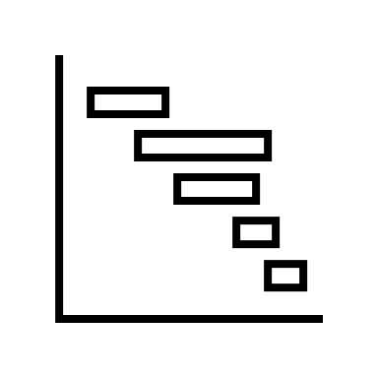








Agenda
10:10 – 10:25
AGENDA 1
Dir Support Transformation and SRO for BMfS Introduction and Welcome
13:15 – 13:45
AGENDA 6
End State Delivery Model
BMfS Programme Delivery Approach
AVM Richard Hill
Edward Roberts
10:25 – 11:10
AGENDA 2
Dir BMfS introduction to the Programme and Strategic Context
13:45 – 14:00
AGENDA 7
Commercial and Lotting Strategy
James Daniel
Clare Lacey
Break
11:10 – 11:40
AGENDA 3
MoD Support CIO brief on the Support Business Functional Model
AGENDA 8
The Defence Engineering and Equipment Asset Management (DEEAMS) Project
14:00 – 14:30
Richard Puttick
Lt Col Simon Mansfield
Break
Break
12:00 – 12:30
14:45 – 15:30
AGENDA 4
BMfS Requirements, KURs and Benefits
Col Gavin Lenthall
AGENDA 9
Panel Q&A
Presenters
12:30 – 13:15
AGENDA 5
Lunch and networking
15:30 – 15:45
AGENDA 10
Summary and Close
Edward Roberts
James Daniel
Official

Slide 4
Questions?
Please submit questions via Slido
www.slido.com
Code: 02658213
Official

Slide 5
Introduction
Business Modernisation for Support (BMfS)
Notes:
Key messages:
This is the first large scale practical application of the DefDig/UKStratCom Digital Strategy for Defence. BMfS will set the foundations for others to follow. If you haven’t read it, I strongly encourage you to do so as this will be used as the means of assessment for commercial tenders
This will create an ecosystem of suppliers upon which all Defence information and data services will function.
The MOD is completely changing the way it obtains and delivers services, migrating from a vertically integrated support model to a horizontally integrated model, borrowing from industry best practice
Intent – follow industry lead and be a "data driven enterprise" – decisions will be based more on data and less on subjective experience and “gut-feel”
The MOD needs visible, transparent and usable information to allow analysis, forecasting and scenario based planning. BMfS seeks to achieve this
This transition from vertically to horizontally integrated service provision is a major change and there will undoubtedly be bumps in the road. James Daniel will go into greater detail after me
Reference pan-defence coherence and the Digital Strategy for Defence frequently (a key message). Recommend suppliers read; it should drive proposal responses

Slide 6
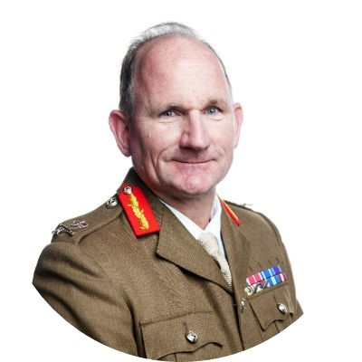
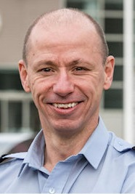
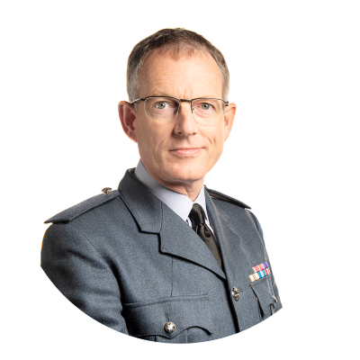
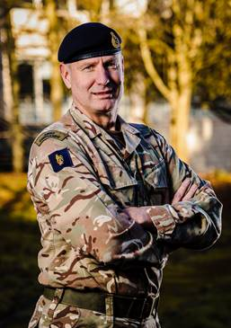

Defence Support
Chief of Defence Logistics and Support
Lt Gen Richard Wardlaw
BMfS sits within Support Transformation, under the 2* pillar of AVM Richard Hill.
Support
Operations
Support
Transformation
Joint
Support
AVM Rich Pratley
AVM Richard Hill
Maj Gen
Simon Hutchings
Operational
Plans
Strategic Plans
Support Policy
Functional Portfolio
Defence Support Operating Model (DSOM)
Business Modernisation for Support (BMfS)
F&RP
Defence Support Chain Operations and Movements
Head of Capability – Defence Support
CIO/CTO
Pex, Assurance & Compliance
Official
Notes:
Support Transformation was formed to ensure Defence met the operational capability required under Joint Force 2025. It covers both delivery of enterprise-wide programmes but all Support related transformational activity within the MOD. Support Transformation has an ambition to deliver of £10bn savings over 10 years and led by CDLS Lt Gen Richard Wardlaw it has three pillars: Support Operations, Support Transformation and Joint Support.
BMfS sits under SRO AVM Richard Hill’s portfolio within SpTx.

Slide 7

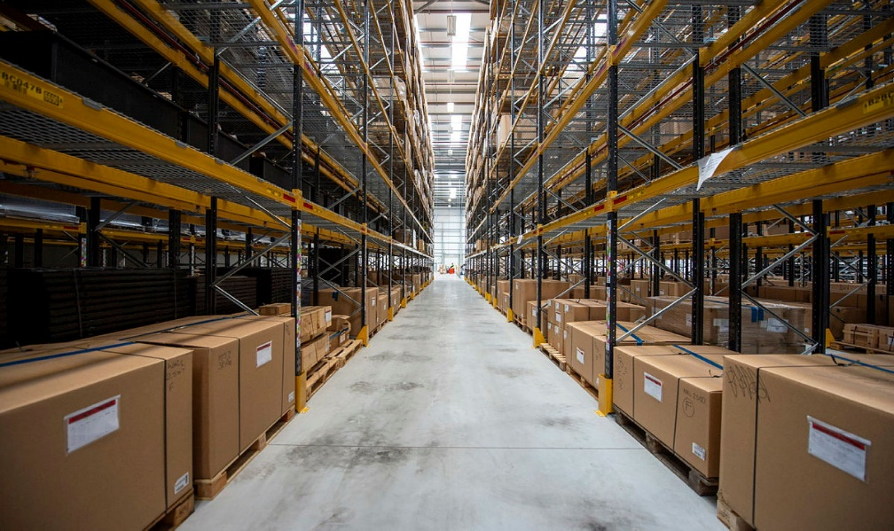
BMfS Vision Statement
At the heart of achieving Support Advantage
One robust, evergreen, integrated set of digitally enabled services that deliver world class support for Defence
Streamlined business processes enabled by the minimum number of information services
Seamless interactions across the Support Network
The information we need, when we need it, where we need it, on demand
One tool, many information services
Modern solutions that meet or exceed User expectations
7
Official

Slide 8
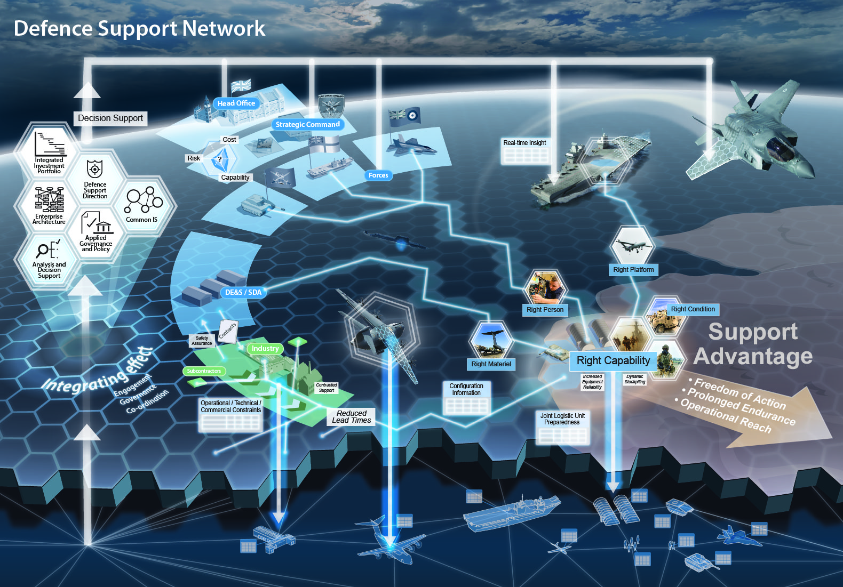
Superior, assured, environmentally-sustainable and cost-effective logistic services
A paradigm shift in platform and equipment availability
Exploitation of data and technology
A culture of interoperability

Slide 9
Why we are changing - Case for Change
It is also clear that more efficient and readily available standard market offerings (incl. Commercially of the Shelf (COTS)) and developments in modern best practice has proven that organisations (both in Industry and Other Government Departments (OGDs)), can be transformed to utilise them.
The current Defence Support processes are often convoluted, single service, not integrated and do not enable the procurement of efficient solutions to support them.
The current Support Information Services are complex, expensive, vulnerable, becoming obsolete and carry a significant training burden.
The analogue experience reduces attractiveness and retention of Support personnel and the low quality, incoherent or non-existent data leads to inadequate management information and inefficient decision making. It is becoming increasingly unaffordable to extend current contracts.
One robust, evergreen, integrated set of digitally enabled services that deliver world class
support for Defence ​
BMfS is also the key programme within Support Transformation in addressing the wider challenge of lack of Defence Support identity and culture.
20200730-UKStratCom014_BMfS(LOG_IS)_Mandate_AVM Richard Hill_V2.0-OS
Official

Slide 10
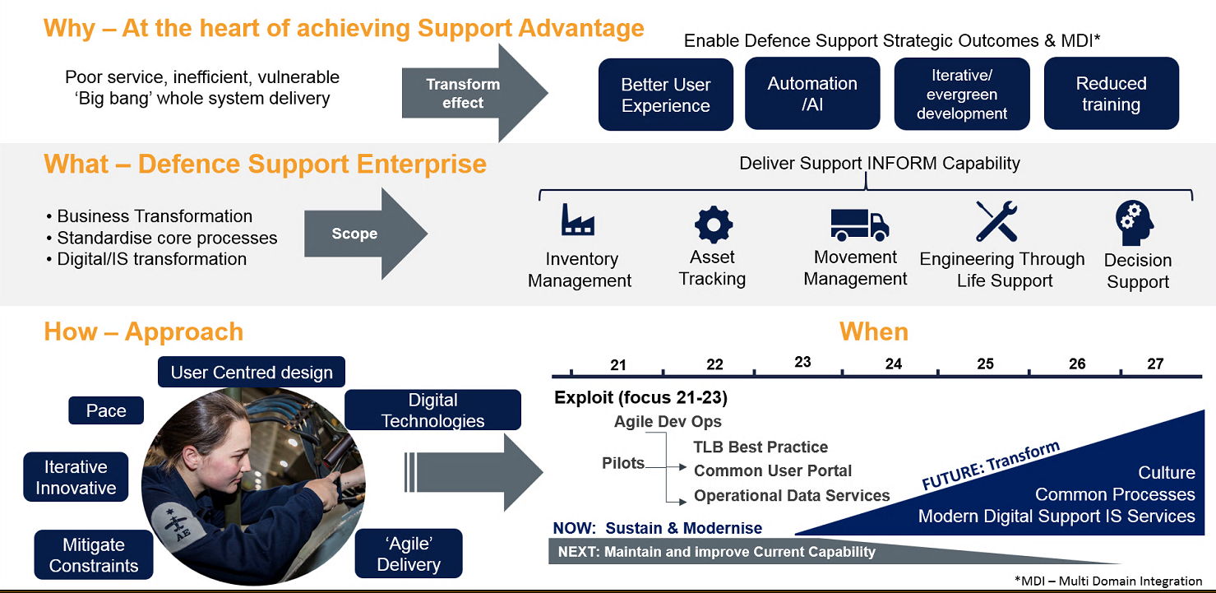
Business Management for Support
Official
Notes:
Why – BMfS is at the heart of achieving Support Advantage. BMfS impacts on achieving all the elements of the DSS Vision (e.g. information-led, technology enabled, resilience, integrated & Interoperable and people). For SpTx it will be the lead programme for cultural change, achieving and enabling the desired efficiencies and benefits, and will central for achieving ‘Support Information advantage’ by leading on one of the strategic outcomes:
Enhance Decision Making (through improved access to data – improved data quality, delivery of Secure IS services, and standardised processes)
But will also input significantly to the others;
Effective Delivery – BMfS will maximising industry expertise by partnering with them which should result in a step change in capability. Also Sp CIO (through the Defence Support Design Authority and BMfS will become the Support Conscience of digital, processes and IS across Defence by recommending adoption best practice from other TLBs) where possible and highlighting where there are inefficiencies/ incoherencies
Resilience – especially in cyber defence.
Digital skills – having standardised processes will enable the ability to have common skills as well as improve the in the digital age
BMfS will be at the heart of achieving interoperability and integration on processes and IS – thus it is key to enabling Multi Domain Integration
What - Defence Support Enterprise. BMfS will mean a significant change across Defence as it will affect operations, logistics, engineering and CIS for the whole Defence Support Enterprise. The Programme aim is to sustain, modernise and transform the Defence Support core business processes and supporting information services in order to enable effective, efficient and resilient digitised Support capability that enables gaining of the Support Advantage.
How – Top Down led Transformation. Critical to success is that this must be a top down led transformation. We are working on getting Min DP, CDS and Chiefs support. In addition, in line with Govt guidance, BMfS will be a benefits driven programme underpinned by an Enterprise Architecture (EA) approach . This EA approach will mean the implementation of key principles and governance to ensure coherence, visibility, integration and interoperability. As the BMfS scope is covering Business As Usual as well as transform it have been broken down into 3 tranches:
Sustain. This is about ensuring we maintain the current capability – by managing the systems provision, refreshing where necessary, improving where possible and seeking continued efficiencies by further retirements. This Tranche is ongoing and is due to finish in Jun 22 when FLIS Reset contract ends.
Modernise. This Tranche is about modernising the systems and approaches where possible but also will be take on the Sustain tasks in Jun 22 until BMfS Transform is implemented. There are two key projects within this Tranche; – Bridging the Gap that will essentially carry on the sustain tasks but seek more improvements and ensure transition to BMfS Transform; and Legacy Exploit which will seek other opportunities for modernisation of current systems. This Tranche is currently in its Concept Phase and aims to be live in Jun 22 and will transfer systems and services to Transform . This is expected to be complete by 26/27
Transform. This Tranche will lead on:
The change management through effecting the cultural and behavioural changes required for successful implementation BMfS and the wider Support Transformation. Key to this is making the case for change for which this brief is key.
Design and implementation of the standardised core processes.
Procurement of the evergreen, resilient IS services that will enable them.
Lead coordination across Support Transformation for digital transformation and any information systems

Slide 11
Programme alignment across Defence
SpTx
Delivers overall Portfolio of Improvements to Support
BMfS provides modernised processes and systems improvements to drive efficiency and effectiveness
EST specifies the Engineering standards and develops use cases for future transformed Engineering business processes
Business Modernisation for Support (BMfS)
Engineering Support Transformation (EST)
Identifies ways to modernise business processes through better use of digital technologies and systems
Reduce cost of delivering activities by automating and accelerating workflows
Exploits advances in Engineering Support Processes and Technologies to enable more/same Equipment Availability Days per platform for same/less cost
Pilots process and technology improvements to demonstrate benefits
EST specifies Eng Support processes & User Requirements
BMfS provide EST with digital tools and services aligned to modern industry best practice Processes
Official
Notes:
BMfS and DEEAMS are the delivery vehicles for the EST vision

Slide 12
BMfS Delivery Strategy
Business Modernisation for Support
Notes:
Define what DEEAMS means and what is stands for during this section of the presentation and where it sits within the overall model. Describe a high level structure. Need to give a little of the story about how this was arrived at to link to what they have seen.
Key messages:
As mentioned by Richard…. Digital Strategy for Defence. Recommend read and absorb. It will be the way we proceed for all IT service projects going forward.
Why are we doing this: as stated by Richard, the MOD needs visible, transparent and usable information to allow analysis, forecasting and scenario based planning. At present, this is extremely difficult, particularly when working across multiple services. Timelines are long and protracted, it is time consuming of key personnel, it is expensive, inflexible, unresponsive, limited (if any) SME involvement, lagged significantly behind industry best practices and in some cases the Defence need cannot be met.
There are many roots and causes but one of the key elements is how we have obtained IT services. Traditionally, vertically integrated models were used for each service delivered: a single provider procures and configures the software, hosts the data and then manages it to service termination. It has also tended to be heavily customised increasing costs and reducing flexibility.
This will allow us to create an ecosystem of suppliers and services resulting in an accessible, transparent, flexible and responsive system of services to support Defence
Pivoting from Vertical to Horizontal. We want to collaborate with industry to deliver the solution. Trade-offs – and use the workshops to establish what they are. Demonstrate how we have used the feedback from industry

Slide 13
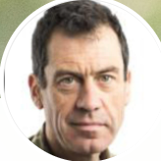
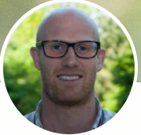
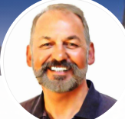

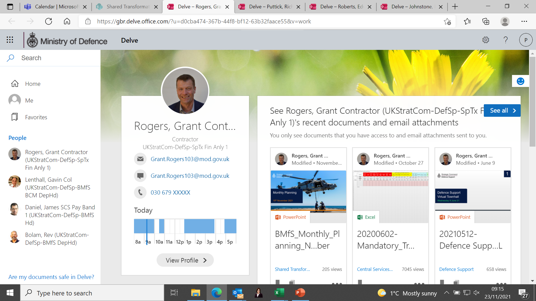
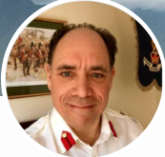


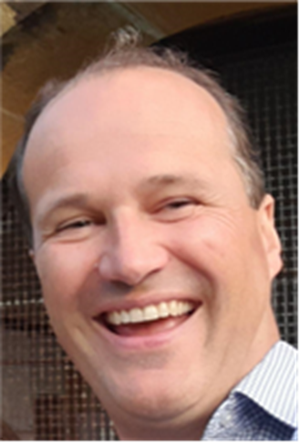
Key BMFS Stakeholders
BMFS PROGRAMME LEADERSHIP
James Daniel
Programme Dir.
Ed Roberts
Deputy Pgm
Director
Rev Bolam
Technical Lead
Clare Lacey
Commercial Lead
Grant Rogers
Finance Lead
Gavin Lenthall
Change Lead
DE&S DIGITAL
UK StratCom - Joint Support
Chris Turner
DEEAMS Project
Lead
Bets Chiocca
DEEAMS Project
Lead
Richard Puttick
Support CIO
Cdre Charles Evans
Support HOC

Slide 14






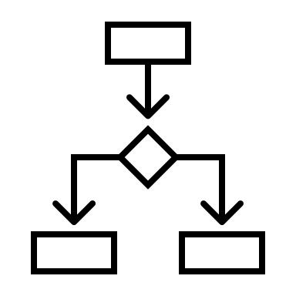


What are we buying…
BMfS scope and requirement within Defence Support ETLS
Enterprise-wide Support Services
ETLS
Inventory Management
Movements Management
Asset Tracking
Enablers
ETLS
Inventory & Warehousing
Movements & Transport
Asset Tracking
CUP
ODS
Breakdown:
Maintenance, Repair & Overhaul
Asset Management
Systems Integration
BFM L1 Mapping:
Obsolescence
Asset Management
Maintenance & Repair
Technical Information
Recondition / Repair Requesting
Fleet Management
Safety Management
Engineering Planning
Breakdown:
Inventory
Warehousing
Specialist add-ons (fuels, food, munitions)
Systems Integration
BFM L1 Mapping:
Inventory Management (Base and Deployed)
Warehousing
Note: demand forecasting delivers Decision Support Service but is bought as part of Inventory / Warehousing lot
Includes munitions / foods / fuels as specialist scope
Breakdown:
Transport Management System (TMS)
Global Network Design (modelling tool)
Customs compliance
Air passenger movements
Specialist add-ons
Systems Integration
BFM L1 Mapping:
Movements and Transport
Breakdown:
Asset tracking
Systems Integration
BFM L1 Mapping:
N/A
Note: asset tracking sits across logistics support in the BFM but is not called out specifically
Breakdown:
Custom User Interface licenses
Business Process Orchestration licenses
DevSecOps licenses (PREDA).
Systems Integration
Breakdown:
Master Data Management licenses
Specialist application licenses
API integration
Systems Integration
Data Exploitation Service
Breakdown:
Logistics Planning: Demand (material requirements) Forecasting licenses, Systems Integration
Data Exploitation Services: Data tools (DT&A) licenses, Specialist add-ons (TBD) licenses Systems Integration, Logistics Support Reporting and Performance Analysis
Decision Support
Logistics Planning

Slide 15



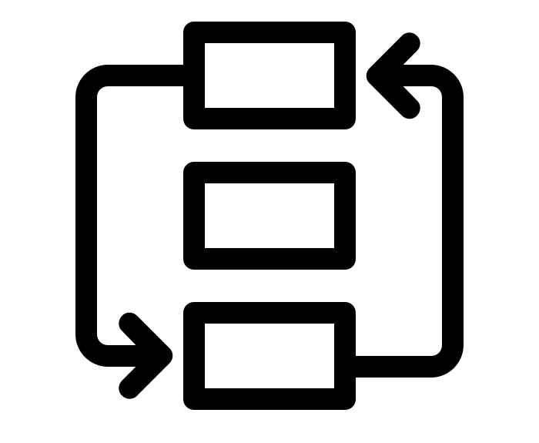



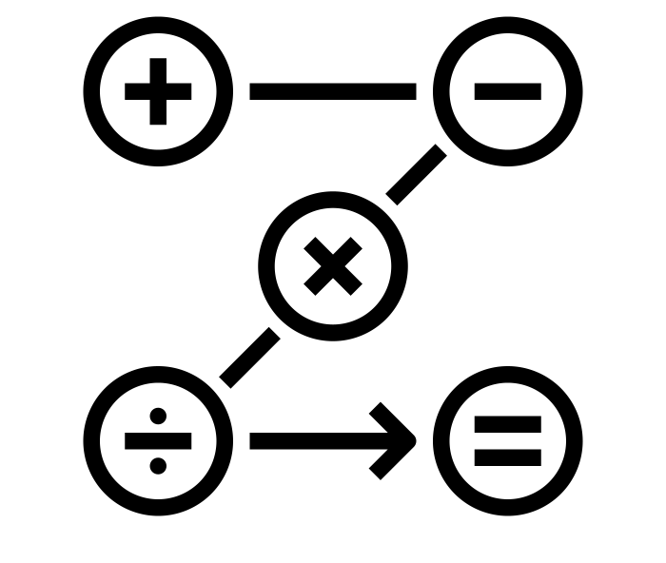

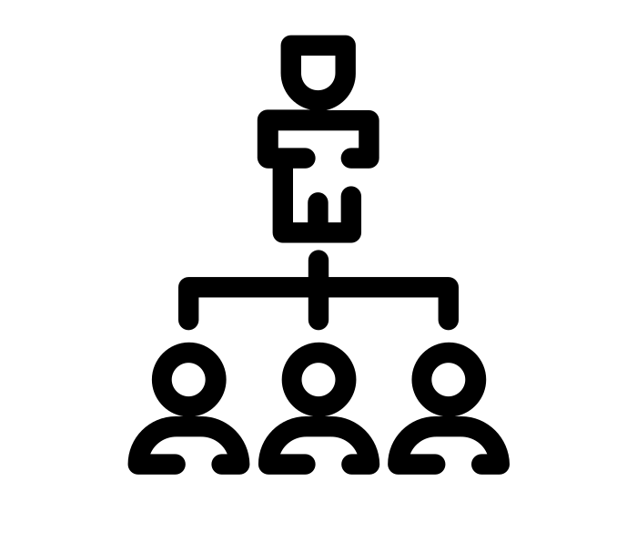

Our interpretations from the RFI process
What you told us
Commercial RFI feedback
Develop a robust and deliverable programme
Collaboration & partnership
Create the ecosystem and then scale
Determine scale of process change across MOD
Commercial and procurement
Ensure alignment across Defence
Technical RFI feedback
All epics can be satisfied by fully aggregated or fully disaggregated technical models
MOD already has all the necessary tools to deliver BMfS
Outcome-based delivery contracts and models
The MOD organisation must change its approach to data governance and ownership
Specialised requirements can be satisfied without jeopardising COTS principles (e.g. deployed)
Don’t over-complicate the E2E solution – this will increase cost and risk
Notes:
Summarise RFI feedback received revolving around some of the key themes (focussed on our intended outcomes to show that we have listened to what they have told us and are responding accordingly). Fully articulate and explain the transition from a vertical to horizontal model of operation. Anticipated that this is a major change to the status quo and there will be some disruption.
Fundamentally, where are we in BMfS? Case for change. Non-discretionary change. And a huge amount of user frustration with the current, and recognition of the opportunity. Everyone reads across from this – to what they’ve got in Defence. But to zoom into the way you know we operate, we’re in a concept phase which, to me, seeks to identify what are we going to buy, when and how.
And, self evidently, you can’t buy anything without talking to the seller. Hence why this engagement and the workshops which follow are critical to us. You’ll decide whether you want to engage with that, but fundamentally we want to put out the best set of procurement documentation we can to achieve the programme aims – and you have the opportunity to influence that.
We will return to the overall business architecture and then zoom in more closely on BMfS, but there are a series of opportunities here for us and for you. The scope and nature of BMfS is broad and complex – and it is sitting in a brownfield site. They occur at different timescales driven by contract landscape and complexity and – most of you will know we have advanced the pan Defence engineering aspect.
Insert EWSS and enabler slide.
Each one of these to a greater or lesser degree is an opportunity and we want to explain how we see that and seek your views.
I’ll start with what you are saying so far:
Deliver a robust and deliverable programme: To ensure a robust delivery programme, the formation of a Digital Delivery Partner Consortia is advised to deliver BMfS successfully. Later on we will show the delivery construct, and will subsequently look at feedback to that. There should be an emphasis on collaboration between suppliers with responsibilities and accountabilities clearly defined and aligned to the programme vision, principles and outcomes. The MOD should identify and incorporate existing capability to manage this programme. Links to the next one – collaboration and ISO 44001.
Collaboration and partnership: Collaboration is key to the success of BMfS. You’ll have spotted, if you’ve read that, that we aren’t able to quite have the cards on the table at the outset discussion that you would outside a DSPCR context. It is recommended that the MOD should work with organisations who have adopted ISO44001 collaborative working principles. Additionally, to reduce programme complexity, the number of interfaces / commercial partners should be kept to a minimum – is that a broadly held view. I think we should also be really transparent about the benefits we are trying to achieve. Partly that is a more efficient and effective delivery of Logistics Information Services – direct efficiency and benefit. But more importantly it is the indirect benefits across the enterprise – the opportunity to redeploy people, or to train more effectively and more quickly, to achieve efficiencies at the enterprise scale that we need to identify – the indirect benefits which you will have seen and delivered in other sectors. And, we will want to understand the balance between upfront cost and downstream benefit – none of these are straightforward.
Create the eco-system and then scale: Build a supplier ecosystem early on which is underpinned by open data architecture and open data standards (not proprietary tied to individual suppliers). The design of the ecosystem should be suitable for the deployed environment and requirements should be sufficiently flexible from the outset. The data architecture we’ll cover later in the Support context.
Determine scale of process change across MOD: A balanced approach to organisational transformation across the MOD will be required to avoid a high change burden associated with COTS OOTB. To encourage early benefit realisation, the impact of training should be considered across the programme and not run as a separate workstream in isolation. Yes. Change and transition are massive issues. What we have seen in the pilot activity is the need to engage both the end user and the business owner in this so that we are meeting both what the front line user needs but also setting the right performance, monitoring and control framework – Defence and more particularly wider government is littered with examples of where this hasn’t taken place, with poor results. What we have seen to date is that the core functionality of COTS products is firstly so far ahead of what we have that the users are receptive, and secondly that configuration of the product is possible. Ultimately we will seek a situation in which a user who is trained in their primary role can adopt the new tools in an intuitive way, and a construct that allows us to develop the pan-DLOD wrap before rolling out at scale.
Commercial and Procurement: Recognising the complex and iterative nature of the BMfS programme, competitive dialogue or competitive procedure with negotiation will be the most viable route to market for procuring the Systems Integrator. From a lotting perspective, it is advised to group logical software services together so as to avoid contractual complexity and reduce the quantity of interfaces. Lotting is the big item here – we will explain where we’ve got to later. Ultimately there will be different views in the room, but this is really the critical area for engagement with you over the workshops.
Ensure alignment across Defence: There are several large change programmes currently running across the MOD. For BMfS to be successful, they must all align. The creation of a pan-defence Target Operating Model that is aligned to the technical solution will enable benefit realisation earlier. Yes. In particular, we must answer the question around what is our aspiration around Strategic Asset Management in a Defence context in the next epoch? ISO55001? Or something more tailored to where our platforms and facilities are now.
All epics can be satisfied by fully aggregated or fully disaggregated technical models: Enterprise level products are capable of satisfying all the epics (both Enablers and EWSS). The same can also be said for the fully disaggregated model. Disaggregated does however need clear delineation between who is delivering what and when. It also needs to be cognisant of deliverability in the deployed, discontinuous comms environment. Both methods allow best of breed. So – back to lotting and you could do it a number of ways…
MOD already has all the necessary tools to deliver BMfS: Several suppliers stated that all the tools and contractual arrangements exist within the MOD to deliver BMfS from a technical perspective. Existing tools (don’t say but you can all guess pretty well what I mean (LCST/SCIP, CP&F plus others)) are already cloud based and could be leveraged for speed, commonality, cost effectiveness. Would require a change to the operating model at the enterprise level – pan-Defence. Which I think is code for – you’d have to break DSPCR, with its emphasis on VfM at the project level, which we aren’t about to do right now.
Outcome based delivery contracts and models: Deploy outcome based performance excellence models, drawing on industry best practice (e.g. the Baldridge performance excellence model) to drive and incentivise the right behaviours of buyer and supplier. Work with the market from the start of procurement activity and create the contract together. Build and jointly agree outcome based metrics. Share risk between MOD and supplier(s) with financial incentives for success to create win-win. Yes. And in particular let’s be as clear as we can about the downstream indirect benefits, which is where the real value lies.
The MOD organisation must change its approach to data governance and ownership: The MOD needs to shift the perception of the entire organisation and its personnel to focus on and care about data management and its quality. The perception needs to change from that of little importance to one of utmost significance to the enterprise. This is not a technology challenge but a people challenge. It needs clear roles and responsibilities over data quality, it’s management and governance before the BMfS transition starts. Yes. Richard P to talk to both the Sp and wider approaches to this.
Specialised requirements can be satisfied without jeopardising COTS principles (e.g. deployed): There are proven designs and services available to satisfy challenging requirements (e.g. AI/ML, digital twins, deployed environment, etc). Yes – BMfS is buy not make. Care must be taken to employ a proven service to prevent “reinventing the wheel” and that a total solution works in the deployed environment (with all the compute, space and communications constraints that exist). Yes – bandwidth/security architecture. Solutions exist (or can be built) that can work without creating technical debt.
Don’t over-complicate the E2E solution – this will increase cost and risk: A balance needs to be drawn technically between a single enterprise system (which could fail to meet all the requirements) and full disaggregation (increased cost, complexity, integration risk, commercial interfaces, etc) in an already complex endeavour. This will drive the structures of the commercial, end-state, people and process change. The optimum approach must balance all risks; this may mean EPICs are best grouped logically. Tell me more!!!!

Slide 16


Moving from vertical to horizontal architecture in alignment with the Government Digital Strategy
JAMES
MJDI
BIWMS
GOLD
MIRANDA
Notes:
Focus – DefDig Digital Backbone (and the broader defence context) and COTS throughout. Configured, not customised
Key messages:
We will be following Government Digital Strategy direction and moving away from procurement of vertically integrated ‘Packaged software’ and moving towards a Horizonal Architecture consisting of ‘Applications’ that are provided on Software as a Service principles.
Approach- building out from the digital backbone to move away from fragmented technology stacks to integrated platforms. Implication of this is more centralisation (enterprise wide solutions). History shows the advantage of this – decentralisation would result in proliferation of systems and divergence of business process (i.e. replicating today). The CUP/ODS will allow access that is specific to users, roles and commands.
Vertical to horizontal:
Improve user experience with a common interface
To access and exploit data across the estate
To enable interchangeability
Bespoke to COTs:
Drive alignment with industry – benefits of easier training and recruitment
Reduce implementation / development costs
Avoid costly through life support and vendor lock in
On prem to MOD Cloud and SAAS:
Evergreen capability
Improve resilience and security
Capex to Revex / OpEx
Easier to scale and therefore manage cost

Slide 17
The BMfS Approach
How we achieve the vision
What are we trying to achieve?
Enterprise interoperability – horizontal vs vertical integration pan-Defence
Enterprise Agility – optimise and streamline processes, change culture
Resilience – reduce vulnerability, increase consistency and flexibility
Availability – enable information advantage in order to create improved platform availability
Efficiency – apply industry standards, fit for purpose
Transformation of digital capabilities – right information, in the right place, at the right time
Changes
Opportunities
Benefits
Challenges
DefDig Digital Backbone
COTS based and “evergreen”
MOD Cloud hosted & API driven
Open standards – nothing proprietary
Leverage existing services and contracts (where possible)
MOD-owned configuration of data and software
Focused on deployed environment (i.e. highly constrained comms)
Configured not customised
First steps to digitally enable defence
Defence effect multiplier – change culture to use data as a weapon
Opportunity for industry to showcase capabilities
Increased opportunities for SMEs and innovation
Opportunities for new capabilities (both suppliers and pan-defence)
Enable innovation, continuous improvement and development
Collaborative environment – disincentivise transactional relationships
Industry best practice: make it easier for suppliers to satisfy MOD requirements
Fewer specialised resources required – more flexible workforce
Flexibility and agility across defence and supply chain
Make it easier to do business with the MOD
A major change in how MOD procures IT services. There will be challenges as we migrate to a new business model
Whilst not one big opportunity, opens up many other opportunities pan-Defence
Key success factor – adapting to the new environment
MOD can't use industry best practice procurement so we must compromise; this will be long journey
A “brownfield” site
Notes:
BMfS wants to work with industry to get the best solution
Government and MOD procurement policy means we cannot use the optimum industry practices so we must compromise and Due to government and MOD procurement policies this will be long journey.
How do we tailor this?
What we haven’t talked about:
VfM -
Demonstrating Confidence
Incentivisation
Contract Duration
IP
Interfaces

Slide 18
Further planned Industry Engagement
Intent and Purpose
Industry engagement intent:
Refine ROM costs to obtain government funding
Confirm value for money & benefits
Confirm the lotting strategy
Demonstrate confidence
How to best manage interfaces (all types)
What we need from you to help us address the challenge?
Help us shape the requirement
How to create collaborative ecosystem of suppliers
Highlight with the market:
We have listened and are responding accordingly
Architectural approach
Role of the Enabling Agent(s)
Contract durations and assumptions
Incentivisation / VFM
Landscape around IP / interfaces
Future engagement:
21 Jun – System Integrators workshops (F2F)
22 Jun – Software Vendors demo brief (virtual)
Confidence levels:
High maturity: architectural models, elements of the commercial model, business change
Medium maturity: size and scope of “bundles”, costings, division of activity, collaborative incentives
Notes:
What do we need:
Better ROM cost estimates
VFM
Lotting
Confidence
Interfaces – commercial and technical
Eco-system, of suppliers – how do we ensure this is successfully created?
Highlighting / confirming our intent with the market:
We are listening and your efforts have not been wasted
We have determined our architectural approach that is 100% aligned ot the Digital Strategy for Defence – this is not a discussion or negotiating point so please don’t try and convince us that our architecture and technical principles are wrong
Enabling agents – these are the internal MOD orgs (DE&S and Def Dig) who will deliver outcomes based on our requirement. These projects and programmes are therefore UKStratCom’s and the BMfS programme teams to manage so we should be the principle port of call
Contract durations – we are not going to be embarking on 20-30 year contracts where we give everything in a vertical service to a single supplier. We are going to create an ecosystem around the Defence Digital architecture that allows the MOD to own the data AND the service configuration. This allows greatest flexibility to change supplier and allow surge capacity to be built in from the start. Contracts will in general be 3-5 years in duration with suitable and appropriate incentives for service delivery. We are aiming to avoid the technical debt that has hounded the MOD for many years
We are intending to create an collaborative environment which means that the areas around IP, incentives and interfaces is key. This is something we are very aware of and we will need your assistance to help guide us to the right outcome.
The bit at the bottom regarding high maturity and medium maturity surrounds what we do know and has been decided and what we are not 100% sure of. We know, understand and have created appropriate and relevant architecture models that are aligned to the Digital Strategy for Defence, key parts of the commercial model and the proportion of Business change that we need to accommodate.
What we have medium levels of maturity and confidence is on the size and scope of the lots, where the transitions or divisions of activities lie, costings and how to create suitable collaborative incentives to drive a successful supplier eco-system and hence programme success.

Slide 19
Further planned Industry Engagement
Intent and Purpose
Date | Industry Engagement | Purpose | Who
21 Jun 2022 | System Integrator workshops | Obtain feedback on the technical approach Obtain feedback to the Programme approach Refine programme ROM costs (without prejudice or commitment) Obtain feedback on the groupings to feed the lotting strategy (i.e. what the MOD is buying) Identify potential gaps and opportunities | System Integrators
22 Jun 2022 | Briefing on Industry Demonstration Day | Introduce the plan, pupose and intent of the Industry Demonstration Day Provide vendors a detailed briefing on the Demonstration Day Use Cases Provide awareness of the stakeholders that will be attending | Software Vendors
TBC | Enterprise Wide Software Services (EWSS) Demonstration Day | Demonstrate utility of COTS solutions to key MOD user groups, that BMfS is possible, viable and practicable in the MOD Enthuse MOD staff about the future path Start to build the environment and culture within the MOD for change (i.e. plant the seeds) | Software Vendors
*The market will be informed via the Defence Sourcing Portal
Notes:
Data architecture?
COTS OOTB

Slide 20
Aligning the Business Functional Model across Defence
Business Modernisation for Support

Slide 21
Business Function Model - Utility
The aim of a Business Function Model is to provide a communication tool that describes the scope and functionality of an organisation in a way that’s clear and unambiguous
It describes the operations performed routinely to carry out an organisation's mission and it does this by showing functions that are groups of related business activities performed to produce an output or to provide a service.
A BFM can be used to:
It can be used to describe the current organisation in a consistent way across Defence and industry
To describe and agree the scope of future change
Identify gaps and overlap during programme delivery to be able to take corrective actions
Notes:
There will be many Business Function Models across Defence
They will be developed by the Business Architecture teams
Defence Support BFM is owned by my team in DefSp CIO
It is an enduring Artifact exploited by DefSp and projects such as BFMS.
It is not static but continues to mature as the business evolves

Slide 22
Breakdown of Functions – Planning Example
The BFM is broken down into different Function levels, each function is defined
Level 1
Level 2
Level 3
Strategy
Engineering Planning
Supply Requirements Forecasting
Planning
Logistics Planning
Distribution Network Planning
Bringing into Service
Logistics Capability Planning
Logistics Planning enables logistics requirements to be evaluated and established across the Defence Lines of Development to better plan, support and sustain military operations. Logistics is the science of planning and carrying out the movement and maintenance of forces as defined in Logistics for Joint Operations, Joint Doctrine Publication 4-00.
Logistics Support
Inventory Definition
Logistics Resource Definition and Planning
Equipment Support
Enabling
Definition of Inventory required to meet demand.
Other Business Capabilities
Planning takes inputs from Strategy and other sources to develop forward looking plans for Logistics Support and Engineering Support. It includes activities such as F&RP, which is a programme of works within Support Operations Planning and is in scope for BMfS.

Slide 23
The Defence Support Business Functional Model (BFM)
Architecture is how you control complexity; models are how you express that control.
Strategy
Movements Capability Definition
Acquisition Strategy Definition
Supply Policy Definition
Supply Network Strategy Definition
Operating Model Definition
Planning
This model is designed using a standard enterprise architecture methodology.
Logistics Planning
Engineering Planning
Bringing into Service
Product Intent
Product Design Management
Resourcing
Prototyping
Sourcing
Prototyping
Through Life Support Design
Bringing Into Service Management
New Service Planning
The model shows:
Function hierarchy
Organises functions
Shows them in logical groupings
Logistics Support
Logistics Support Reporting and Performance Analysis
Inventory Management (Base and Deployed)
Movements and Transport
Warehousing
Equipment Support
Obsolescence
Asset Management
Maintenance and Repair
Technical Information
The model does not show:
Processes
Who does what
Mapping of locations or activities
Recondition/Repair Requesting
Fleet Management
Safety Management
Enabling
Training
Digital Definition
Other Business Capabilities
Finance
Health and Safety
Estates Management
Human Resourcing
Digital Delivery
L1/L2 of the latest version, BFM v2.0.
Notes:
This is a very basic idea: a hierarchy of boxes each with a definition, each unique
A Function represents the ability that an organisation has of achieving some goal or delivering value by realising an outcome.
… alternatively
Functions are a way of focusing on business outcomes.
Functions provide a high level view of the current or future abilities of the organisation.
Functions are realised by various elements (organisation, people, process, systems (information/technology) and so can be described, designed and implemented.
Consists of a hierarchy of Functions
Level 1 – 7 functions defined
Level 2 – 33 functions
Level 3 – 110 functions
Level 4 – 280 functions
Level 5 – under development

Slide 24
Contextualising a recent Demonstration of Feasibility
Showcasing some of the key Equipment Support business functions
Strategy
Planning
Bring into Service
Equipment Support
Logistics
Other Business Capabilities
Enabling
Fleet Management
Recondition / Repair Requesting
Maintenance & Repair
Obsolescence
Asset Management
Technical Information
Maintenance Capability Management
Maintenance
Maintenance Management
Fault / Incident Management
Maintenance Facilities Management
Maintenance Allocation
Technical Options Identification & Assessment
Maintenance Execution
Maintenance Task Closure
Maintenance Scheduling
Maintenance Resourcing
Maintenance Activity Reporting
Maintenance Exceptions Management
Maintenance Assets Identification
Maintenance Management Monitoring
Inspection & Testing
Maintenance Task Execution Monitoring
Maintenance Scoping
Maintenance Task Quality Assurance
Notes:
BFM is not a static framework and is continuously extending. The model will be used in conjunction with other architecture models and artefacts to support Defence Support services.
Present version 2.1 produced yesterday.
The BFM can be accessed via SharePoint - https://modgovuk.sharepoint.com/sites/supporteapractice/SitePages/Business-Function-Model.aspx. Available in BizzDesign or in a navigable PDF version.

Slide 25
Mapping Scope of DEEAMS to BFM
Engineering contains functions that relate to management of “Fleets” and Assets and well as containing the Maintenance functions and management of the Technical Information relating to Assets.
Equipment Support
Fleet Management
Maintenance and Repair
Technical Information
Fleet Acquisition
Fleet Sustainment
Maintenance Management
Maintenance
Technical Doc Delivery
Technical Information Maintenance
Fleet Composition
Manage Fleet Management
Fault/ incident Management
Maintenance Capability Management
Certification
Maintenance Facilities Management
Recondition/Repair Requesting
Obsolescence
Asset Management
Recondition Request
Repair Request
Obsolescence direction and reporting
Obsolescence Capability Management
Asset Management State
Asset Configuration Management
Authorised Modification Request
Obsolescence Task Execution
Obsolescence Task Management
Safety Management

Slide 26
Examining that in Detail for Technical Docs
Technical Documentation has aspects that are delivered for us by industry as well functions we do ourselves
Technical Information
Technical Information Maintenance
Technical Information Delivery
Content Authoring
Content Assurance
Tec Doc Development Planning
Tec Doc Development
Tec Doc Publishing
Tech Doc Version Control
Certification
Conformance Testing
Certificate Issuance
Certificate Access

Slide 27
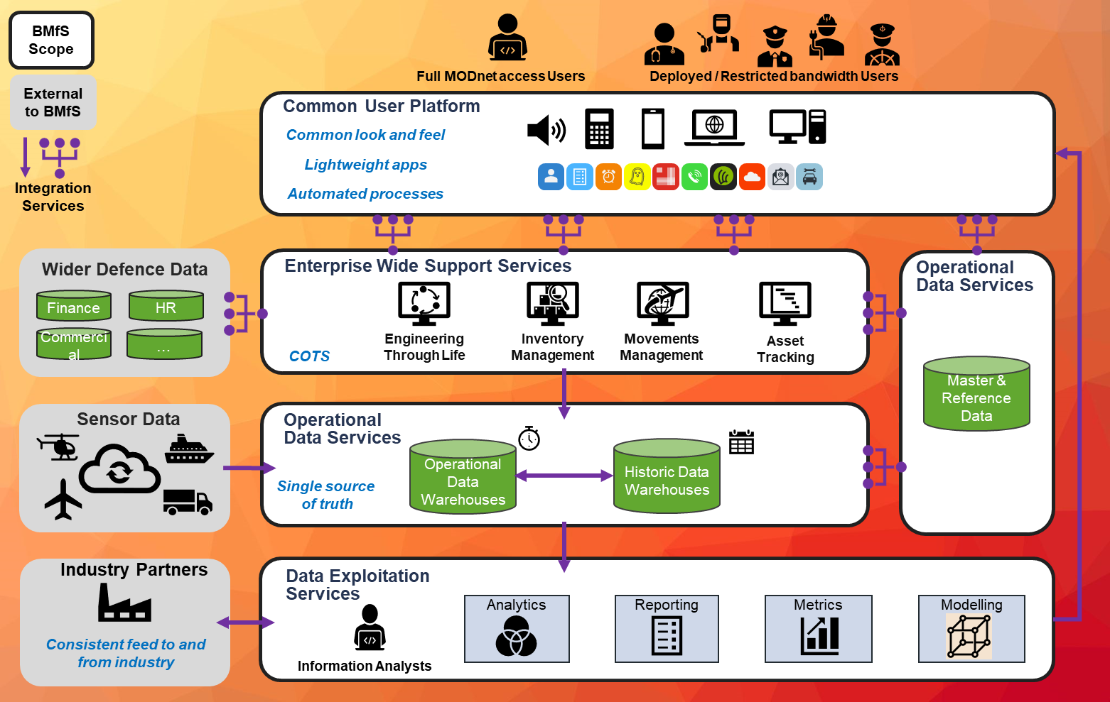
Target Architecture for Defence Support
V2.3
Notes:
We will be following Government Digital Strategy direction and moving away from procurement of vertically integrated ‘Packaged software’ and moving towards a Horizonal Architecture consisting of ‘Services’.
Approach- building out from the Digital Backbone to move away from fragmented technology stacks to integrated platforms. Implication of this is more centralisation (enterprise wide solutions). History shows the advantage of this – decentralisation would result in proliferation of systems and divergence of business process (i.e. replicating today). Let’s remind ourselves that the core of BMfS is process transformation: this is not just technology remediation so we are not looking to replace like-for-like.
Vertical to horizontal:
Improve user experience with a common interface
To access and exploit data across the estate
To enable interchangeability
Bespoke to COTs:
Drive alignment with industry – benefits of easier training and recruitment
Reduce implementation / development costs
Avoid costly through life support and vendor lock in
On prem to cloud:
Evergreen capability
Improves resilience and security
Easier scalability and therefore cost management
The

Slide 28

Managing Complex Pan-Defence SpTx Programmes
The BFM is the one tool you have got to organise the moving parts of a large EAP product. Linking these multiple parts of the programme to BFM, you can talk about them consistently and coherently
Scope mapped to BFM
People mapped to BFM
Systems mapped to BFM
The BFM allows you to understand the scope of the programme across TLBs, and how it impacts other programmes
Stakeholders can see how many people are in each function and redeploy them into value adding areas
Stakeholders can pin-point which business functions are affected by changes in legacy systems. Change impacts, end user engagement and operational capability can be closely managed due to the link between the systems and what functions it supports
Benefits mapped to BFM
Processes mapped to the BFM
Requirements mapped to BFM
Benefits are fully aligned and traceable to the functions of Defence Support. This allows easier tracking and realisation of benefits
Linking processes to the BFM allows standardisation of activities for further value creation
Requirements for new systems can be organised in a way which is aligned across TLBs so we can use one unified set. These are also closely mapped to the scope to ensure full coverage
Notes:
Insight
Heatmap of systems and technology used for each L4 activity
Key Inputs - Interviews, Tech survey
Insight
Heatmap of where FTE are concentrated across L4 activities
Key Inputs - FTE survey, Focus Groups
Insight
Heatmap of value contributions across activities
Key Inputs - Value Add Analysis, Outcome Alignment
Insight
Heatmap of different types of work, (i.e. simple/rote vs. innovation)
Key Inputs – Interviews, Workshop 1 Outcome
Insight
Heatmap of the level of standardisation for each L4 activity
Key Inputs – Interviews, Standardisation Survey
Insight
Heatmap of activities where employees feel the most pain
Key Inputs - Interviews, Workshops , Focus Groups

Slide 29
Systems Architecture and CUP
Intent of the Common User Platform
Consistent single point of entry for all users to access underlying services with single sign on
Basic workflows and simple automation for high volume, low complexity processes
Specialist users routed directly to the underlying services
Hosts small productivity tools that can be deployed at speed to address immediate needs
Means of Delivery
Iterative development through DevSecOps; tooling determined by DefDig (e.g. PREDA / Foundry)
Number of processes will be constrained by capacity, i.e. a fixed team managing a backlog
MOD procure software licences and defined DevSecOps capacity to deliver
Benefits of the Common User Platform
Reduced training burden
Efficiency through automation
Improved user experience
Notes:
Within all this standardisation, we have to retain the option to provide an experience tailored to our users and their roles. This will be achieved through the Common User Platform.
From the industry feedback that we have received so far I believe that there has been a significant misunderstanding of the role of the CUP and I’d like to take the opportunity to address that here. Although the CUP is that single point of entry for the majority of users into Defence Support systems, it is not intended to be the interface through which all functionality is presented. Instead it will be delivering the means to integrate common services with data, allied to basic workflow and automation, such areas as ordering an item or querying a receipt, as well as documentation and training to assist the user execute these processes. Users who do their job day-in day-out with the same information services will expect to pass through the CUP into their application of choice where they will carry on their specialised tasks. But every specialist in one area is a novice in another who will have tasks to do that they won’t remember the intricacies of from one month to the next.
Another aspect of the CUP that shouldn’t be understated is the ‘Platform’ part. This is it acting as a launch pad for small apps which can feed off the functional services offered up from the systems of record, use the workflow, exploit the data services. So how is that going to be delivered? [running into Means of Delivery]

Slide 30
Requirements, KURs and Benefits
Business Modernisation for Support
Notes:
High level notes: Summarise the end-state delivery slide decks briefed to date. Outline the key models being considered and the most likely. Detail the models and the challenges of each (the pros and cons). Highlight that this is always a balance of risk, complexity and ability to achieve the Digital Strategy for Defence and hence Defence long term benefits and goals. It is appreciated that this new approach is quite different to approaches in the past where prime models were used across the full vertical stack. As this is now no longer in accordance with the Digital Strategy for Defence, a horizontal model is now being followed. This will enable pan-defence coherence, allow for greater flexibility, responsiveness, visibility, transparency and also allow greater competition within the tools and services that we need for the next 20-30 years

Slide 31
Requirements Development
20+ Personae
200+ workshops
750+ End users
1600+ User stories
900+ User requirements
~70 Process Maps
400 Risks & Opportunities
As- Is Analysis & Validation
Scenario Scoping
As-Is User Journey Capture
400 Opportunities
To Be Visioning Development & Refinement
Persona Development
Candidate Harmonised User Processes
User Requirements
RMWG
Requirements Management
Working Group
Top Down / Bottom up Requirements
Industry Best Practice
SME
Forums
TLB Senior Stakeholders
Optimised requirements
Maritime
Air
Land
DE&S / SDA
MOD Programmes

Slide 32




TLB Engagement - Priorities and Pain Points
COMMON USER PAIN POINTS
Improved Platform Availability
Sustainability
Military Productivity
Technology to Enhance
Lack of integration
Poor decision making
Duplication of tasks
Unintuitive
Manual duplication of data input
Inefficient ways of working
Wasted time
Operational Effectiveness
Improved Efficiency, Strategic Planning, Cost, Visibility and Control

Slide 33
BMfS Key User Requirements
1
2
3
4
5
Delivering Support advantage through enhanced decision support
Effective Support Services planning to maximise Platform and Equipment Availability and Capability to FLCs
Effective execution of regulatory complaint Equipment maintenance and repair
Proactive orchestration and optimisation of a lean supply chain enabled through end to end transparency
Supply of the right part, in the right condition at the right location
Make faster, better evidence-based decisions to improve outcomes for Defence through access to consistent, accurate and timely information.
Optimise Defence Support Services, maximising Platform capability and availability, through a clear understanding of operational requirements.
Plan and manage the execution of equipment maintenance, repair and overhaul to improve asset availability and sustainability ensuring full compliance with safety, quality, regulatory and performance requirements in line with operational objectives and plans.
Manage and optimise the demand and return of items through a single, transparent information service which orchestrates its provision and timely delivery to optimise asset availability and minimise end to end supply chain costs.
Optimise stock holding based on predicted demand, ensuring minimal inventory levels are available at appropriate locations, in the right condition, at the right time, to improve overall service provision at a reduced cost to Defence.
The User shall be able to…
Notes:
EWSS and the enablers

Slide 34
BMfS Key User Requirements
6
7
8
9
Standardised best practice processes driving efficiency, effectiveness and sustainability across the Defence Support Enterprise
Enabling the efficient delivery of adaptive capability at pace into operations
Driving Business Transformation through enhanced user centric experience and enabling new technology
Improved resilience through an accessible, secure, safe, legal, high availability, and adaptable information services
Deliver Defence Support activities across the Enterprise through common standardised Industry best practices that continue to positively adapt and evolve overtime based on learning to maximise operational outcomes for FLC.
Operate the continually evolving BMfS Services with minimal formal training through provision of intuitive, easy-to-use applications, providing a simplified and enhanced end-user experience, minimising Capability insertion / introduction cost for Defence.
The information services will promote the use of new ways of working, user centric experiences and cultural change exploiting modern IT, process automation and new productivity enhancing technologies.
Discharge Defence support activities through readily available, reliable access globally to a set of secure safe, legal, high availability, integrated and adaptable Defence Support Information services from the Defence Support Node(s) leveraging defence infrastructure coherence.
The User shall be able to…

Slide 35
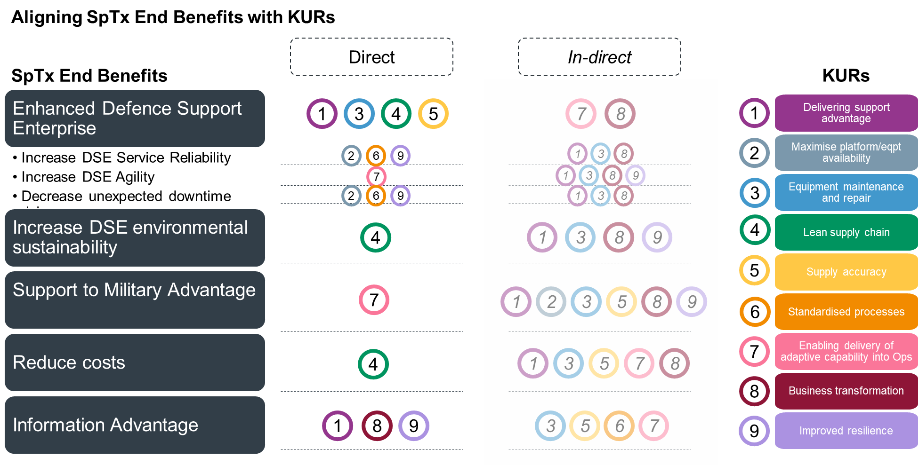

Slide 36
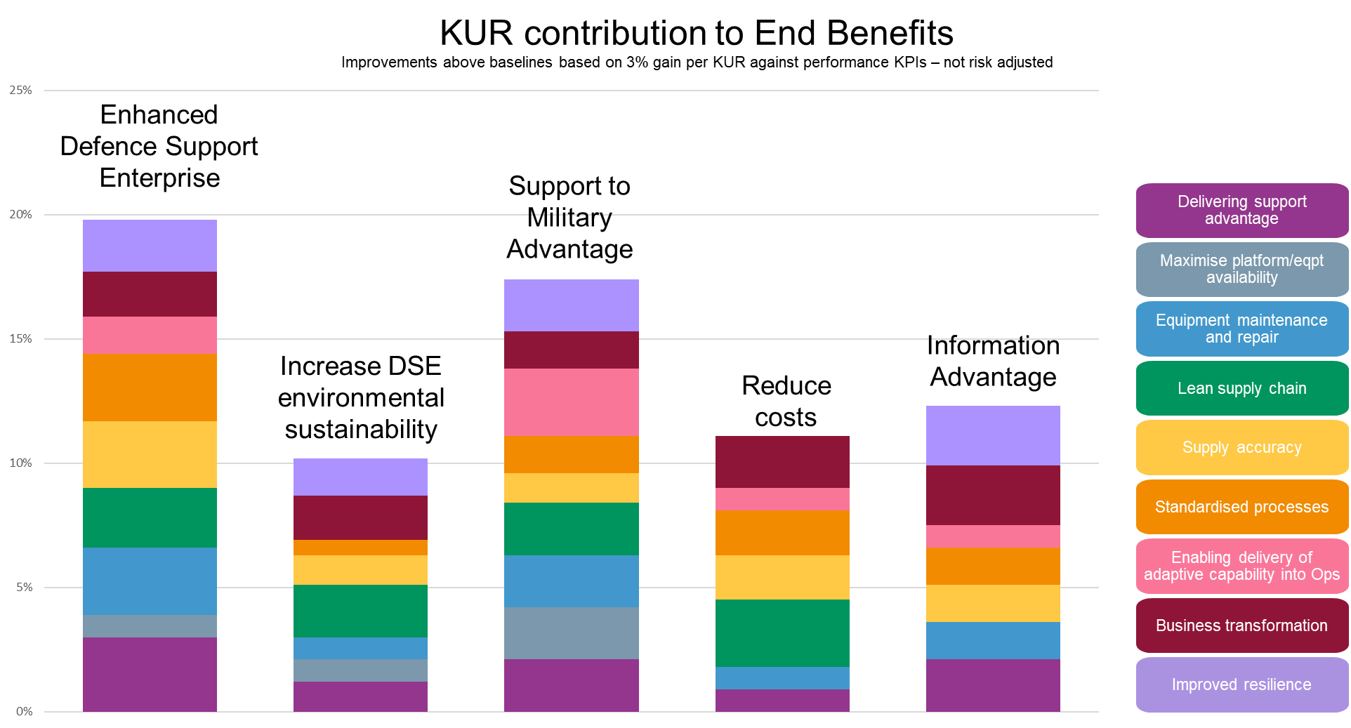

Slide 37
Establishing new ways of working – a new service delivery model
Business Modernisation for Support
Notes:
High level notes: Summarise the end-state delivery slide decks briefed to date. Outline the key models being considered and the most likely. Detail the models and the challenges of each (the pros and cons). Highlight that this is always a balance of risk, complexity and ability to achieve the Digital Strategy for Defence and hence Defence long term benefits and goals. It is appreciated that this new approach is quite different to approaches in the past where prime models were used across the full vertical stack. As this is now no longer in accordance with the Digital Strategy for Defence, a horizontal model is now being followed. This will enable pan-defence coherence, allow for greater flexibility, responsiveness, visibility, transparency and also allow greater competition within the tools and services that we need for the next 20-30 years

Slide 38
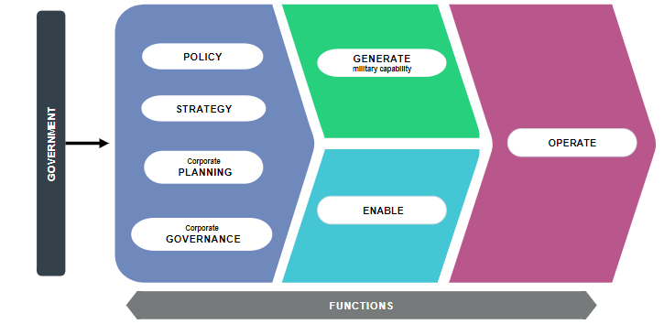
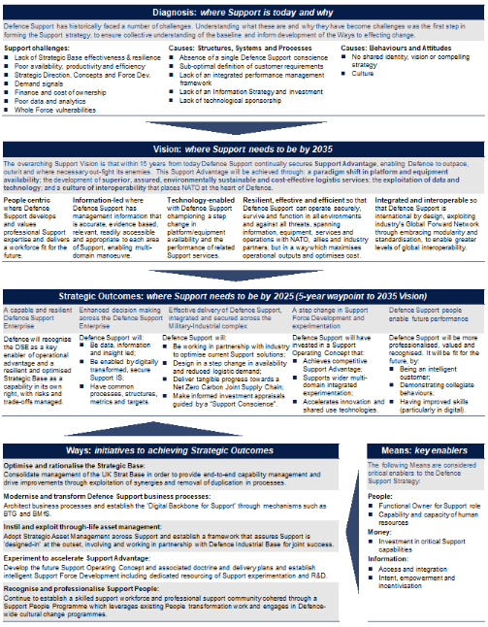
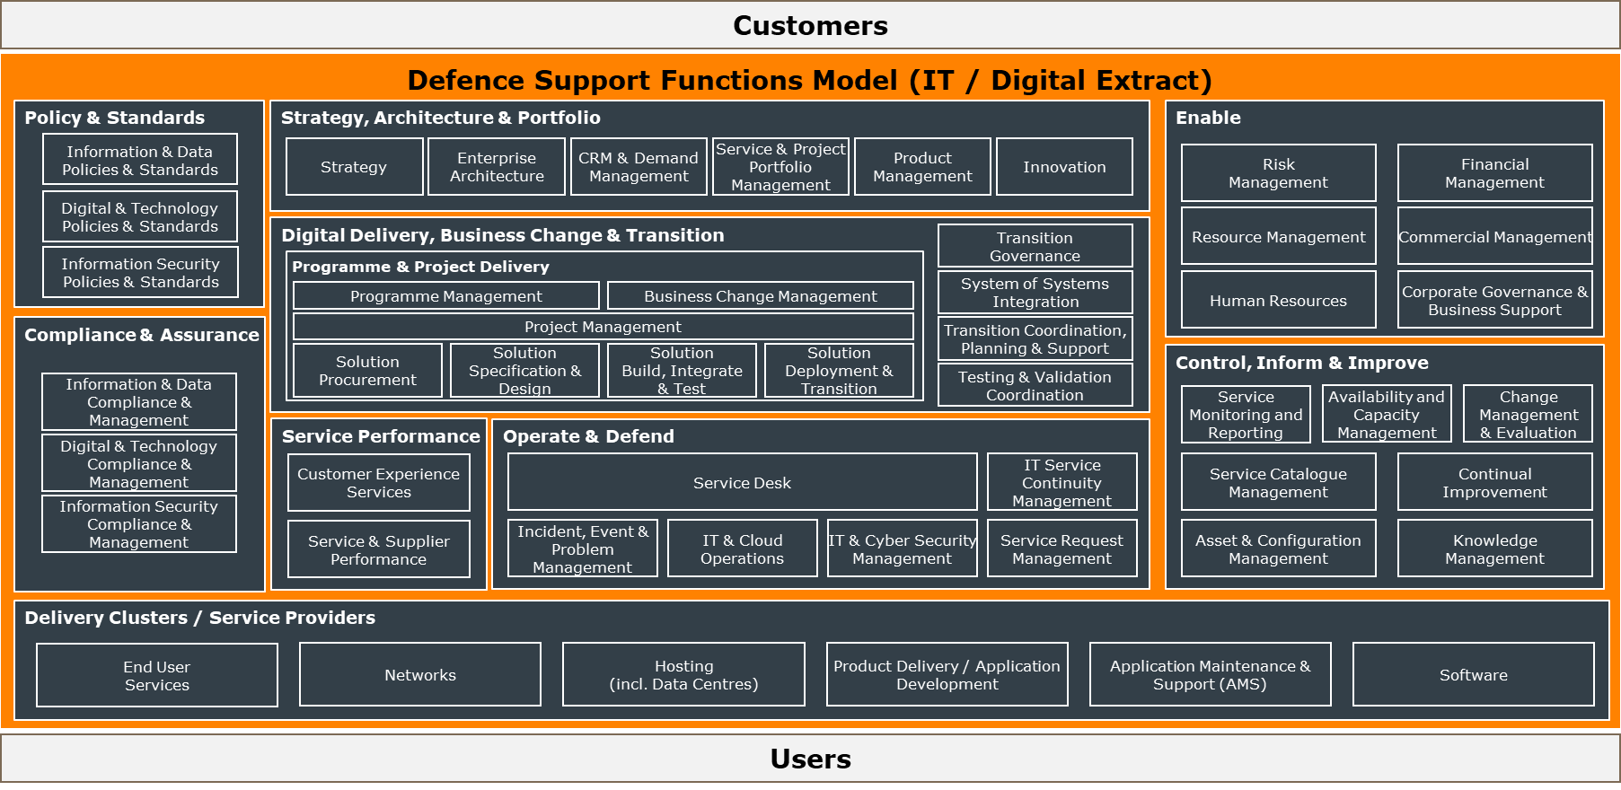
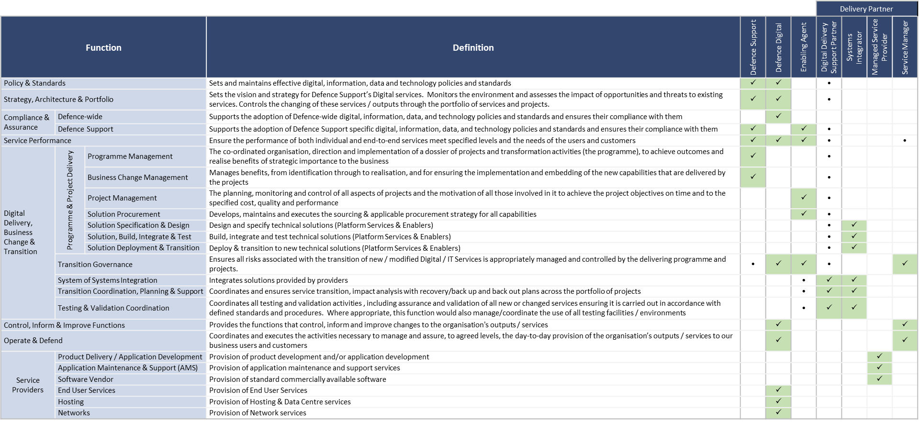
Delivery Partner Model Generation
Defence Operating Model
Defence Support Operating Model
BMfS End State Delivery Model Functions
Functional Model Roles & Responsibilities
Sponsor
Enabling Agent
Delivery Partners
 | Change | Run
Additional Delivery Partner Model Inputs:
Digital Strategy for Defence
Defence Support Strategy
Defence Support Business Functions Model
Defence Digital’s Service Management Framework
Support INFORM Capability Management Plan
BMfS Programme Mandate
BMfS Programme [Transform]
Delivery Partner Model Leverages the strengths of the MOD Enabling Organisations
Delivery Partners workshare and lotting strategies are aligned
D2SP to provide holistic support to all partners defined by Programme Sponsor
Final arrangements for some Managed Service Providers still to be determined
DE&S Digital
Defence Digital
Digital Delivery Support Partner
(D2SP)
Platform System 1 SI
Platform System 2 SI
Enablers Systems Integrator(s)
Service Manager
Def Dig Managed Service Providers
DefSup
Managed Service Providers
Transition
Notes:
Introduce Yourself, I would like to talk about the End State Delivery Model and Proposed Delivery Partner Model
The End State Delivery Model was developed with a number of inputs including DOM, DSOM, Digital Strategy for Defence along with expertise from other Operating Model deployments across government and specific Defence Support Expertise. The model identifies the functions required to be carried out by the enterprise to successfully implement Defence Support using modern IT infrastructure.
Using the End State Functions Model a number of options were generated, these were assessed with technical solution options and the commercial options along with input from the industry RFI responses. This effort resulted in the proposed Delivery Partner Model shown.
As can be seen in the diagram, the team presenting today are from the Sponsoring Organisation, BMfS, it is considered that the BMfS programme with engage a Digital Delivery Support Partner with expertise of Operating Model transformations and Enterprise IT system deployments & multiple system & service integrations to augment the BMfS Programme team.
In line with the Defence Operating Model the BMfS Programme will engage the Enabling Organisations of DE&S Digital and Defence Digital to undertake the lions share of the Source & Procure work, including deployment and roll out to users. The model above shows workshare split between the two identified Enabling Agents that align to the strengths of each organisation, with DE&S digital being aligned to delivering specific programmes of change and Defence Digital delivering continuing services.
The Proposed model is aligned to the Commercial & Procurement Strategy and lotting approach developed using input from the RFI responses. More of which will be presented by Clare Lacey our Commercial Lead a little later today.
This model shows DE&S Digital formally engaging the System Integrators, who are organisations that specialise in the design, deployment, and integration of technologies, applications and infrastructure in order to meet a specific need.
Defence Digital are shown providing the enabling technology solutions through existing agreements such as Hosting; as well as engaging with technology partners to deliver, Data, Tools & Analytics and a Common User Portal (CUP) amongst other items. Once the deployments of the Platform Systems has been accepted, through life support will be delivered through a Service Manager facility provided via Defence Digital in line with ITIL standards.
Finally, there are a number of areas that have not been fully aligned in the final end state model, these are shown as Managed Service Providers which could be contracted by either Enabling Organisation or even the BMfS Programme itself. As we proceed through OBC and on to FBC, this Delivery Partner Model will be developed & refined and more formal articles that detail the scope of work and boundaries for each role will be produced.
Thank you for your time, next up we have XXXXX speaking about the Programme Delivery Approach…
Definitions
Roles within the Delivery Model are defined below. No assumption is made regarding organisations which will hold these roles unless made explicit in the Defence Operating Model (DOM)¹⁵
An Enabling Agent is an Enabling Organisation as defined in the Defence Operating Model. They are an internal MOD Organisation that will source and procure the Delivery Partners, manage performance, and ensure compliance against policy. Optionally they may also coordinate testing, validation and transition as well as transition management
Digital Delivery Support Partner (D2SP). A Defence Support and Enabling Agent partner that provides expertise and specialist skills to support the delivery of the new Defence Support Digital Services and the supporting business transformation.
A Delivery Partner (DP) is an external organisation that undertakes a coherent set of functions. For the purposes of this analysis the following types of DP have been identified:
Systems Integrator. An organisation that specialises in the design, selection, and integration of technologies, applications and infrastructure to work together in order to meet a given customer need
Service Manager. An organisation that manages the day-to-day provision and change of IT services provided by multiple managed service providers so as to ensure an agreed level of end-to-end services is maintained
Managed Service Provider (MSP). An organisation that provides one or more specific IT services. It can be either internal or external to the customer organisation
A Delivery Partner undertakes their role in relation to a defined scope of IT services. For example:
A Managed Service Provider may be responsible for the maintenance of a defined portfolio of applications
A Systems Integrator may be responsible for the design, selection and integration of one or more platform services, that in turn may be exploiting a series of enabling IT services that have been built and integrated by another systems integrator.

Slide 39
Developing a robust and deliverable programme
Business Modernisation for Support

Slide 40
What are we buying…
BMfS scope and requirement within Defence Support ETLS
Enterprise-wide Support Services
ETLS
Inventory Management
Movements Management
Asset Tracking
Enablers
ETLS
Inventory & Warehousing
Movements & Transport
Asset Tracking
CUP
ODS
Breakdown:
Maintenance, Repair & Overhaul
Asset Management
Systems Integration
BFM L1 Mapping:
Obsolescence
Asset Management
Maintenance & Repair
Technical Information
Recondition / Repair Requesting
Fleet Management
Safety Management
Engineering Planning
Breakdown:
Inventory
Warehousing
Specialist add-ons (fuels, food, munitions)
Systems Integration
BFM L1 Mapping:
Inventory Management (Base and Deployed)
Warehousing
Note: demand forecasting delivers Decision Support Service but is bought as part of Inventory / Warehousing lot
Includes munitions / foods / fuels as specialist scope
Breakdown:
Transport Management System (TMS)
Global Network Design (modelling tool)
Customs compliance
Air passenger movements
Specialist add-ons
Systems Integration
BFM L1 Mapping:
Movements and Transport
Breakdown:
Asset tracking
Systems Integration
BFM L1 Mapping:
N/A
Note: asset tracking sits across logistics support in the BFM but is not called out specifically
Breakdown:
Custom User Interface licenses
Business Process Orchestration licenses
DevSecOps licenses (PREDA).
Systems Integration
Breakdown:
Master Data Management licenses
Specialist application licenses
API integration
Systems Integration
Data Exploitation Service
Breakdown:
Logistics Planning: Demand (material requirements) Forecasting licenses, Systems Integration
Data Exploitation Services: Data tools (DT&A) licenses, Specialist add-ons (TBD) licenses Systems Integration, Logistics Support Reporting and Performance Analysis
Decision Support
Logistics Planning

Slide 41

All dates are deterministic*
Q1 22/23 | Q2 22/23 | Q3 22/23 | Q4 22/23 | Q1 23/24 | Q2 23/24 | H2 23/24 | H1 24/25 | H2 24/25 | H1 25/26 | H2 25/26 | FY 26/27 | FY 27/28 | FY 28/29
Concept Phase
Assessment & Demonstration Phase
Manufacture & In-Service Phase
EWSS SI FBC
BMfS SOC
BMfS OBC
BMfS FBCs
BMfS Pgm OBC Outletter inc. DEEAMS
TMS FBC
Approvals
Develop OBC inc. DEEAMS Approval
Additional Approvals for EWSS Tooling & MSPs
Enablers
CUP &
ODS DoF
CUP/ ODS/ DT&A Tooling Procurement
CUP
Iterative releases against a prioritised backlog
Develop the CUP/ ODS/ DT&A Requirement
DT&A
Establish DevSecOps Teams
ODS
Data
MVP
Support Data Warehouse Data Archive Service Data Exploitation Services Decision Support Capability
Platform Services
Develop the DEEAMS Requirement
DEEAMS Competition
Feature Development inc.
unlock additional Asset Management capability
ETLS
DEEAMS FBC
User migration
Approvals
Systems Integration
IOC
FOC
Movements Management
Legacy analysis
TMS Procurement
Movements Management Competition
Systems Integration
Requirements development
Inventory Management
Legacy analysis
Requirements development
Capability Assessments
Additional IM Competitions
BIWMS+
IOC
Service Management OSM
MSP
MSP
MSP
Digital Backbone
MoDCloud Hosting
Digital Foundry
41
IDAM
Official

Slide 42
Indicative dates for industry
 | 2022 | 2023 | 2024 | 2025 | 2026 | 2027
ETLS (DEEAMs)
Remaining EWSS
Enablers including CUP, ODS, DT&A, Hosting, DevOps
Digital Delivery Support Partner (D2SP)
SI
Competition Launch
Contract(s) Award
Release 1
MSP
Number of contracts and awards to be determined
Competition(s) Launch
Multiple releases for different services
MSP
Leverage MOD enterprise toolsets including elements of the Defence Digital backbone
DevSecOps Teams
Iterative releases against a prioritised backlog
Onboarding
Competition Launch
Contract Award
All dates are indicative only and should be considered as "not before" dates; a number of factors could result in later start dates than shown.
Official

Slide 43
Lunch
Notes:
Good afternoon Ladies and Gentlemen, my name is Clare Lacey and I am the Commercial lead within the BMfS programme.
Everything you have heard so far today details the structure, the intent and explains where we are in the programme.
All this is bound by what is possible in the commercial domain and as you are aware, we have to operate within both Government and MOD procurement rules.
Over the next few slides, I will take you through the Commercial principles that define how we will operate within the BMfS programme and how this aligns with the market.
I will then summarise our proposed lotting approach that groups our requirements prior to engagement with the market.
At this stage, this is indicative and subject to approval. However, we have been engaging with the scrutiny community with regard to the approach that is being briefed today and indications are positive.
The commercial approach taken should enable the benefits to be realised resulting in flexible, accessible, adaptable, and cost-effective market leading services that will suitably support the MOD into the future.

Slide 44
Commercial Approach
Business Modernisation for Support
Notes:
Good afternoon Ladies and Gentlemen, my name is Clare Lacey and I am the Commercial lead within the BMfS programme.
Everything you have heard so far today details the structure, the intent and explains where we are in the programme.
All this is bound by what is possible in the commercial domain and as you are aware, we have to operate within both Government and MOD procurement rules.
Over the next few slides, I will take you through the Commercial principles that define how we will operate within the BMfS programme and how this aligns with the market.
I will then summarise our proposed lotting approach that groups our requirements prior to engagement with the market.
At this stage, this is indicative and subject to approval. However, we have been engaging with the scrutiny community with regard to the approach that is being briefed today and indications are positive.
The commercial approach taken should enable the benefits to be realised resulting in flexible, accessible, adaptable, and cost-effective market leading services that will suitably support the MOD into the future.

Slide 45
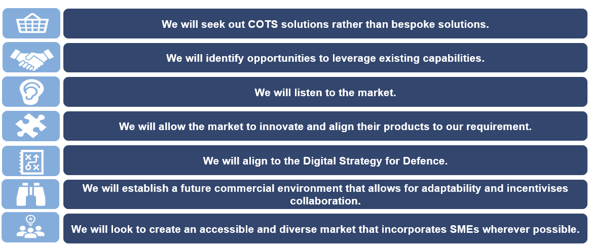
The BMfS Commercial Principles
A set of principles have been established to guide all commercial activity on the BMfS programme. The seven principles focus upon the acquisition of Commercial Off The Shelf (COTS) products wherever possible, early and continued market engagement, and the establishment of the correct commercial environment for the BMfS programme.
Notes:
I will start with the commercial principles that underpin everything we are doing within the programme.
These principles are the practical application of the Digital Strategy for Defence and will need to apply to the majority of our existing services going forwards.
These 7 Commercial principles as shown are a break to how we have obtained software services from suppliers in the past. As mentioned by James this morning, we are migrating from a vertically integrated model to a horizontally integrated model and elements of this can be seen here in these principles.
Starting at the top, we intend to seek COTS solutions throughout. Our aim is to avoid bespoke solutions and want to take industry standard approaches wherever this is possible. This will enable the provision of the “evergreen” aspect of the programme’s vision. COTS and therefore configuration as opposed to customisation is the key principle that threads through this programme.
Number 2: we will leverage existing capabilities wherever possible. This applies to existing services, assuming they are compliant with the both technical and commercial principles.
Number 3: we will listen to the market. As you are aware, we have already conducted several RFIs to date where suppliers have provided feedback that has already assisted the direction of the programme. James has already detailed some of the key messages that have been received.
Principle Number 4: centres around innovation with significant crossover with collaboration. As we covered during previous sections, the vertically integrated model of providing services from software selection through configuration and integration with subsequent service management has not facilitated and restricted large degrees of innovation. It has also created commercial barriers between services and prevented economies of scale and the flexibility we really need as a modern support provider for Defence.
Number 5: is that we must align ourselves around the Digital Strategy for Defence and I therefore recommend that you familiarise yourself with its contents, this can be found on the GOV.UK Website. This strategy contains commercial principles within it as it drives behaviours across the MOD as we migrate to being a data driven organisation.
Principle 6: is focused on an adaptable and collaborative commercial environment with incentives that drive positive enterprise level behaviours. This means there will be a number of contracts with multiple vendors, large and small operating and developing alongside each other across multiple services as the environment, tools and operating model evolves over time.
Number 7 encourages multiple suppliers to work alongside each other, bringing in small and medium sized enterprises that can bring new thoughts and innovative ways of thinking. In the long term, we intend to create an eco-system of suppliers that can operate collaboratively at all levels of the support enterprise. The intention is that each will be project based to create and roll out a change that endures.

Slide 46
Simplified view of the lotting approach
Some of the Service Management element is expected to be delivered by Defence Digital. There may be a requirement for further capability in this area.
Service Management Layer (SIAM)
Overarching Systems Integrator?
The structure of the Systems Integration requirement is to be determined. We are seeking insights from the market on the correct structure to apply to the BMfS programme.
Enablers Systems Integrator
EWSS Systems Integrator
DEEAMS Systems Integrator
The DEEAMS requirement, previously ’ETLS’ in the RFI process. This has been separated out to capture an opportunity presented by the joining of FMMS and JEMMA into a pan-defence ETLS.
Hosting
Movements Management
DEEAMS
DevOps
Inventory and Warehousing
The intent is to 'bundle' the remaining EWSS elements to reflect feedback from the RFI process. The extent to which these elements should be bundled or separated needs to be tested further through industry engagement.
CUP
Asset Tracking
ODS
The Enablers are likely to be supported by smaller framework procurements e.g., an MDM requirement/AI or ML tools/API Dev resource. They represent unique requirement sets and are therefore separated.
DT&A
Notes:
Now that we have covered the commercial principles, I would now like to move to the lotting approach and how we intend to split the programme into appropriate groupings.
This slide details how we expect to group activities and hence contracts. This represents how the MOD expect to procure services in the future and it will act as a blueprint for service provision going forward. BMfS is therefore leading the way in how we procure services going forward.
The lotting approach has been developed iteratively through the requirements development process and reflects both market feedback and industry best practice.
To explain the slide in more detail, the black boxes at the bottom that includes hosting, DevOps, Movements Management and DEEAMS represents the procurement of software. The intent here is that the MOD will procure software and then employ a systems integrator to configure it.
The systems integrator will configure the software and then hand it over to the service manager. This way, systems integrators are employed on a project by project basis, handing over to a service manager who will maintain it in the long term. MOD will own the software licencing and the software configuration to allow multiple suppliers to operate within the software to increase flexibility, agility and increase the potential for innovation. This will also allow significant surge capacity should the need arise.
If a single supplier holds the licence and owns the configuration, this is not possible and a collaborative eco-system of suppliers is extremely difficult to realise in the long term. As stated by James earlier, we are trying to work towards an eco-system of support across Defence who work collaboratively. This can only be achieved by having open relationships and ownership that can be shared across the enterprise.
A programme level decision was taken to launch the DEEAMS programme early due to customer need and the close down of JAMES and JEMMA. We will explain DEEAMS in more detail in the next section.
The number of lots is currently fluid and this picture has been designed with the intent of testing it further with the market which we will look to test during the industry workshops in a few weeks time. It is perhaps better to refer to these as ‘service groupings’ at this stage.
There are two main discussion areas that will be key at the Industry Workshops and worth highlighting in this brief. Firstly we will need to discuss what is the correct way to establish the systems integration structure. Is it one overarching integrator? Multiple with an overarching integrator? Or multiple with a selected ‘lead’ Integrator? The second area is the EWSS space. To what extent should the MoD bundle the EWSS requirements? Is a single contract a better approach, if so, why?
We need to note here that a key point in this model is the separation of software choice and licencing, the Systems Integrator and the Service Manager. The MOD will hold the licences as it will be managing the software services for their lifetime.
All intellectual property such as product configuration will be held by the MOD and allows multiple vendors to adjust the configuration in the future. This also retains flexibility and drives performance and competition, increasing SME involvement and allowing variation of suppliers.
We will be attempting to undertake as much procurement activity as is possible through established frameworks. However if these frameworks are not suitable our intension will be to utilise the restricted procedure in line with government and MOD policy.

Slide 47
Next steps for the lotting approach
Service Management Layer (SIAM)
During the industry workshop 21 June there will be a dedicated section on lotting approaches. The key elements to be discussed will be:
The structure of the Systems Integration elements.
The extent to which the EWSS elements should be bundled or separated.
In line with the commercial principles of the Programme, we would like to test approaches potential suppliers and gather constructive feedback.
Overarching Systems Integrator?
Enablers Systems Integrator
EWSS Systems Integrator
DEEAMS Systems Integrator
Hosting
Movements Management
DEEAMS
DevOps
Inventory and Warehousing
CUP
Asset Tracking
ODS
DT&A
Notes:
So to recap the next steps for our lotting approach in line with our commercial principles is to run Industry Workshops that will test the approach with suppliers and gather constructive feedback. We are looking to hold this workshop at the end of June where we will have a dedicated session on the lotting approach. The key elements we will want to discus will be:
The structure of the Systems Integration elements.
The extent to which the EWSS elements should be bundled or separated.
And the positioning of the Asset Tracking and Decision Support elements.
And we very much welcome supplier support during these workshops.
This now concludes the commercial section of the briefing, and I welcome any questions during the Q&A session at the end of todays briefing.

Slide 48
DEEAMS
Defence Equipment Engineering and Asset Management System
Lt Col Simon Mansfield

Slide 49
The why
Pan-Defence Investigation
Position Paper Delivered
As At
01 April
Sprint 1
Understanding Domains Needs
Sprint 2
User Requirements
Sprint 3
Enablers
Sprint 4
Programme Plan
Live Replacement Projects
We
Are
Here
GO
BMfS
2* Strategic Decision
FMMS
Defence ETLS System
JEMMA
Notes:
Copy and paste sprints rather than URD etc.

Slide 50
The what
BMfS now has a mandate to deliver an ETLS capability across Defence
Delivery of the Pan Defence ETLS Capability has been split into logical tranches based on business need and the migration of groups of users with an intent to allow new Naval platforms to roll straight onto the new DEEAMS platform from FY 24/25.
The System will aim to deliver the Engineering areas of capability detailed in the Business Functional Model and begin to address elements of Asset Management.
The Project to deliver the Pan Defence ETLS capability will be formally known as the Defence Equipment Engineering & Asset Management Systems (DEEAMS).

Slide 51
The how
The Ask
Expectation
Consolidate current Air, Land, Sea assets (including complex weapons and medical devices) onto a single pan Defence platform, through consolidation of the existing applications (GOLDesp / JAMES / UMMS/NAWDAS*)
Transform the way we provide capability to our Front Line Customers through adoption of standardised industry best practices & processes and new technology
  Increasing Asset Availability
  Improving Productivity
  Continue to adapt to changing threats
Remove obsolescence Risk
*Naval Armament Weapons Database Analysis System
Proven (Scale & Complexity) COTS solution with a clear future roadmap
Solution that satisfies our requirements with minimal customisation
A collaborative partner that will ensure their product continues to meet the evolving requirements of Defence
Realise the intended benefits for Defence in line with the Digital Strategy for Defence
Certainty of delivery
Innovation and leading thinking

Slide 52
DEEAMS BFM Scope
DEEAMS functional scope can be defined via the Business Functional Model (BFM). The wider BMfS addresses the Planning and delivery of Equipment and Logistics Support Capabilities. The DEEAMS solution will specifically address Engineering Planning and Equipment Support Capabilities.
BFM Level 1 Capability
BFM DEEAMS Level 2 Capability
BFM DEEAMS Level 3 Capability
Strategy
Maintenance Planning
Engineering Demand Forecasting
Planning
Engineering Planning
Engineering Resource Definition & Planning
Fleet Composition
Fleet Acquisition
Bringing in to Service
Fleet Management
Manage Fleet Management
Fleet Sustainment
Logistics Support
Asset Management
Asset State Management
Asset Configuration Management
Maintenance Capability Management
Equipment Support
Maintenance and Repair
Maintenance Facilities Management
Maintenance
Enabling
Fault/Incident Management
Technical Information
Technical Information Maintenance
Certification
Other Business Capabilities
Obsolescence
Technical Documentation Delivery
Obsolescence Capability Management
In Scope
Obsolescence Task Execution
Out of Scope
Safety Management
Obsolescence Task Management
Obsolescence Direction and Reporting
Official

Slide 53
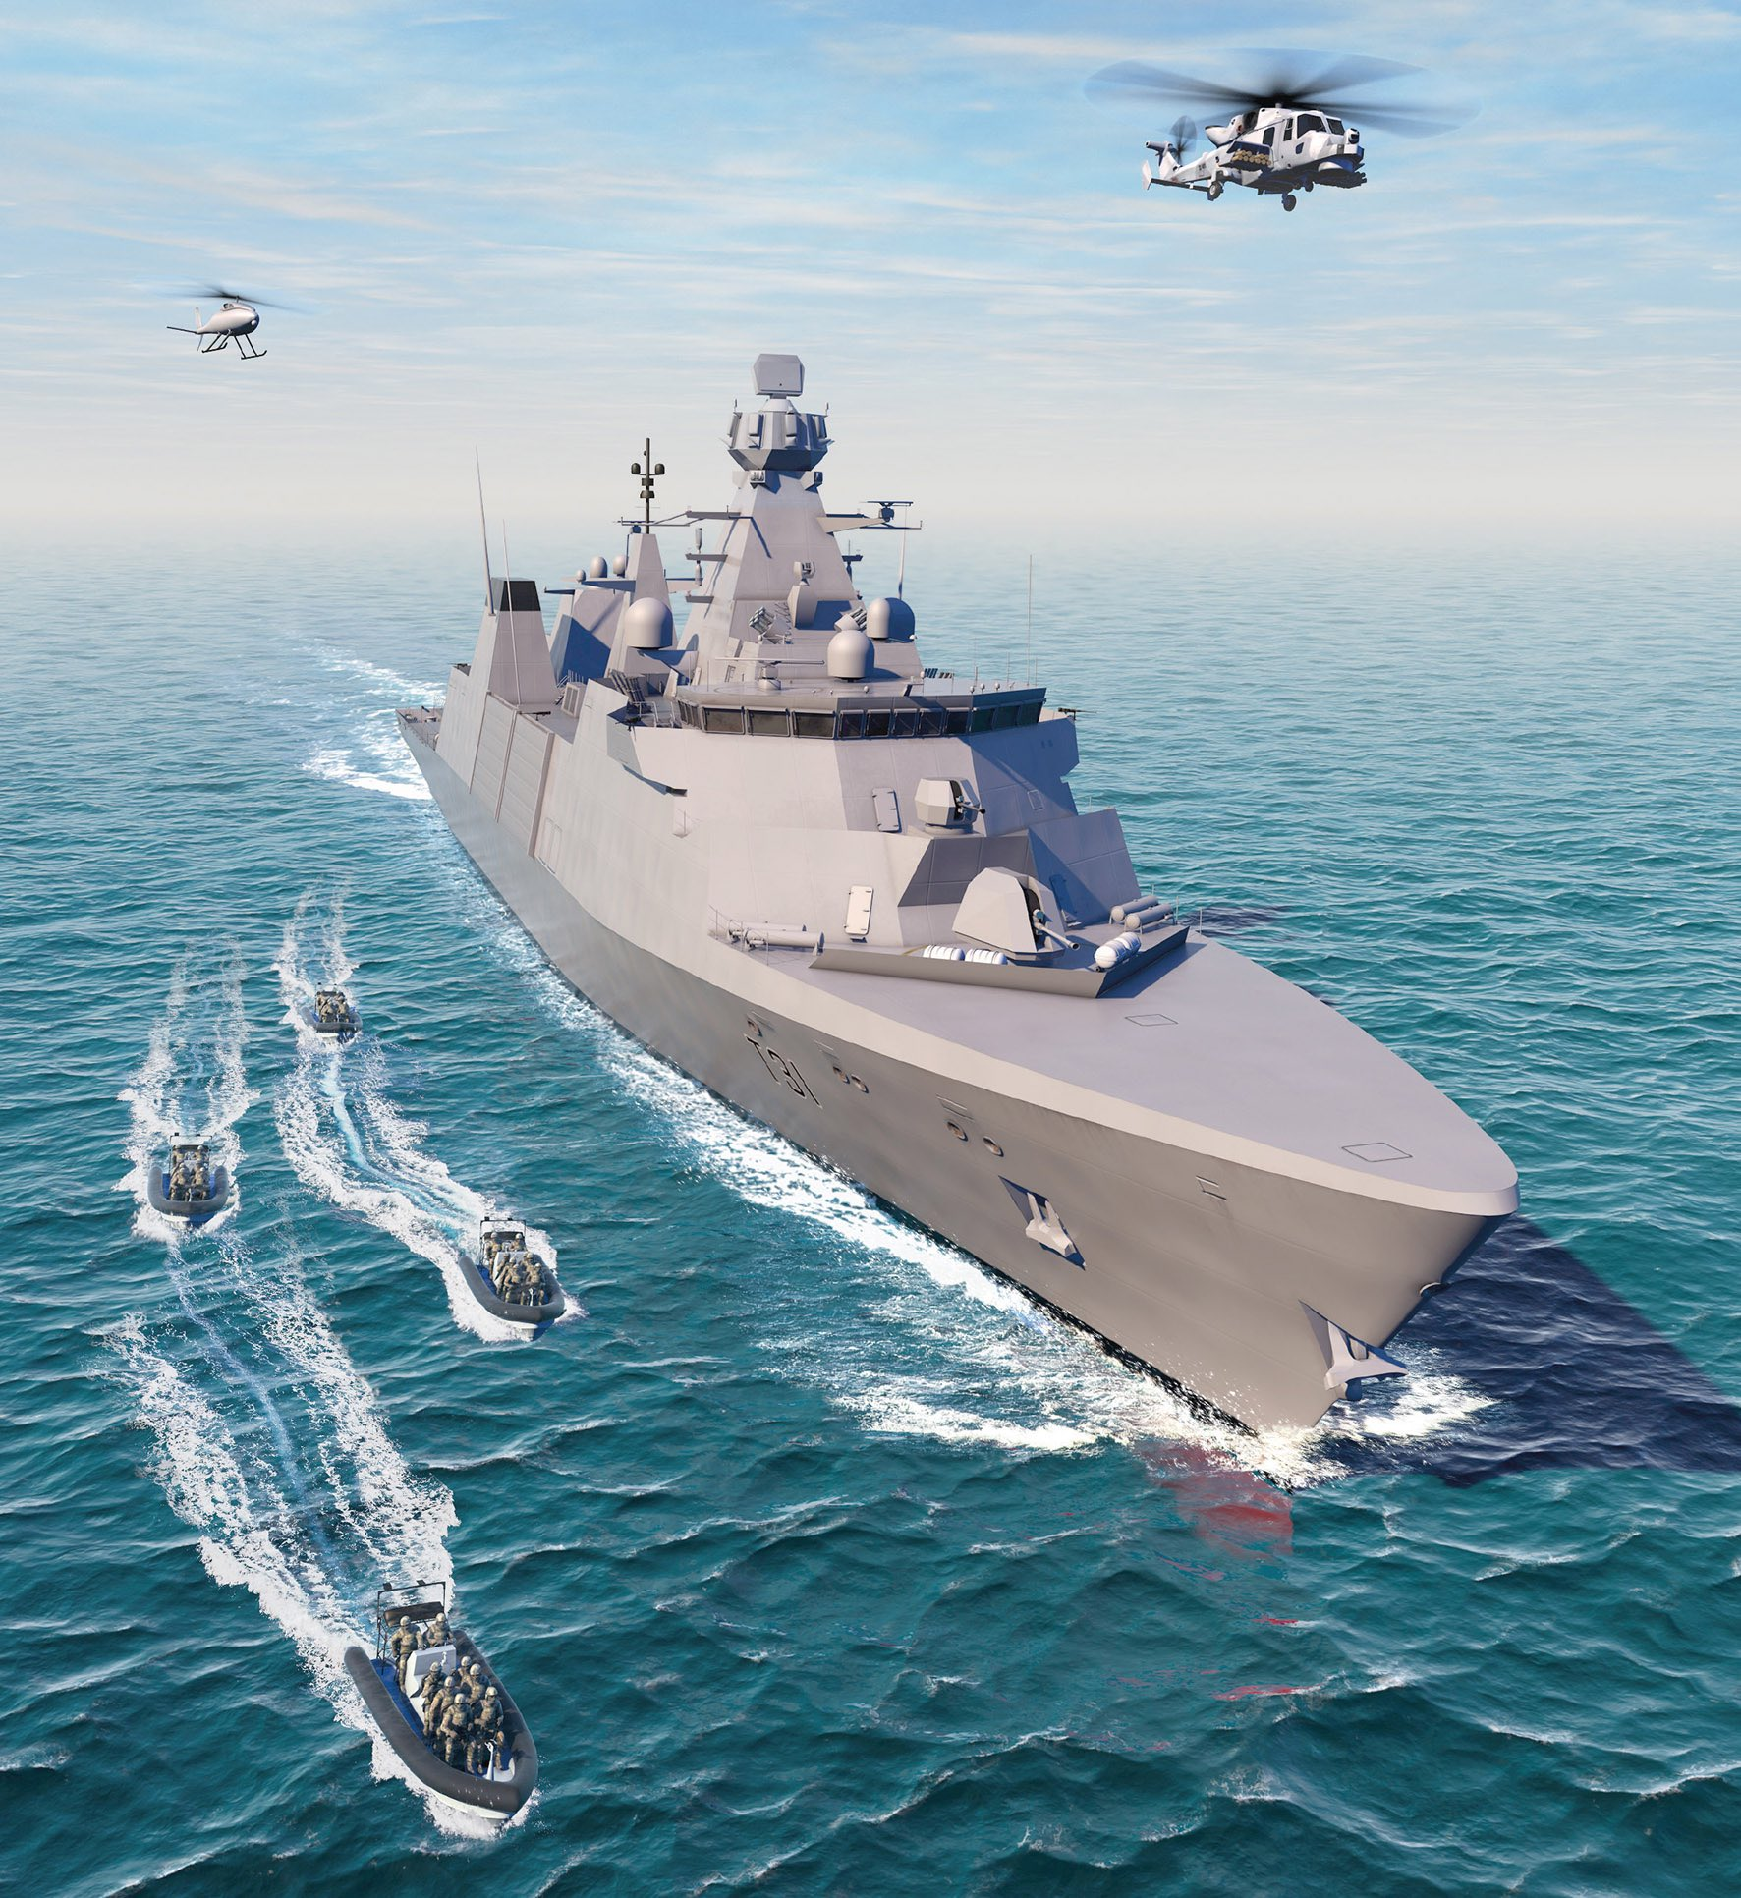
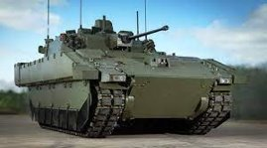
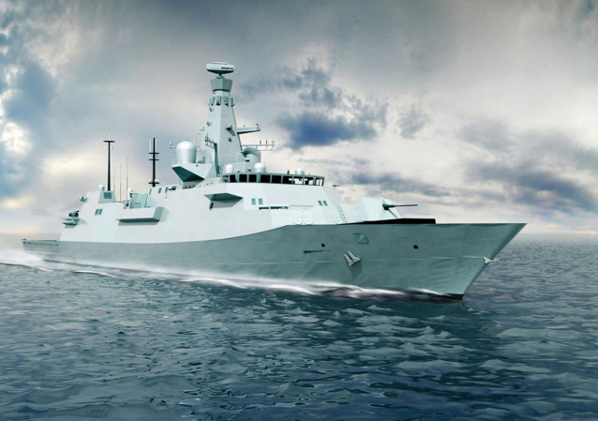
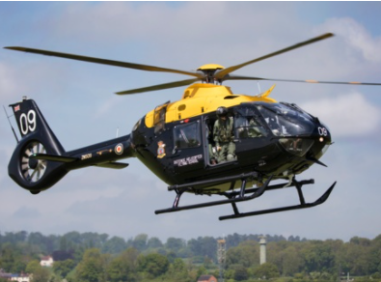
Indicative Phased Release Plan
Q1 | Q2 | Q3 | Q4 | Q5 | Q6 | Q7 | Q8 | Q9 | Q10 | Q11 | Q12 | Q13 | Q14
Contract Award
Release 1
Maritime MVP
New Platforms only
No Data Migration
Release 2A
Land IOC
Migration of JAMES assets onto DEEAMS
Release 2B
Maritime IOC
Migration of UMMS assets onto DEEAMS
Release 3
Air/Land/Navy FOC
Migrate Golds and apps associated with rotary or fixed wing
Upgrade additional functionality to all
Release 3+
All
Enhancements in line with vendor upgrades
Go Live
Bug Fixes
Enhancements
Official
Copyright © 2021 Accenture. All rights reserved.
53

Slide 54
DEEAMS Key User Requirements
1
2
3
4
5
Optimisation of Planning
Maintenance Activity
Asset Lifecycle
Data & Analytics
Safety & Technical Information
Maximise platform availability through optimising planning, considering all relevant constraints. Utilise efficient planning techniques and tool sets to deliver cost effective, maintenance activities which ensure full compliance with safety, quality, regulatory and performance requirements.
The solution must support execution, monitoring, and inspection of all planned and unplanned maintenance activities, exploiting advanced digital technologies, ensuring adherence to quality & safety standards, functional expectations, and assurance.
The solution should allow the management of all assets throughout their lifecycle along with any associated approvals. Management of assets should include fleet composition, configurability, availability, assignment and obsolescence.
The solution should provide stakeholders with data insights to enable effective decision making, providing support chain information advantage.
The solution should support the system-wide distribution, control and auditability of technical and safety information including legislative and policy documentation, data and design.
The User shall be able to…

Slide 55
DEEAMS Key User Requirements
6
7
8
9
Standardisation – Joint Force Capability
Training
Accessible, secure, safe IT
Integration
The solution should support a defined standard set of Defence Support Network activities, which allow for optimal operational performance for each Front-Line Command, promoting interoperability in defence, and enabling spending efficiencies.
The solution should be simple, intuitive, and easy to use, supported by on-demand digital training to ensure that any user with basic computer skills can operate with minimal training.
The solution should be secure by design to ensure that users can discharge defence support activities through robust, secure, legal and high availability infrastructure.
The solution should exchange and share information seamlessly with supporting systems to allow for exploitation of relevant data throughout the value chain.
The User shall be able to…
Official
Notes:
EWSS and the enablers

Slide 56
DEEAMS Engagement & Delivery
DE&S Digital is the DEEAMS Enabling Agent responsible for Project delivery and will be the commercial lead for procurement.
The BMfS’ role is to act on behalf of the SRO (AVM Hill) to coordinate delivery and lead business change activities across Defence.
All DEEAMS communications relating to procurement activities should be channelled to DES Digital Commercial: to Sarah Mitchell <Sarah.Mitchell664@mod.gov.uk> Nick Clarke <Nick.Clarke425@mod.gov.uk
The delivery approach and timings are subject to approval and so should be treated as indicative.
DE&S will next engage the market during FY 22/23 Q3 to outline the approach and timings for the DEEAMS competition.
Respectfully request that suppliers do not contact Front Line Command customers and Senior Programme staff outside of the proposed commercial channels. All DEEAMS correspondence should be directed to the accounts above.
A BMfS Technical workshop (including the DEEAMS requirement) will take place on the 21 June.
Official

Slide 57
Panel Q&A
Business Modernisation for Support

Slide 58

Panel Q&A - Our Panel Members
Dir BMfS
James Daniel
Dep Dir BMfS
?
Ed Roberts
Q&A
Support CIO
Richard Puttick
Commercial Lead
Clare Lacey
Please submit questions via Slido
www.slido.com
Code: 02658213
Change Lead
Gavin Lenthall

Slide 59
Summary
Business Modernisation for Support

Slide 60
Panel members
Key messages
Impact of BMfS on the MOD
Impact of BMfS on the Supply Chain
Horizontal vs vertical integration will change commercial and technical interactions
Adopt COTS throughout – acknowledge significant impact on business change
This is a business transformation programme, not just an IT update
Collaborative vs transactional relationships
Much greater focus on data ownership
Ownership of the end-to-end support process
Develop capabilities to assess, analyse and interpret data to transform it into useable information
Pan-Defence coordination of support transformation projects
Horizontal vs vertical integration will change commercial and technical interactions
Eco-system of suppliers working collaboratively, separating licencing, system integration and service management
MOD will own data and system config
Multiple vendors configuring services within a common environment (creating a support eco-system)
Open architecture, open standards, open APIs
Configured COTS (not bespoke customisation)
Visibility of data across the support domain
Notes:
Impact on the MOD:
Horizontal vs vertical
COTS – a lot of the enterprise will need to realise that they are “not special” and will need to adjust or change wholesale their processes
Business and process transformation. This is NOT a replacement IT project. It’s accepted that there will be a lot of process and behavioural change required across the business and the impacts will be significant
Collaborative vs transactional – the MOD has traditionally been difficult to work with. We are seeking to change this and a collaborative relationship around the Digital Strategy for Defence is the key starting point
Data ownership – it is understood that Defence does not have a good sense of ownership of data. This programme gives us the opportunity to change that – usable tools applying industry standard processes that draw on an accurate and trusted single source of the truth.
Turn data into information and then knowledge. At present, We struggle with the data but this transformation will change that
Pan-Defence coordination - we know that there are multiple change and transformation projects across Defence. We are now coordinating those in the support arena and ensuring that we are no longer working against each other or paying for the same thing twice. DEEAMS is a good example of this and there are others. More will come along as we start to coordinate MOD tools, processes and the environment within which they operate. We are making progress in preventing the “good ideas club” from having too much of a field day.
Impact on the Supply chain:
Horizontal vs vertical
Eco-system of suppliers – this is a significant change from the status quo. At present, suppliers work within their own silo with only managed interaction outside their silos (if any). The separation of licencing from system integration and service management means we can ensure we don’t create technical debt and lose all flexibility. All contracts will be project based that will handover on completion to the MOD or a new supplier. MOD will buy, hold and maintain software licences. System integrators (from large to small) will configure the software products and then hand that configured software over to the MOD who may then in turn either use an outsourced service manager to maintain it or do it internally. Projects will be large and small, long and short in duration. We can surge capacity based on the need and specialisation. It allows us to apply niche suppliers to satisfy a specific and sometimes urgent need, all based on the architecture detailed in the Digital Strategy for Defence
A key point of this separation is that there will no longer be 20-30 year contracts
All of this is based on the MOD owning the data and the system configuration with suitable support documentation. It requires open architecture, open standards and Open APIs to ensure that this lack of technical debt can endure
To enable the evergreen requirement in our vision, the systems need to be configured and not customised or bespoked and that data is visible and accessible across the support domain
In final summary, this is a big change in commercial and technical approach by the MOD and much of it is driven by the Digital Strategy for Defence. If you haven’t read and digested it yet, please Google and download it because this is the future of Digital and Support Transformation across UK Defence.
I thank you very much for your time and engagement………..
Reiterate the benefits and the challenges
Challenges
A major change in how MOD procures IT services. There will be challenges as we migrate to a new business model
Whilst not one big opportunity, opens up many other opportunities pan-Defence
Key success factor - adapting to the new environment
MOD can't use industry best practice procurement so we must compromise; this will be long journey
A “brownfield” site
Benefits
Enable innovation, continuous improvement and development
Collaborative environment – disincentivise transactional relationships
Industry best practice: make it easier for suppliers to satisfy MOD requirements
Fewer specialised resources required - more flexible workforce
Flexibility and agility across defence and the supply chain
Make it easier to do business with the MOD

Slide 61
Close
Business Modernisation for Support

Slide 62
BFM Overview

Slide 63
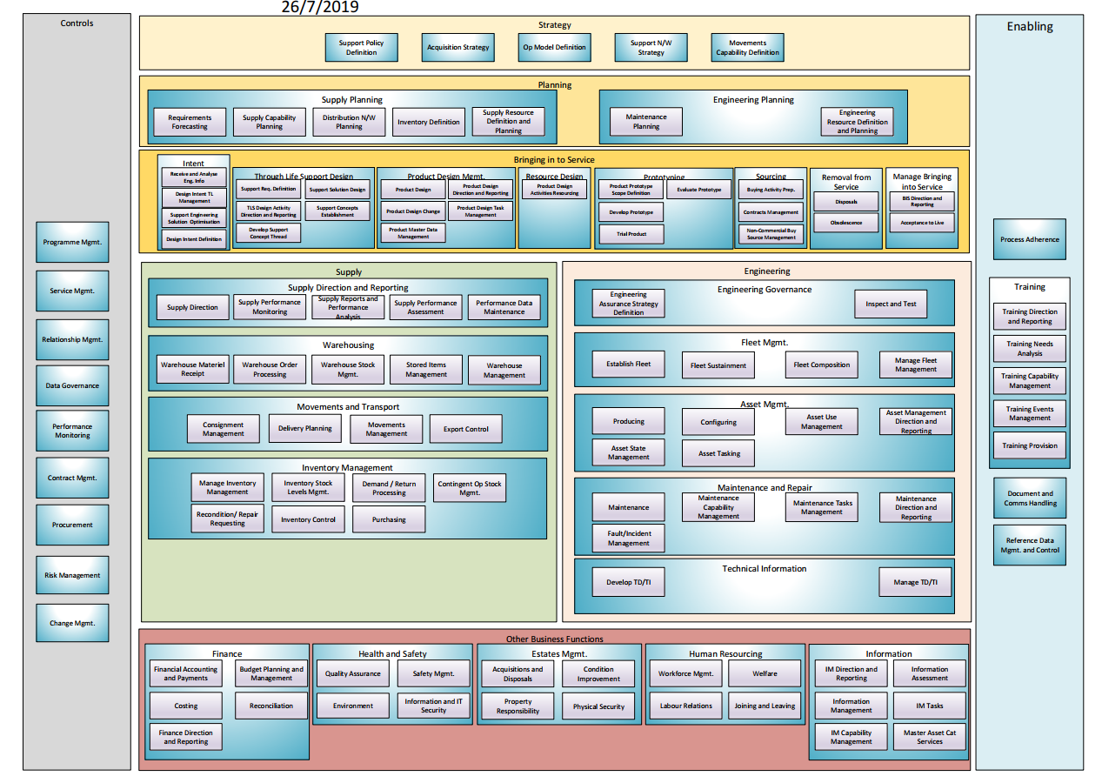
The Defence Support Business Function Model
The model shows those business functions that have a direct impact on the delivery of Defence Support and distinguishes between those functions owned by Defence Support and those owned and delivered by others (acquisition, finance, infrastructure etc).
<Placeholder> update with level 3 BFM Image
Notes:
The model shows the entirety of functions required to deliver Defences output from a Support perspective. It includes and distinguishes between those business functions owned by Defence Support and those owned and delivered by others (acquisition, finance, infrastructure etc) which still have a direct impact on the delivery of Support.

Slide 64
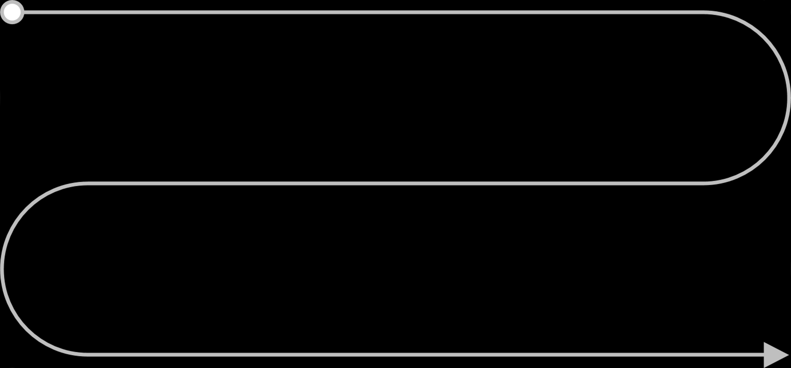
Logistics Use Case
Show, within context, how scheduling maintenance of a military asset results in logistics forecasting, planning and optimisation, to ensure parts are in the right place, at the right time and in the correct quantities to execute the maintenance activity.
  Key elements and pain points for consideration are shown below and to be used as a guide only
  Please make any assumptions required to showcase your capability
  The use case is purposefully at a high level to allow vendors flexibility within the showcase
F35 Aircraft maintenance schedule is submitted in line with asset availability targets
Generate inventory demand forecast based on maintenance activity bills of materials and historical data
Generate supply plan using material resource planning based on forecasts, constraints and priorities
Access multiple systems to gain full picture
Lack of automated consideration of multiple inventory types. E.g. hazardous, munitions, fuels, consumables
Lack of ability to translate activity forecasts into a demand plan
Manual analysis of multiple datapoints to make decisions
Manual compiling of reports is time consuming
Lack of useful, accurate supply data that is easily displayed
Automated “on time in full” supply risk alerts generated
An alternate optimal supply plan is generated and agreed across stakeholders in real time
Scenario modelling allows what-if analysis of supply risk alerts to inform a holistic solution
Many systems collate the data all of which provide different recommendations
Perform capability planning to determine overall capacity gaps (warehousing, transport network, resources) required to deliver the forecasted demand and supply
Supply plans automatically trigger the fulfilment process to ensure parts are available in the correct locations to execute the maintenance.
planning tools are too limited
Plans not automatically cascaded to all connecting applications (Warehousing, Inventory, Transportation etc.)
Key Elements
Painpoints
Notes:
As a principle we are going to use off the shelf technology, SaaS solutions as a principle THEREFORE… this the approach to take, processes work the way they do. Information we need to give to the market to address specific MoD functionality required and problems and assess what’s the change gap for the business. By going COTS we are leveraging the best in class we are going with the best, assume its got the leading practice built it
We know that technology implementation will not be the biggest challenge for BMfS, it will be the business change required and the effort to bring our customers along with us, and it is our responsibility to make it easy for them to this
We need to present our requirement to industry in this way to ensure Best innovation, most interesting solutions, not constrained, how do we get the best from industry.
Solve MoD problems WHY are we doing it like this:
We wont pick up the specific painpoints that wont be in a COTS solution, we have to address them.

Slide 65
Logistics Use Case
Show, within context, how an operational requirement for an asset to be available for use triggers a review of the asset lifecycle resulting in the scheduling and execution of maintenance to ensure readiness
  Key elements and painpoints for consideration are shown below and to be used as a guide only
  Please make any assumptions required to showcase your capability
  The use case is purposefully at a high level to allow vendors flexibility within the showcase
Access multiple systems to gain full picture
Poor user experience
Technical information stored in multiple locations
Lack of useful, accurate data that is easily displayed
Foxhound vehicle driver training requirement is submitted to a Unit
Review required vehicles health, allocation and utilisation status and set availability requirement
Generate maintenance requirement based on set availability target and failure mode data
Uncertainty on who the right support points of contact are
Lengthy wait to get support from experts
Paperwork used instead of digital alternatives
Maintenance execution complications require additional SME support to complete, which is digitally enabled
Enable, in real time, the digitised completion of instructed maintenance activities
Generate optimised maintenance schedule and trigger execution activities
Record completion of maintenance, including digital and notify wider stakeholders
Automated updates to vehicle status and feedback loop of executed maintenance activities to inform future planning
Shop floor observations shared via email
Manual analysis of multiple datapoints to make decisions
Key Elements
Reliance on paperwork for sign-off
Difficult to pull reports as data does not align across systems
Painpoints
Manual compiling of reports is time consuming
Back-and-forth chasing between various stakeholders
Notes:
As a principle we are going to use off the shelf technology, SaaS solutions as a principle THEREFORE… this the approach to take, processes work the way they do. Information we need to give to the market to address specific MoD functionality required and problems and assess what’s the change gap for the business. By going COTS we are leveraging the best in class we are going with the best, assume its got the leading practice built it
We know that technology implementation will not be the biggest challenge for BMfS, it will be the business change required and the effort to bring our customers along with us, and it is our responsibility to make it easy for them to this
We need to present our requirement to industry in this way to ensure Best innovation, most interesting solutions, not constrained, how do we get the best from industry.
Solve MoD problems WHY are we doing it like this:
We wont pick up the specific painpoints that wont be in a COTS solution, we have to address them.

Slide 66
What is a Business Function Model and why is it useful
The aim of a Business Function Model is to provide a communication tool that describes the scope and functionality of an organisation in a way that’s clear and unambiguous
It describes the operations performed routinely to carry out an organisation's mission and it does this by showing functions that are groups of related business activities performed to produce an output or to provide a service.
A BFM can be used to:
It can be used to describe the current organisation in a consistent way across Defence and industry
To describe and agree the scope of future change
Identify gaps and overlap during programme delivery to be able to take corrective actions

Slide 67
What can we use the BFM for?
Example Usage
Description
Example
Describe the current organisation in a consistent way across Defence and industry
Improves understanding of Defence Support through a single pan-defence taxonomy and provides mechanism to drive down operating costs
Reducing and consolidating legacy information services
To describe and agree the scope of future change
Shows where and to what extent the business will be impacted by future initiatives
Assisting stakeholders understand the scope of BMfS
Identify gaps and overlap during programme delivery to be able to take corrective actions
Show where change initiatives are doing the same thing in multiple places or where expected scope is not being delivered at all
Transfer of Fuels Transformation Programme Information Systems (FTP IS) delivery into BMfS

Slide 68
The scope of BMfS and using it to identify overlap
Strategy
Key
Movements Capability Definition
Acquisition Strategy Definition
Supply Policy Definition
Supply Network Strategy Definition
Operation Model Definition
Out of Scope for BMfS
Logistics Planning
Planning
Engineering Planning
Partially in scope for BMfS
In scope for BMfS
Bringing into Service
BMfS scope overlap with FTP IS
Product Intent
Product Design Management
Resourcing
Prototyping
Sourcing
Through Life Support Design
Bringing Into Service Management
New Service Planning
Logistics Support
Analysis of FTP IS and BMfS requirement showed overlap for Inventory requirement services
Logistics Support Reporting and Performance Analysis
Inventory Management (Base and Deployed)
Movements and Transport
Warehousing
Equipment Support
Obsolescence
Asset Management
Maintenance and Repair
Technical Information
Recondition/Repair Requesting
Fleet Management
Safety Management
Enabling
Training
Digital Definition
Other Business Capabilities
Finance
Health and Safety
Estates Management
Human Resourcing
Digital Delivery

Slide 69
Strategy
This functions determines the changes that will be necessary to achieve medium to long term Support plans
Strategy
Movements Capability Definition
Acquisition Strategy Definition
Support Network Strategy Definition
Acquisition Strategy Definition
Logistics Policy Definition
Equipment's Support Policy Definition

Slide 70
Planning
Planning takes inputs from Strategy and other sources to develop forward looking plans for logistics and Engineering.
Planning
Logistics Planning
Engineering Planning
Supply Requirements Forecasting
Distribution Network Planning
Maintenance Planning
Engineering Demand Forecasting
Logistics Resource Definition and Planning
Logistics Capability Planning
Engineering Resource Definition and Planning
Inventory Definition

Slide 71
Bringing into Service
Driven by Strategy and Planning this function contains those business areas that define, design, develop source and bring into service all assets.
Bringing into Service
Product Intent
Product Design Management
Resourcing
Receive and Analyse Information
Design Intent Through Life Management
Product Design Control
Product Master Data Management
New Service Planning
Product Design Activities Resourcing
Other Support Resourcing
Support Solution Design Optimisation
Design Intent Definition
Product Design Change
Product Design Direction and Reporting
Product Design Task Management
Product Design Authority
Prototyping
Sourcing
Through Life Support Design
Bringing Into Service Management
Product Porotype Scope Definition
Prototype Development
Sourcing Implementation
Source Identification
Support Requirements Definition
TLS Design Activity Direction and Reporting
Bringing into Service Direction and Reporting
Service Preparation
Product Training
Prototype Evaluation
Specification and Sourcing Strategy Definition
Acquisition Plan Establishment
Support Solution Design
Support Concepts Establishment
Acceptance to live
Support Concept Thread Development

Slide 72
Logistics
This function brings together Warehouse management, Inventory Management and Movements and Transport and controls the storage of stock at all different types of location and the movement between locations as well as the amount of stock available at each location.
Logistics
Logistics Support Reporting and Performance Analysis
Inventory Management (Base and Deployed)
Warehousing
Movements and Transport
Disposals
Demand/Return Processing
Warehouse Material Receipt
Warehouse Order Processing
Exports Control
Consignment Management
Logistics Reports and Performance Analysis Provision
Logistics Performance Analysis
Inventory Stock Level Management
Contingent Op Stocks Management
Warehouse Management
Warehouse Stock Management
Transport Management
Delivery Planning
Performance Data Maintenance
Logistics Performance Monitoring
Inventory Control
Stored Items Management
Movements Management

Slide 73
Equipment Support
Engineering contains functions that relate to management of “Fleets” and Assets and well as containing the Maintenance and Repair functions and management of the Technical Information relating to Assets.
Equipment Support
Fleet Management
Maintenance and Repair
Technical Information
Fleet Acquisition
Fleet Sustainment
Maintenance Management
Maintenance
Technical Documentation Delivery
Technical Information Maintenance
Fleet Composition
Manage Fleet Management
Fault/ incident Management
Maintenance Capability Management
Certification
Maintenance Facilities Management
Recondition/Repair Requesting
Obsolescence
Asset Management
Recondition Request
Repair Request
Obsolescence direction and reporting
Obsolescence Capability Management
Asset Management State
Asset Configuration Management
Authorised Modification Request
Obsolescence Task Execution
Obsolescence Task Management
Safety Management

Slide 74
Other Business Capabilities
Other Business Functions covers all other functions that are required to successfully deliver Engineering and Supply capabilities into defence
Other Business Capabilities
Finance
Human Resourcing
Estates Management
Financial Accounting and Payments
Budget Planning and Management
Workforce Management
Welfare Management
Acquisitions and Disposals
Property Management
Finance Direction and Reporting
Purchasing
Labour Relations Management
Joining and Leaving Management
Condition Maintenance
Physical Security Management
Health and Safety
Digital Delivery
Quality Assurance
Environment
Service Change
Service Provision
Design, Build and Transition
Service Operations

Slide 75
Enabling
Enabling functions are those that support the delivery of all the other functions. This includes the development and delivery of training as well as technical capabilities such as the Operation Data Services or Common User Portal.
Enabling
Training
Digital
Training Direction and Reporting
Training Provision
Strategy, Architecture & Portfolio
Data
Training Needs Analysis
Training Capability Management
Opportunity Assessment
Security & Resilience
Training Events Management
Support Engineering Governance

Slide 76
BFM overview - Appendix

Slide 77
The Defence Support BFM
L1/L2 of the latest version, BFM v2.0.
Strategy
Movements Capability Definition
Acquisition Strategy Definition
Supply Policy Definition
Supply Network Strategy Definition
Operation Model Definition
Planning
The model is designed using the TOGAF (The Open Book Architecture Model) enterprise architecture methodology. Architecture is how you control complexity; Models are how you express that control
Logistics Planning
Engineering Planning
Bringing into Service
Product Intent
Product Design Management
Resourcing
Prototyping
Sourcing
Prototyping
Through Life Support Design
Bringing Into Service Management
New Service Planning
Logistics Support
Logistics Support Reporting and Performance Analysis
Inventory Management (Base and Deployed)
Movements and Transport
Warehousing
The model shows:
Function hierarchy
Organises functions
Shows them in logical groupings
Equipment Support
Obsolescence
Asset Management
Maintenance and Repair
Technical Information
Recondition/Repair Requesting
Fleet Management
Safety Management
The model does not show:
Processes
Who does what
Mapping of locations or activities
Enabling
Training
Digital Definition
Other Business Capabilities
Finance
Health and Safety
Estates Management
Human Resourcing
Digital Delivery

Slide 78
Breakdown of Functions – Planning Example
The BFM is broken down into different Function levels, each function is defined
Level 1
Level 2
Level 3
Strategy
Engineering Planning
Supply Requirements Forecasting
Planning
Logistics Planning
Distribution Network Planning
Bringing into Service
Logistics Capability Planning
Logistics Planning enables logistics requirements to be evaluated and established across the Defence Lines of Development to better plan, support and sustain military operations. Logistics is the science of planning and carrying out the movement and maintenance of forces as defined in Logistics for Joint Operations, Joint Doctrine Publication 4-00.
Logistics Support
Inventory Definition
Logistics Resource Definition and Planning
Equipment Support
Enabling
Definition of Inventory required to meet demand.
Other Business Capabilities
Planning takes inputs from Strategy and other sources to develop forward looking plans for Logistics Support and Engineering Support. It includes activities such as F&RP, which is a programme of works within Support Operations Planning and is in scope for BMfS.

Slide 79
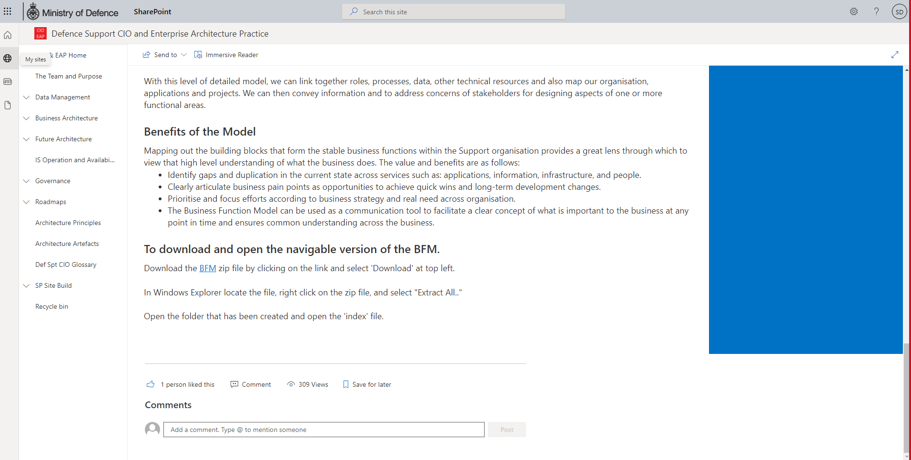
Accessing the BFM
The BFM can be accessed via SharePoint - https://modgovuk.sharepoint.com/sites/supporteapractice/SitePages/Business-Function-Model.aspx
There is an option to download a PDF version of the BFM. 20211101-Business_Function_Model_v2.0(scoping).pdf
There is a navigable tool version of the BFM on SharePoint

Slide 80
BFM Timeline
BFM is not a static framework and is continuously extending. The model can be used in conjunction with other architecture models and artefacts to support Defence Support services.
The Model was created by the Defence Support CIO/EAP team to support current processes, application development and allow future change activities
Function definitions continuously refined
Present: BFM Version 2
Origin
Future
BFM mapped to processes
BFM mapped to Data and DefSCOR Standards*
Potential addons
*By mapping BFM to DefSCOR standards, we can measure performance

Slide 81
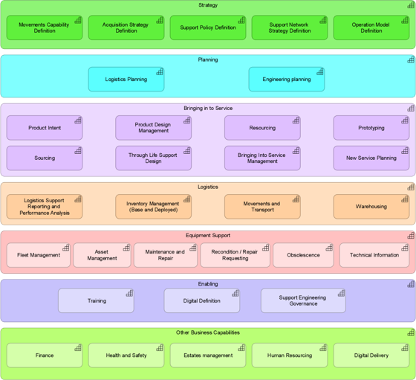
BFM Version 2 Updates
Version 2 changes to the BFM are significantly great in comparison to previous changes. This is due to the engagement of Defence Support projects such as BMfS and to allow the BFM to support future Support projects.
The picture illustrates the BFM v1.3
The picture illustrates the L1/L2 of the latest version, BFM v2.0
The most significant changes made to the BFM is the removal of Controls section, structural and renaming of functions in Logistics, the addition of Digital Definition functions to Enabling, and Digital Delivery functions to Other Business Functions areas.

Slide 82

Communications Approach
Delete when presenting
Generate Executive Communications Pack
Engage with Key audience up to 1*
2* Engagement, CDLS engagement
Develop more intuitive and navigable version of BFM including automated heatmap
[Key next step]
Prepare for 2 * and CDLS Engagement (especially including heat map)
Key Audience: Defence Support organisation, Management stakeholders of SpTx programmes, or TLB specific change programmes

Slide 83
Delete/amend as appropriate
Appendix: Other BFM examples
Delete/Amend slides as appropriate

Slide 84
Managing SpTx Portfolio by Function
Illustrative Defence Support Heat Map
Delete/amend as appropriate
Strategy
Movements Capability Definition
Acquisition Strategy Definition
Supply Policy Definition
Supply Network Strategy Definition
Operation Model Definition
Planning
BMfS
Logistics Planning
BMfS, F&RP,
DSCOM
Engineering Planning
Bringing into Service
Heatmap shows BMfS scope overlapping with other Support Transformation (SpTx) and where the BMfS operates independently.
Product Intent
Product Design Management
Resourcing
Prototyping
Sourcing
LEIDOS
Through Life Support Design
Bringing Into Service Management
New Service Planning
Logistics Support
Logistics Support Reporting and Performance Analysis
BMfS, DSOM,
LEIDOS
Inventory Management (Base and Deployed)
BMfS, FTP,
LEIDOS
Movements and Transport
BMfS, DSCOM,
LEIDOS
Warehousing
BMfS, WDO,
LEIDOS
Key Takeaways:
a.) Logistics Planning overcrowded
b.) Strategy, Bringing into Service and Other Business Capabilities are not being developed by SpTx
c.) Opportunities for collaboration within overlaps
Equipment Support
Obsolescence
BMfS
Asset Management
BMfS
Maintenance and Repair
BMfS
Technical Information
BMfS
Recondition/Repair Requesting
BMfS
Fleet Management
BMfS
Safety Management
BMfS
Enabling
Training
Digital Definition
BMfS
Key
Not covered by SpTx
Other Business Capabilities
Finance
Health and Safety
Estates Management
Human Resourcing
Digital Delivery
Covered by 1 SpTx Prgm
Covered by >1 SpTx Prgm
*Projects: BMFS, Defence Support Operating Model (DSOM), DSCOM, Forecast and Resource Planning (F&RP), Logistics Transformation (WDO), Fuels Transformation Programme (FTP), LEIDOS

Slide 85
Managing complex Pan-Defence SpTx Programmes
Delete/amend as appropriate
The BFM is the one tool you have got to organise the moving parts of a large EAP product. Linking these multiple parts of the programme to BFM, you can talk about them consistently and coherently
Scope mapped to BFM
People mapped to BFM
System/s mapped to BFM
The BFM allows you to understand the scope of the programme across TLBs, and how it impacts other programmes
Stakeholders can see how many people are in each function and redeploy them into value adding areas
Stakeholders can pin-point which business functions are affected by changes in legacy systems. Change impacts, end user engagement and operational capability can be closely managed thanks to the link between the systems and what functions it supports
Benefits mapped to BFM
Processes Mapped to the BFM
Requirements mapped to BFM
Benefits are fully aligned and traceable to the functions of Defence Support. This allows easier tracking and realisation of benefits
Linking processes to the BFM allows standardisation of activities for further value creation
Requirements for new systems can be organised in a way which is aligned across TLBs so we can use one unified set. These are also closely mapped to the scope to ensure full coverage

Slide 86
Control the direction and scope of change
Delete/amend as appropriate
Stakeholders can use a BFM to control the scope of a new system by facilitating the mapping of existing and new systems through a common language to visualise what service each system is trying to provide and which functions are affected by changes to legacy systems
Illustrative Example
Strategy
Key
Movements Capability Definition
Acquisition Strategy Definition
Supply Policy Definition
Supply Network Strategy Definition
Operation Model Definition
Not covered by DEEAMS or JAMES
Planning
Covered by DEEAMS
Logistics Planning
Engineering Planning
DEEAMS, JAMES
Bringing into Service
Covered by JAMES
Product Intent
Product Design Management
Resourcing
Prototyping
Sourcing
Covered by JAMES and DEEAMS
Prototyping
Through Life Support Design
Bringing Into Service Management
New Service Planning
Logistics Support
Logistics Support Reporting and Performance Analysis
Inventory Management (Base and Deployed)
JAMES
Movements and Transport
JAMES
Warehousing
Equipment Support
Obsolescence
DEEAMS
Asset Management
DEEAMS, JAMES
Maintenance and Repair
DEEAMS, JAMES
Technical Information
DEEAMS, JAMES
Recondition/Repair Requesting
Fleet Management
DEEAMS
Safety Management
DEEAMS
Enabling
Training
Digital Definition
JAMES
Other Business Capabilities
Finance
Health and Safety
Estates Management
Human Resourcing
Digital Delivery

Slide 87
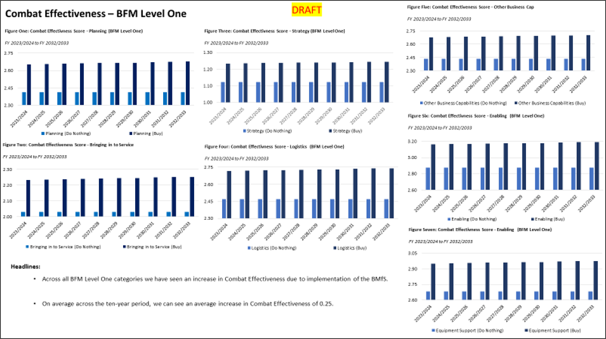
Track and realise benefits through the BFM
Delete/amend as appropriate
By designing the Benefits Model around the BFM, we are able to track and realise performance over time
Illustrative Example

Slide 88
Visualise what service each requirement is trying to provide
Delete/amend as appropriate
The BFM allows us to control our requirements and makes it easier to understand what service each requirement is trying to provide
Logistics Support
Key
Movements and Transport
Not covered by Requirement
Export Control
Consignment Management
Covered by Requirement
Transport Management
Delivery Planning
Movements Management
Requirement Description: TUSBPW movement and transportation plans, over defined planning horizons, which have been automatically generated by the system to make efficient usage of all resources in a view which provides detail relevant to their specific usage, this would differ for alternate stakeholders such as drivers, asset owners, demanders, suppliers etc. This should be global and multimodal across all specified shipping modes (e.g. road, private fleet, small package, rail, intermodal, air and ocean)

Slide 89
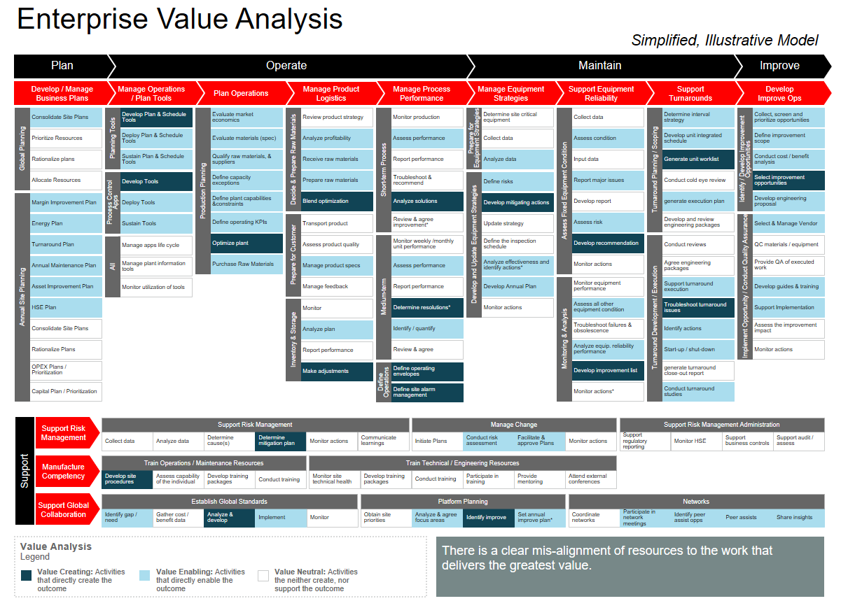
Use the BFM to identify value and non-value adding activities
Delete/amend as appropriate
BFM helps you identify which activities can be standardised to enable further value creation

Slide 90
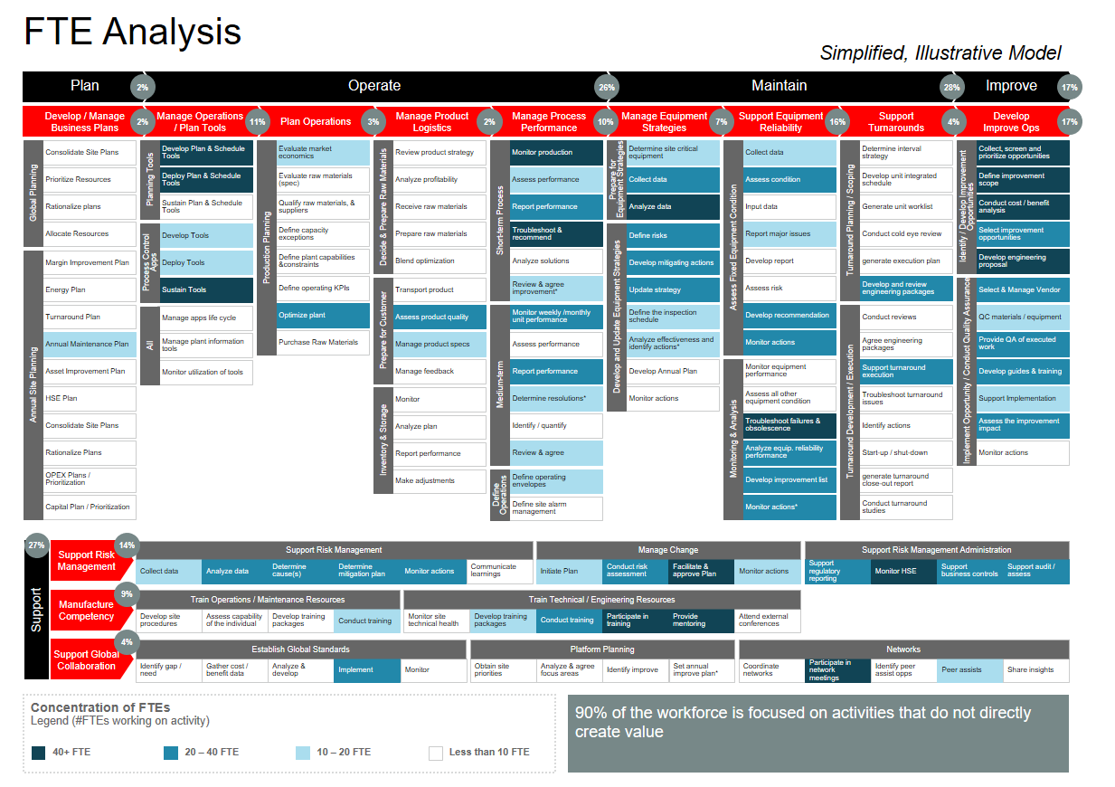
Unlock additional insights on who is delivering Defence Support
Delete/amend as appropriate
Using the BFM we can see the number of people in each business function and redeploy them to more value adding areas

Slide 91
Description of SpTx
Delete/amend as appropriate
Forecast and Resource Planning - Forecast and Resource Planning (F&RP) is a change programme that will improve the way Defence forecasts and resources support requirements. Once the programme has been fully implemented, F&RP will provide Front Line Commands with better access to strategic data, which will allow them to make investment decisions based on affordability and risk. F&RP will deliver both financial and non-financial benefits, including better processes and more widely available information.
DSCOM - The mission of DSCOM is to provide the singular DE&S operational focus to plan, configure and execute the strategic deployment, sustainment and recovery of material and personnel in order to support current and contingent operations, training and routine activity worldwide. The vision for DSCOM is to be a highly capable and trusted support chain planning and movements organisation that delivers global, multi-modal support chain options and cost-effective solutions
Logistics Transformation (WDO) - The Warehouse and Distribution Optimisation programme role is to deliver to Defence a Control Tower, that will deliver the ability to understand non-explosive warehousing and storage capability and capacity in the Defence Estate at site and building asset level in order to plan better the use and management of those assets and provide a central point of contact for greatly enhanced planning.
Defence Support Operating Model (DSOM) - There are four layers of the Defence Support Operating Model: performance management of support, technology, structure and people.
  Performance - An integrated performance management system embedded throughout Defence Support is needed, with CDLS overseeing goal setting and monitoring FLC and Delivery Agent performance.
  Technology - Decision management capability will need to be established in Defence Support, supported by a digital decision centre and underpinning digital technologies for priority use cases.
  Structure - A ‘Defence Support’ organisation will be established, led by CDLS.
  People - Support competencies and capabilities will be established for the Defence Support organisation, FLCs and Delivery Agents.
Fuel Transformation Programme (FTP) - The Fuels Transformation Programme intent is to modernise and transform the Defence Fuels Enterprise Operating Model, core business processes, supporting information services, financial model and fuels services delivery, including the operating and maintenance of fuels infrastructure, in order to enable effective, efficient and resilient bulk fuels supply chain that helps to enable the attainment of Support Advantage and contribute toward Net Zero 50.

