Slide 1
Def Sp Supply Chain Sub- Working Group
CDLS Tasker: Additive Manufacturing Maturity

Slide 2
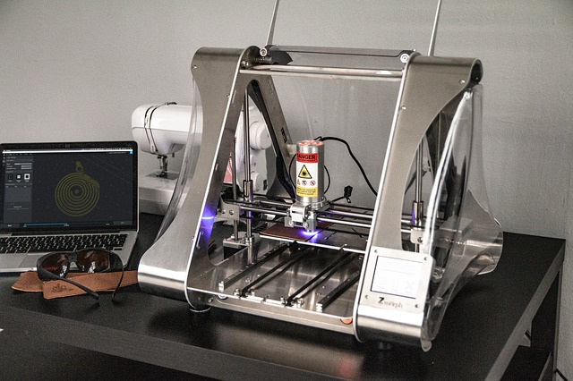
The ask
The aim of the task set upon the Supply Chain SWG is to provide input to DefSp Innovation Team Leader to inform the subsequent direction of travel notably The maturity of Industry strategies to adopt Additive Manufacturing as a component within their supply chains, the maturity of their implementation plans; and the extent of their current capabilities and planned capabilities. Within this the degree to which they are addressing: Certification IPR cost models information architecture information integrity.

Slide 3
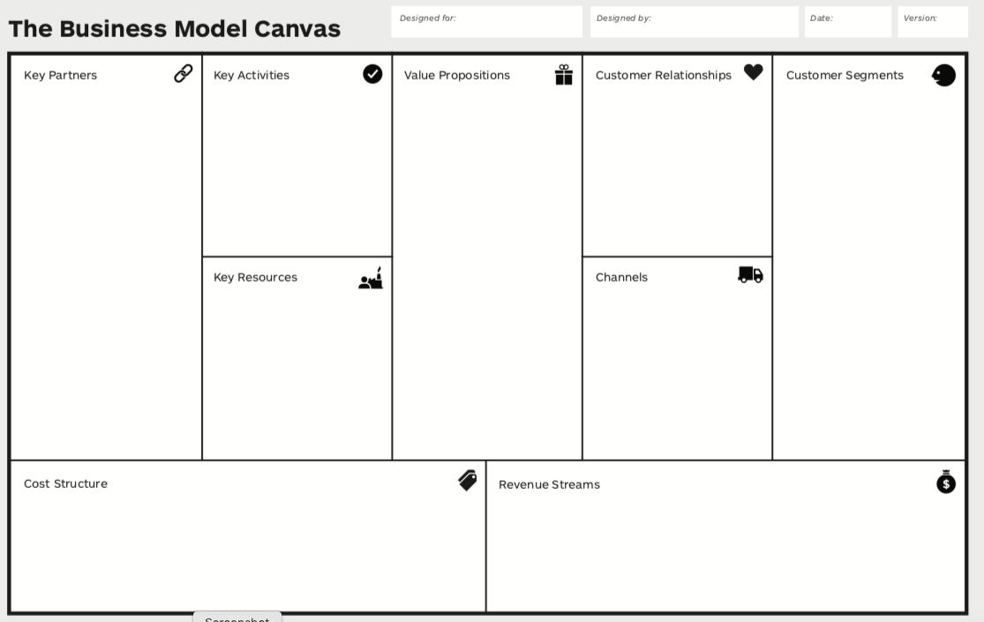
Approach

Slide 4
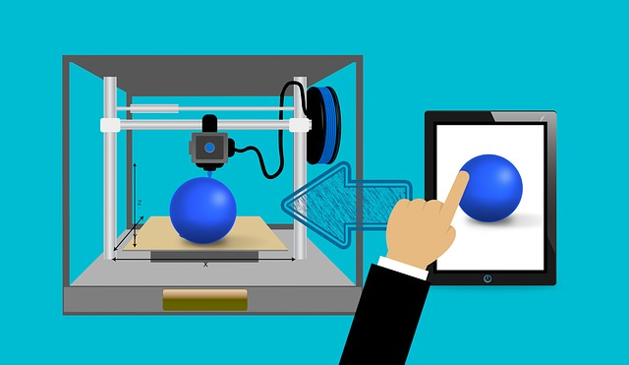
Finding 1 Two Emerging Business Models
Design & Development
Rapid Pro-typing and Tooling:
In-service Support, PDS & Resupply
Future Product Design:
Higher performance
Lower weight
Lower part count
Increased durability
Service and Availability:
Addressing obsolescence
Re-engineering and low batch numbers
Increase Service levels
Sorter lead times
Digital Manufacturing
(additive and advanced)
Digital Inventory
Lower number of SKU
Lighter items and subsequent reduction in cost to serve
Production close to point of need
Just in time with reduce lead time
No MOQ

Slide 5
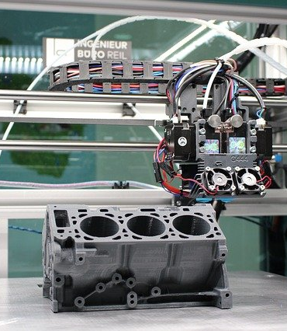
Finding 2: Common Challenges
Process qualification and Quality control: Repeatability, QoS, post processing and quality of finish
Maintaining Design Intent: geometry capture, safety criticality, material specification, heat treatment, finishing
Part qualification and certification: Compliance with Standards, legislative limitations and recognition by regulatory bodies
IP Protection and Data Management : data files, format, mechanism for sharing while protecting designs and commercial advantage
Environmental control and supply chain assurance of print material

Slide 6
Questions?

