Slide 1
Def Sp Supply Chain Sub- Working Group
Exploring AME for Defence Application with Nano-Di

Slide 2
Overview
The Def Sp Supply Chain (AdM) SWG are investigating Additively Manufacture of Electronics (AME) to assess the suitability and performance in Defence applications Team Defence Information member Nano Dimension will print your circuits, at no cost, and return the part to you for performance testing Bringing production in-house significantly reduces lead time making AME a key enabler of rapid prototyping of designs The designs most suitable for AME contain multilayer vertically integrated circuits Once circuits have been tested findings will be shared and briefed at future SWG meetings There are also Horizon 20 funded research activities for AME in Defence, for more information follow the process outlined or contact steve.green@teamdefence.info

Slide 3
Circuit Suitability
Additively Manufactured Electronics (AME) can produce circuits that meet advanced requirements such as:
Rigid Multi-layer, up to 55 layers
Vertically Integrated Circuits
Embedded applications
Printed:
Capacitors
RF Antennas
Coils (Inductors)
Transformers (DC2DC, AC2DC, AC2AC)

Slide 4
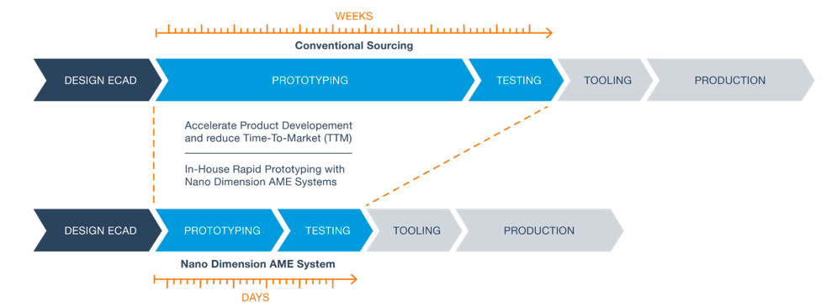
Potential Use Cases
Potentially applying AME to Defence introducing innovative and game changing sensors, antennae and electronic components could transform a range of military capabilities:
C4ISR: RF antenna, Air / Space and Sea (more aerodynamic, embedded, encapsulated)
Solider Systems: Body worn sensors for Health monitor sensors (body worn / IOT)
Military Systems: IOT sensors
UAS: Drone motors (printed induction coils) / drones circuits
Advanced munitions: small, lightweight, focused RF missile applications
“To have high-density components quickly available with reduced effort by means of 3D printing gives us a competitive edge in the development process of such high-end electronic systems.” Thomas Müller, CEO of HENSOLDT

Slide 5
Process
Stage 1. Printed circuit should be focused on applications that leverage the strengths of a AME printed board and the advanced requirements of the Defence sector. Prior to progressing to stage 2 NDAs can be established as required, these will be between Nano Di and the submitting organisation.
Stage 2. Express interest in taking part by completing and returning Annex A
Stage 3. The top designs best suited to AME will be selected
Stage 4. Working in collaboration between Nano Dimensions and the design owner the part will be produced. Note Nano Dynamics will review existing designs with you and provide advice about how they need to be adapted to be suitable for AME, there will be no limit on Application Engineering Consultation time.
Stage 5. The design owner will take ownership of the produced parts and test its performance.
Stage 6. The findings will be presented back to the Defence Support Supply Chain Sub-Working Group
If required Nano Dynamics can recommend a partner company to fully design against a specification however this would incur cost.

Slide 6
Exploitation & Funding
The outputs will inform the Defence Community about the maturity and potential application of AME for application in the sector and any areas where additional development or investment may be required.
Activities are already underway with UK MOD C4ISR with 5 Bn REME and RSME also expressing their interest so make sure you don’t miss out simply complete and return the proforma at Annex A.
The UK have also signed up to Horizon 20 which for the first time includes opportunities for Defence. This includes funded AME calls, Annex B, and Nano Di would be happy to support your proposals.
PDF Document

Slide 7
Questions?

