Slide 1
Defence Logistics Directorate – Logistics Concepts and Futures
Good Practice Study Group
13 Dec 17
Colonel Eddie Corrigan

Slide 2
Scope
The Defence Support Network as it is today
Ends, Ways and Means of transforming the DSN
A proposed way to address the challenges that Defence Logs faces
Questions

Slide 3
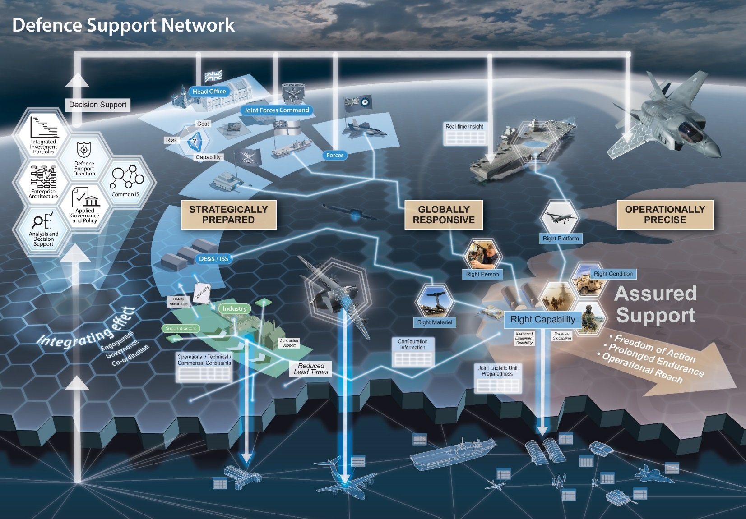
***New DSN Slide***?
Notes:
A rich picture depicting the DSN of today encompassing all elms that must work coherently to deliver logistic sustainment effect. It includes allies and partners, infra, Log IS, intelligence, Force Protection, Industry, Academia, Force Elements, contractors, contracting, etc on a global scale.
We must transform this iot be able to meet policy head mark requirements of Joint Force 25 and beyond.

Slide 4
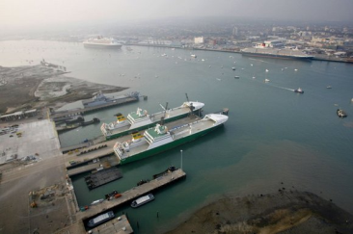
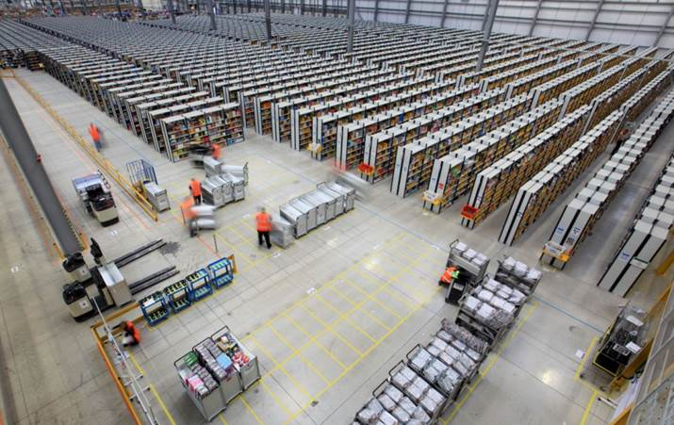
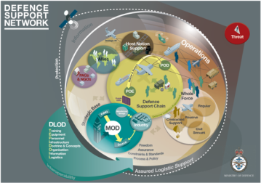
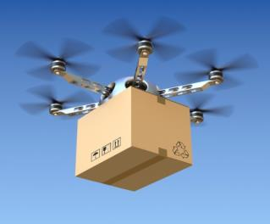
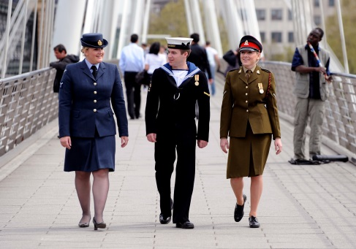
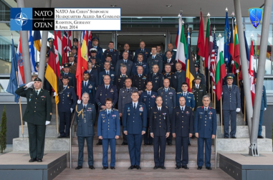
Concepts and Force Development Team – Ends, Ways and (illustrative) Means to achieve DLV Outcomes
Deliver – DSN(T)
Develop – FD
LDA
Innovate – FE
Modelling, Simulation, Info Analysis/IA,
IX, IM, Block Chain (Smart Contracting, Data Veracity, Fraud/Counterfeit Prevention), Cyber Sy), Big Data, IOT, Integrated/Automated/Near-Real-Time Asset Visibility, Automation, Data Velocity, Cyber Vulnerability, Smart/Adaptive User Interface, Log Int, DPAs, Cost Analysis, Causal Analysis, Network/Contractor Risk
Automated Physical Storage (Stocktaking, P&RE, Inventory Optimisation, Smart Warehousing), Distribution (Land, Sea, Air), Manufacture, Maintenance, Asset Tracking, Virtual (Info and Decision Support, P&RE, Intuitive/Interactive Learning, Optimised Storage and Dist Planning & Execution/Maint, Planning
and Spt, EHUMS
FVT
Globally Responsive
3D printing, Smart Packaging, Fossil Fuel Replacements, Self-Sustaining Capabilities (Micro Grids, Water from Air/Fuel, Waste to Energy)
PFT
Optimise Strat Base
Reset Defence
Support Chain
Optimised DSN
Reset Joint
Logistics
Decision Support
Velocity
Strat Prepared
Defence Support Network
JEF 18
JF25
JEF 18
Means
Standardisation
FF30
People
Partnerships
People
Information
Information
Partnerships
PFT
Ways
Operationally Precise
FVT
Reduce: Footprint
Demand
Cost
Challenge Cards
Ends
LDA
DLV
Outcomes
DXP
JV 17
JV 18?
SS3
Refine / Deliver JF25
SFD
PFT 5
PFT
7
Option
Generation
SDSR 20
Develop ‘JF’30
LOG FD
TTX
FVT
JEF
LOGNET
17/1
17/2
18/1
18/2
19/1
Notes:
The LOGNET programme and the Defence Logistics Vision
The ‘end state’ in 2025/30 is an Optimised DSN which is:
Globally Responsive
Strategically Prepared
Operationally Precise
Importantly (given current and future funding challenges) the DSN must also:
Reduce Cost
Reduce Footprint
Reduce Demand
LOGNET programme of Deliver, Develop and Innovate
Deliver (buff colour)
Commences with the 6 strategic objectives of the DSN / DLV (which provide the foundation / endure throughout the DSN)
Set in the 0-4 year time frame it utilises the DSN(T) programme and the DXP to deliver the immediate changes identified in the DSN(T) scoping phase
JEF 18 provides a crucial waypoint / marker
Develop (lilac)
Develop sits very much in the Force Development Space – looking at the requirements of JF 25 and the demand it will create
Considers the fielding and operation of the key new equipment
Interacts with the Deliver function through PFTs – establishing the future demand and accelerating the implementation of ‘benefits’
Utilises bespoke ‘Log’ PFT type events to focus on, and develop, understanding of log issues
Develops options for SDSR 2020
Innovate (pink)
The innovate space utilises the LDA/LIA and the specific LOGNET events to interact more broadly with industry and academia
The ‘reduce’ challenges drive the agenda along with specific areas of automation, autonomy, future energy and advance manufacture shape the discussions.
The FVT process is used as a mechanism by which ideas are fed into, and wargamed, within the DSN (route to market)
Concepts with immediate benefits are accelerated through the DEVELOP and DELIVER functions, while those which require longer have research funding approved to help mature the concept to a point where it becomes of use.

Slide 5
Representative View - 1
 | OSB | RDSC | RJL
Strategically Prepared
Globally Agile
Operationally Precise
Automation
Automation
Automation
Inventory Enhancements
Inventory Enhancements
Timeframe
Smart Packaging
Smart Packaging
Smart Packaging
Near
Middle
Far
Alternative Energy
Automation
Space Food Concept
Smart Packaging
Smart Packaging
Alternative Energy
Ease of Improvement
Defence Procurement Rules
Low
Middle
High
Automation
Automation
Smart Packaging
Automation
Automation
Smart Packaging
Smart Packaging
Space Food Concept
Strat Base Load Exercise
Smart Packaging
Alternative Energy
Alternative Energy
Automation
Pyrolysis
Defence Procurement Rules
Notes:
First view of CUBE based on DSN(T) hexagons
Rigour:
All inputs need to be meaningful & justified.
Drafted an initial ‘process’/flow chart to apply a ‘rigour test’ to all data entered iot filter the entries.
Design Options:
Can alter the parameters & output depending on the questions being asked.
Able to manage and filter data to produce different levels of analysis/views.
See next slide based on different parameters

Slide 6
Representative View - 2
 | Decision Support | Velocity | Standardisation
Reduce Cost
Reduce Footprint
Reduce Demand
Lessons Exploitation
Improve Integration
Technology Exploitation
Strat Base Load Exercise
Smart Packaging
Improve Integration
Timeframe
Smart Packaging
Technology Exploitation
Defence Procurement Rules
Near
Middle
Far
Technology Exploitation
Automation
Lessons Exploitation
Pyrolysis
Space Food Concept
Alternative Energy
Smart Packaging
Smart Packaging
Mobile/Agile Warehouse
Potential Improvement
Mobile/Agile Warehouse
Additive Manufacturing
Low
Middle
High
Lessons Exploitation
Space Food Concept
Smart Packaging
Inventory Enhancements
Mobile/Agile Warehouse
Smart Packaging
Mobile/Agile Warehouse
Notes:
Second view of Cube based on DLV ends (across the top)

Slide 7
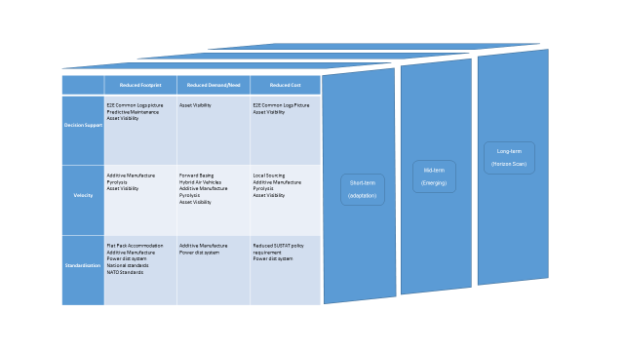
What does the Defence Support Network look like?
Notes:
Not sure about using this slide – your call?

Slide 8
High Level
What does the Defence Support Network look like?
Notes:
Defining the Challenge
- Intent is to use a series of ‘Challenge Cards’ for use by Defence, industry and academia that:
- Seek to further articulate the kind of thing that might fit into the ‘reduce model’
- Using a high, medium and low level focus of problems we face and /or future commitments that we must be capable of sustaining
So far we have developed 36 such dynamic cards, which include the following at various levels:
High level:
International interoperability, constrained manpower, concurrent operations, denied C4I environment, supporting CEPP, Divisional warfighting, Strike Brigades, non-organic support, support in a complex or austere environment
Mid level:
Support at distance and in the littoral, concurrent global operations, urban warfighting, complex demand signals in the maritime environment
Lower level:
Munitions at sea, equipment support at distance, reducing waste, reducing the reverse supply chain, intra-theatre lift, ship loading times, food/water in austere environments, self-sustaining individuals

Slide 9
Mid Level

Slide 10
Lower Level
What does the Defence Support Network look like?
Notes:
These cards are dynamic, they are never finished, and they can only evolve through exposure to industry and the discourse and friction that ensues. Talk to me about what information you need from Defence to better understand what we are seeking to do and how you can help us to achieve it.

Slide 11
Questions?

Slide 12
Good Practice Study Group 2017

Slide 13
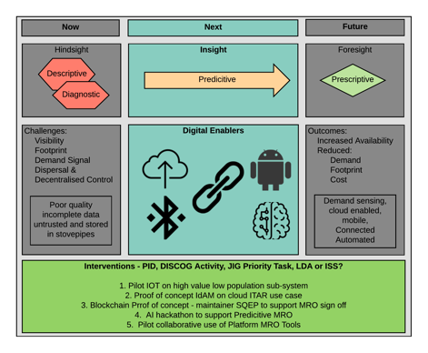
Summary

